Slide 1
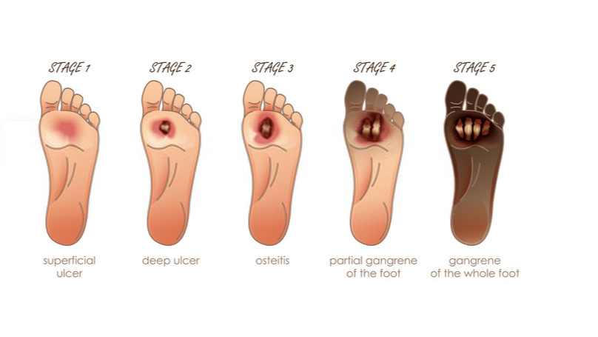
DIABETIC FOOT COMPLICATIONS

Slide 2
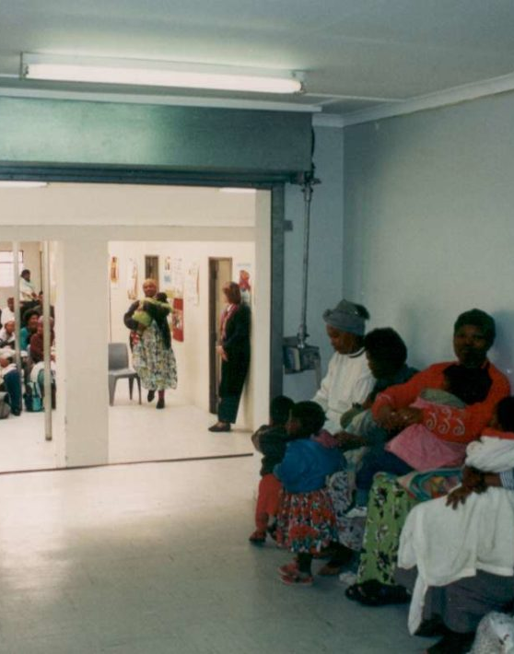
BACKGROUND
Primary healthcare (PHC) in South Africa is predominantly nurse-driven, focusing on illness prevention and treatment of acute and chronic disorders.
However, data on diabetic foot complications at PHC clinics is limited, and the role of podiatrists in prevention is underutilized.
Diabetic foot complications, particularly ulcers, are a significant cause of amputations, with early identification and treatment crucial for prevention.

Slide 3
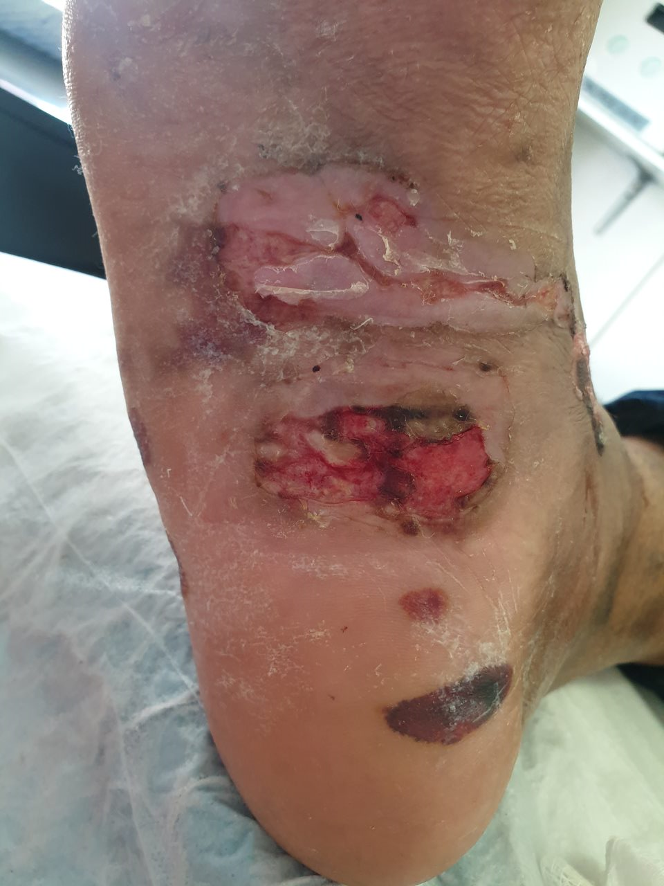
DIABETIC FOOT COMPLICATIONS AND THEIR CURRENT MANAGEMENT
Diabetes causes half of all amputations, primarily due to infected diabetic foot ulcers
Early treatment and identification of risk factors can improve prevention and treatment outcomes
Clinicians can reduce lower-extremity amputation risk through comprehensive history and foot examination.

Slide 4
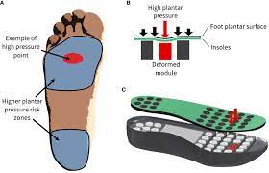
Off-loading is a technique used to reduce pressure at the ulcer site to speed up healing and reduce complications.
It is crucial in foot ulcer treatment as it helps prevent damage to soft tissue voids, often leading to unnoticed damage in diabetic sensory neuropathy patients.
Additionally, diabetes often gives rise to diabetic foot infections (DFIs), a prevalent and expensive complication. Infections affecting the soft tissues and bones in DFIs commonly result in the development of sepsis and/or the necessity for amputation.
However, 25% of patients do not recover.
The ever-increasing number of diabetic-related amputations in South Africa may indicate a lack of access to early care for diabetic patients with foot complications.
Despite this, the current framework is silent on foot health, prevention, and management of foot pathologies across all levels of care, particularly at the PHC level.

Slide 5
METHODOLOGY
In this cross-sectional retrospective design study, the researcher used quantitative methods. This approach allows a complete overview of the research problem.
This study was conducted at three PHC centres in Johannesburg Region F. The researcher used the non-probability sampling method to choose the three clinics as the PHC centres for the study. Only diabetic patients were part of the sample. This method allowed the researcher to choose participants that fit a particular inclusion and exclusion criteria aligned with the study’s aims.

Slide 6
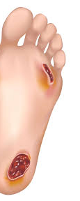
Study population
The study involved diabetic patients with foot complications from three Johannesburg PHC centres. The study used 536 files and a self constructed data collection tool. The tool was piloted at another clinic and discussed with the statistician for improvements to increase validity and reliability.
Descriptive statistical methods were used for this study. The collected data was assessed by a statistician. Count, average, and quartile functions were used to analyze the data statistically.

Slide 7
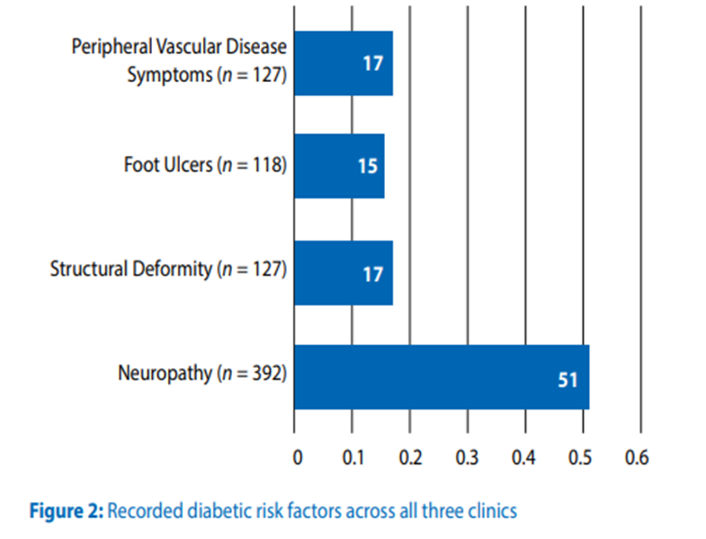
RESULTS

Slide 8
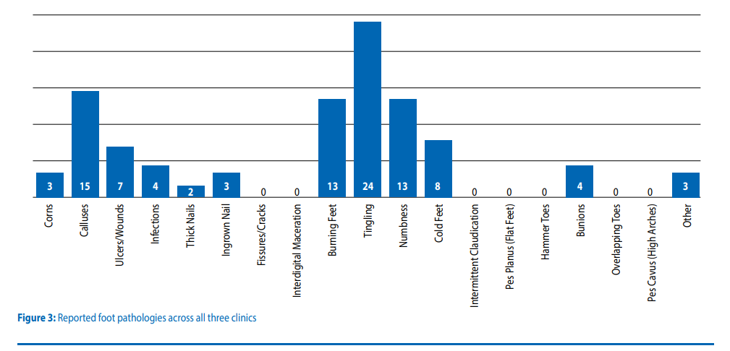

Slide 9
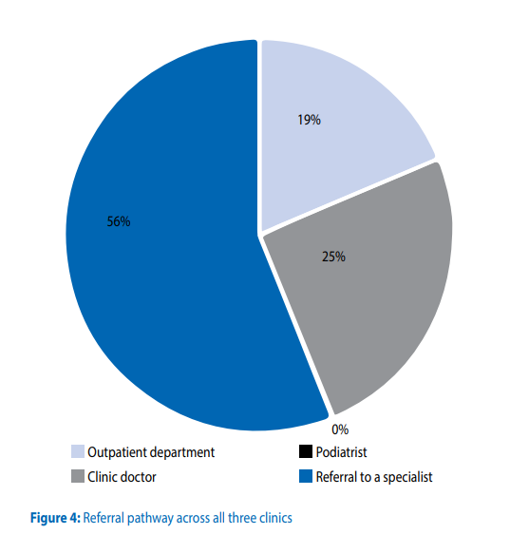

Slide 10

DISCUSSION

Slide 11
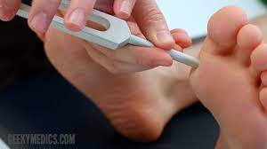
PREVALENCE OF DIABETIC FOOTCOMPLICATIONS AT THE PRIMARY HEALTHCARE LEVEL
This study highlights the number of diabetic foot complications presenting at PHC centers and the percentage of those who already have diabetic foot complications that occur in PHC facilities.
The distinction between males and females is critical since research has shown that diabetes is more common among males than females. The literature highlighted that most patients who present at PHC clinics in South Africa are predominantly females.
Based on the provided information, it is confirmed that the 566 patients whose files were collected from PHC centers all presented with diabetic foot complications.
This implies that the patients seeking care at these centers indeed have diabetic foot complications.

Slide 12

However, podiatric services are only available at a few PHC centers in South Africa, and these are all centered in Gauteng.
In cases where podiatric services are available, they remain poorly structured and ignored or unknown by other healthcare professionals. Without structured foot health services, one might argue that diabetic patients are not given quality care at lower levels of care in the health system.
The exclusion of podiatrists from the PHC team has resulted in a lack of, or severely limited, preventative foot health interventions in most PHC settings.
This statement implies that patients presenting at these facilities may be deprived of a critical component of care, early identification, and prevention of complications, which ought to occur at the PHC level.
The status quo should be changed if there is any hope of making a significant impact in the care of diabetic patients in South Africa.

Slide 13
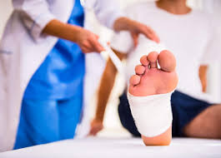
Management of diabetic foot complications at primary healthcare centers
Because of their heavy workloads and training gaps, nurses may struggle to perform diabetic foot evaluations and screenings and implement an adequate management plan.
Evidence of diabetic foot complications in patients seen at PHC centers signals the need for early targeted interventions at this level of care.
Such interventions must include effective prevention measures, early detection of diabetic foot issues, and appropriate assessment and management.
However, although there is an obvious need for foot health services at the PHC level, the service delivery structure still leans heavily towards a curative, high-cost care approach with limited adherence to a defined referral system.
The predominantly hospital-centric healthcare system and emerging epidemics prevent the successful provision of quality, comprehensive, and integrated primary care to millions of South Africans.

Slide 14
The current study found that the 536 patients who were part of this study were inadequately assessed concerning their foot complaints.
The patient files reviewed in this study highlighted the poor capture of foot related complaints or pathologies in patients seen by nurses at the PHC level.
This finding highlights these patients’ risk as their complaints may be overlooked, incorrectly captured, or ignored during consultation.

Slide 15

LACK OF GUIDELINES IN MANAGING PATIENTS WITH DIABETIC FOOT COMPLICATIONS
The Department of Health in South Africa lacks policies for foot-related problems, raising concerns about the ability of nurses to assess diabetic patients effectively.
In terms of diabetic foot services, there is a strong justification and demand for a rethinking of health service provision, planning, and delivery in South Africa.
Based on existing diabetic foot complication recommendations, this study found that diabetic foot disease awareness was poor.
To reduce the burden of diabetic foot disease, type 2 diabetes mellitus (T2DM) patients should have access to improved screening and prevention programs, as well as patient education while maintaining an active approach to risk factor modification, footwear, and identifying the at-risk foot.
South African policymakers need to use these factors to generate guidelines for the healthcare system when encountering a diabetic foot.

Slide 16
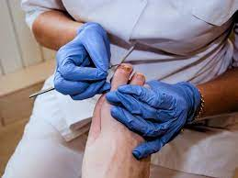
Poorly defined referral pathways for patients with diabetic foot complications
Nurses need assistance managing diabetic foot complications, and a structured foot health service should be accessible at the PHC level.
The referral system is failing, with nurses unaware of podiatrists’ foot health services at tertiary hospitals.
To improve the referral system, PHC nurses must build strong relationships with podiatrists and develop channels of contact.
Visits to healthcare experts are essential for adherence, and stable visits have been positively rated by patients.

Slide 17
NEED FOR PODIATRISTS AS PART OF THE PRIMARY HEALTHCARE TEAM
The research suggests that podiatrists should be included as part of the PHC team.
This study’s findings demonstrate the need for podiatrists at this level of treatment. It is suggested that in the absence of podiatrists, most patients arriving at these clinics will go untreated.
In this study, 392 patients presented with neuropathy, 127 with structural deformities and peripheral vascular disease, and 118 with foot ulcers.
These findings emphasize the importance of including podiatrists as PHC team members.
PHC nurses deal with an ever-increasing number of patients, which has resulted in limited consultation time and, as a result an increase in the lack of effective management of diabetic patients, which has led to the current study’s finding of many diabetic foot risk factors

Slide 18
KEY RECCOMENDATIONS
1. Integrate Podiatrists into Primary Health Care Teams: The inclusion of podiatrists in the primary healthcare (PHC) teams is essential for the early identification and management of diabetic foot complications. Podiatrists can provide specialized care, reduce the risk of amputations, and help implement preventive measures.
2. Develop and Implement Clear Guidelines: Establish standardized guidelines for the assessment, management, and referral of diabetic foot complications. This should include protocols for regular foot screening, patient education, and the use of off-loading techniques to manage ulcers.
3. Improve Training for Nurses: Given that PHC in South Africa is predominantly nurse-driven, it is crucial to enhance the training of nurses to ensure they can effectively screen and manage diabetic foot conditions. Training should focus on early detection, risk factor identification, and appropriate referral pathways.

Slide 19
4. Strengthen Referral Pathways: Create well-defined referral pathways that ensure patients with diabetic foot complications can access specialized care promptly. This involves establishing clear communication channels between PHC clinics and higher-level care facilities, including podiatry services.
5. Promote Community Foot Health Education: Implement community-based education programs to raise awareness about diabetic foot complications. Educating patients on self-care practices, recognizing early signs of complications, and the importance of regular foot checks can help reduce the incidence of severe foot problems.
6. Allocate Resources for Diabetic Foot Care: Ensure that PHC clinics are adequately equipped with the necessary resources, such as diagnostic tools and materials for foot care, to manage diabetic foot complications effectively. This includes the availability of appropriate footwear and off-loading devices.
7. Monitor and Evaluate Diabetic Foot Care Practices: Establish a system for monitoring and evaluating the effectiveness of diabetic foot care practices within PHC clinics. Regular audits and feedback mechanisms can help identify areas for improvement and ensure that best practices are being followed.

Slide 20
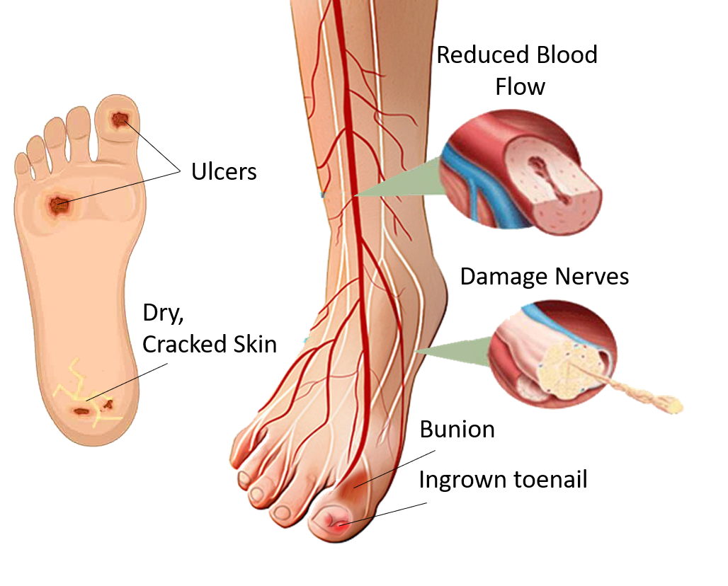
CONCLUSION
In South Africa, there are major challenges as far as the management of the diabetic foot goes.
A significant segment of the patient population is systematically and structurally overlooked.
This is a quantifiable finding of this study, not a coincidental result.
Diabetic patients with foot issues are being neglected across the country, which is a growing concern. Who oversees these patients?

