Slide 1





Fasting plasma glucose performs better than glycated haemoglobin and glycated albumin for diagnosing gestational diabetes
JOHANNESBURG HEALTH DISTRICT
2024 RESEARCH CONFERENCE
Presenter: Lungile Khambule
Authors: Lungile Khambule, Lawrence Chauke, Nigel J Crowther, Jaya A George
#JoburgResearch2024

Slide 2
Background
JOHANNESBURG HEALTH DISTRICT
2024 RESEARCH CONFERENCE
Gestational diabetes mellitus (GDM) affects 1 in 10 pregnancies in South Africa (Macaulay 2018)¹
GDM complications are preventable if diagnosed accurately and in time
WHO 2013² guidelines recommend that ALL pregnant women should be tested, preferably by OGTT.
1.Macaulay S, Ngobeni M, Dunger DB, Norris SA. Diabetes Res Clin Pract. 2018 May;139:278–87.
2. World Health Organization. Report No.: WHO/NMH/MND/13.2. Available from: https://apps.who.int/iris/handle/10665/85975
#JoburgResearch2024
Notes:
Several health organisations have advocated for universal GDM screening using oral glucose tolerance test (OGTT)

Slide 3
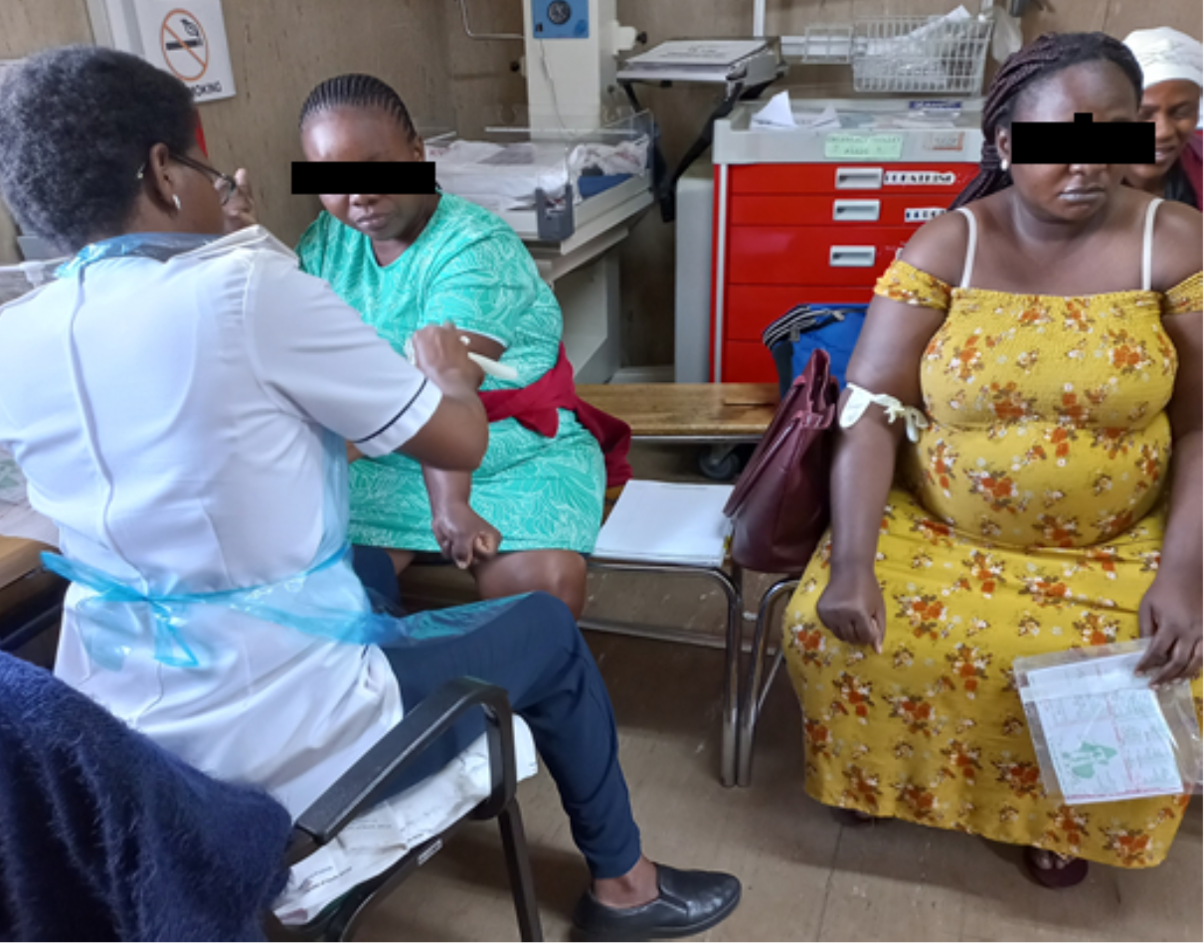
Problem statement
JOHANNESBURG HEALTH DISTRICT
2024 RESEARCH CONFERENCE
Inadequate resources for universal screening/diagnosis by OGTT
OGTT:
  Minimum 2 hours
  Fasting is required
  Glucose solution required, may lead to nausea or vomiting
High risk group approach:
  Not sensitive or specific for GDM
#JoburgResearch2024
Notes:
however, in practice, public health care centres are unable to administer OGTT due to inadequate resources and many women will be subjected to OGTT for no reason, for example, 1000 out 100 participants are negative for gdm (Macaulay 2018),
In addition, we all know the volumes of patients in tertiarty hospitals is massive, it does not help that the OGTT is minimum 2 hours long, nurses would need to prepare glucose solutions for each woman to drink, draw blood minimum 3 times depending on the criteria for diagnosis used. Furthermore, the procedure may lead to vomiting or nausea, and women are required to come fasted.
so only women with high-risk factors for GDM are eligible for OGTT. However, the risk factor approach is known to have poor sensitivity (58.7%) and specificity (58.6%) for detecting GDM.

Slide 4
Aim
JOHANNESBURG HEALTH DISTRICT
2024 RESEARCH CONFERENCE
Find a GDM diagnostic method that would be cost-effective and accurate
  Comparing FPG, HbA1c and GA with OGTT
#JoburgResearch2024
Notes:
In this study, we intended to find a GDM diagnostic method that would be cost-effective and accurate.

Slide 5
Methods
JOHANNESBURG HEALTH DISTRICT
2024 RESEARCH CONFERENCE
477 black African pregnant women @ high risk for GDM(24-32 weeks) from JHB ante-natal clinics
OGTT for GDM diagnosis (75g of glucose and IADPSG criteria)
Demographic and anthropometric data was measured by qualified nurse
Blood glucose and GA (%) was measured by Cobas 8100 automated analyser from Roche. HbA1c (%) measured by HPLC (BioRad)
#JoburgResearch2024

Slide 6
Outcomes
JOHANNESBURG HEALTH DISTRICT
2024 RESEARCH CONFERENCE
Variables | FPG at ≥5.1 mM | HbA1c at ≥5.5 % | GA at ≥35.76% | FPG at ≥4.6 mM
Participants | 477 | 268 | 199 | 409
Sensitivity, % (95%CI) | 87.2 (77.7, 93.7) | 53.7 (37.4, 69.3) | 53.5 (41.3, 65.5) | 90.0 (55.5, 99.7)
Specificity, % (95% CI) | 100 (99.1, 100) | 79.7 (73.9, 84.8) | 82.8 (75.1, 88.9) | 74.9 (70.4, 79.1)
PPV, % (95%CI) | 100 (94.7, 100) | 32.4 (21.5, 44.8) | 63.3 (49.9, 75.4) | 8.26 (3.85, 15.1)
NPV, % (95%CI) | 97.6 (95.5, 98.8) | 90.5 (85.6, 94.2) | 76.3 (68.3, 83.1) | 99.7 (98.2, 100)
False positive, N | 0 | 46 | 22 | 100
False negative, N | 10 | 19 | 33 | 1
True positive, N | 68 | 22 | 38 | 9
True negative, N | 399 | 181 | 106 | 299
#JoburgResearch2024
Notes:
The sensitivity and specificity of HbA1c at 5.5% threshold for GDM diagnosis were 54% and 80% and for GA at 37.56% threshold were 54% and 83% whilst using an FPG cut point of 5.1mmol/L they were 87% and 100%, respectively. FPG missed 10 out of 78 GDM cases. To identify the women with GDM who were not identified using an FPG of 5.1mmol/L we found that an FPG cut point of 4.6mmol/L yielded a sensitivity and specificity of 90% and 75%, respectively.

Slide 7
Summary of Results
JOHANNESBURG HEALTH DISTRICT
2024 RESEARCH CONFERENCE
Women with risk factor for GDM; N=477
OGTT
78 with GDM
10 had FPG<5.1mM but postprandial above cut point
68 had FPG>5.1mM
9 of these women had FPG≥4.6mM
1 of these women had FPG<4.6mM
#JoburgResearch2024

Slide 8
Conclusions
JOHANNESBURG HEALTH DISTRICT
2024 RESEARCH CONFERENCE
Two-tiered approach for GDM diagnosis:
  Women who have FPG ≥ 5.1mmol/L should be classified as GDM
  Women who have FPG levels between 4.6 mmol/L and 5.0 mmol/L to be tested for GDM by OGTT
  Women who have FPG <4.6 should be classified as non-GDM
This would reduce the number of OGTTs by 77%
Women would still be required to fast
Recommend study should be repeated in a general population
#JoburgResearch2024
Notes:
The IADPSG recommends the use of FPG as a first step and a full OGTT to be reserved for those women with a non-diagnostic FPG in areas with limited resources (24). If we would translate this to the current study, 68 out of 477 would be excused from doing the full OGTT. To reduce the number of full OGTTs to be performed, this study recommends that a full OGTT should be reserved for women at high risk for GDM who have FPG levels between 4.6 mmol/L and 5.0 mmol/L. This will allow for a 77% reduction in OGTTs.

Slide 9




Acknowledgements
JOHANNESBURG HEALTH DISTRICT
2024 RESEARCH CONFERENCE
Prof N Crowther
Prof L Chauke
Prof J George
CMJAH, CHBAH, RMMCH and Edenvale Hospital ante-natal clinic staff
NHLS staff members
The women who contributed to the study
Funders
#JoburgResearch2024
Notes:
The IADPSG recommends the use of FPG as a first step and a full OGTT to be reserved for those women with a non-diagnostic FPG in areas with limited resources (24). If we would translate this to the current study, 68 out of 477 would be excused from doing the full OGTT. To reduce the number of full OGTTs to be performed, this study recommends that a full OGTT should be reserved for women at high risk for GDM who have FPG levels between 4.6 mmol/L and 5.0 mmol/L. This will allow for a 77% reduction in OGTTs.

