Slide 1







Voluntary Medical Male Circumcision (VMMC) and Female Condom Uptake during the COVID-19 Pandemic in Gauteng Province, South Africa
JOHANNESBURG HEALTH DISTRICT
2024 RESEARCH CONFERENCE
Cyril Fonka (Wits SPH)
Prof. Nicola Christofides (Wits SPH)
fcyrilbernsah@gmail.com
Cell: 0788 6972 81
#JoburgResearch2024

Slide 2
Presentation Outline
JOHANNESBURG HEALTH DISTRICT
2024 RESEARCH CONFERENCE
Background
Aim and methods
Results
Conclusion
Recommendations
References
Acknowledgements
#JoburgResearch2024

Slide 3
BACKGROUND
JOHANNESBURG HEALTH DISTRICT
2024 RESEARCH CONFERENCE
Voluntary Medical Male Circumcision (VMMC) is 65% effective against HIV transmission (especially in MSM)
Female Condom (like male condoms) are 90-95% effective against HIV Transmission
Also, female condoms prevent unwanted pregnancies and other STIs (eg sex workers)
Both VMMC and Female condoms are cost-effective interventions
However, there is a knowledge deficit of COVID-19's impact on these interventions in Gauteng, one of the most hit provinces in South Africa by the COVID-19 pandemic.

Slide 4
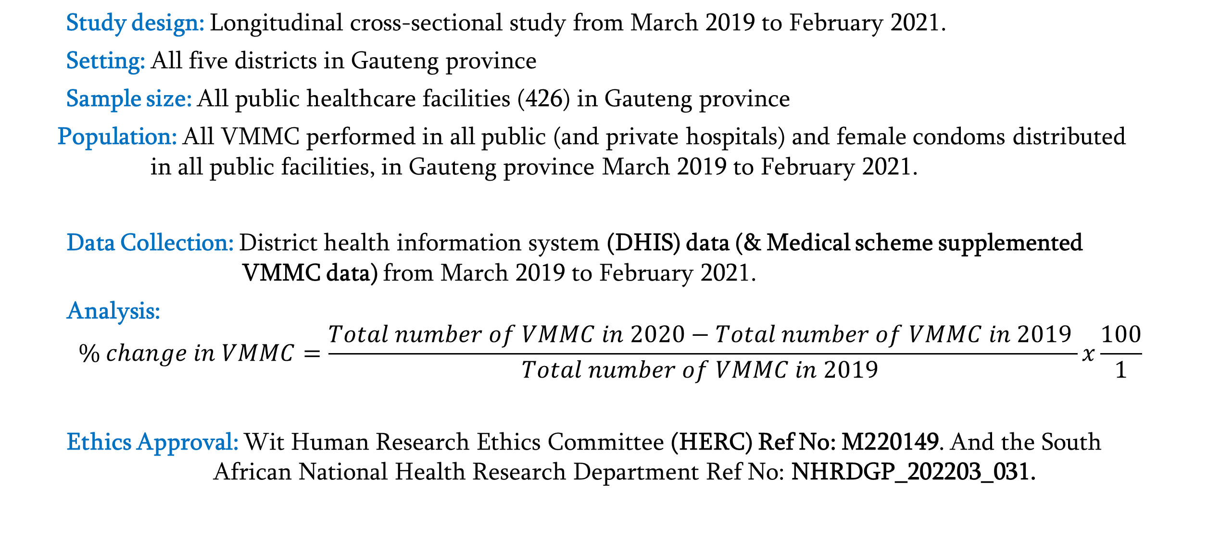
AIM
JOHANNESBURG HEALTH DISTRICT
2024 RESEARCH CONFERENCE
To compare VMMC and female condom uptake before and during the COVID-19 pandemic, in Gauteng province.
METHODS
Study design: Longitudinal cross-sectional study from March 2019 to February 2021.
Setting: All five districts in Gauteng province
Sample size: All public healthcare facilities (426) in Gauteng province
Population: All VMMC performed in all public (and private hospitals) and female condoms distributed in all public facilities, in Gauteng province March 2019 to February 2021.
Data Collection: District health information system (DHIS) data (& Medical scheme supplemented VMMC data) from March 2019 to February 2021.
Analysis:
$$\% change in VMMC=\frac{Total number of VMMC in 2020−Total number of VMMC in 2019 }{Total number of VMMC in 2019 }x\frac{100}{1}$$
Ethics Approval: Wit Human Research Ethics Committee (HERC) Ref No: M220149. And the South African National Health Research Department Ref No: NHRDGP_202203_031.

Slide 5
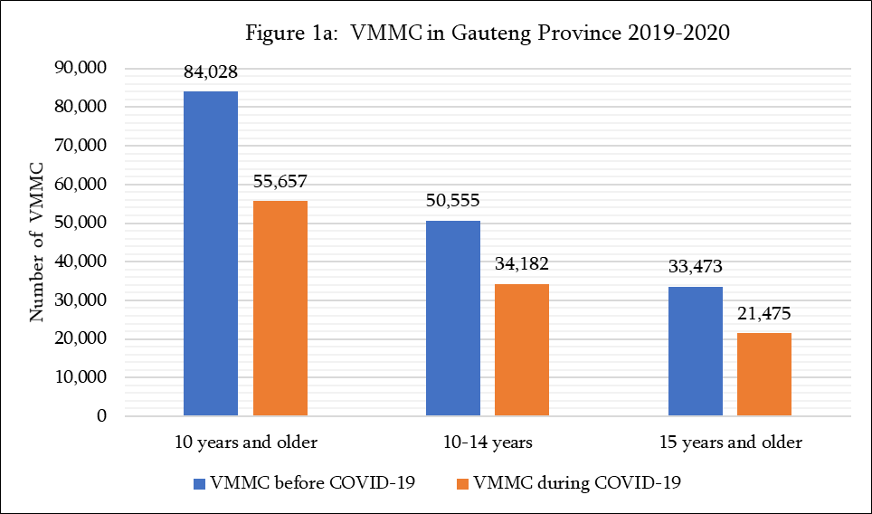
RESULTS: VMMC
JOHANNESBURG HEALTH DISTRICT RESEARCH 2024
Age groups | % change between 2019 and 2020
≥ 10 years | -33.8
10-14 years | -32.4
≥15 years | -35.8

Slide 6
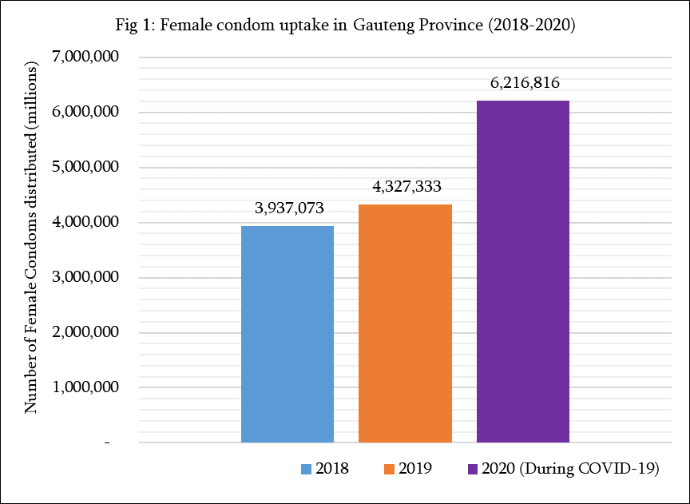
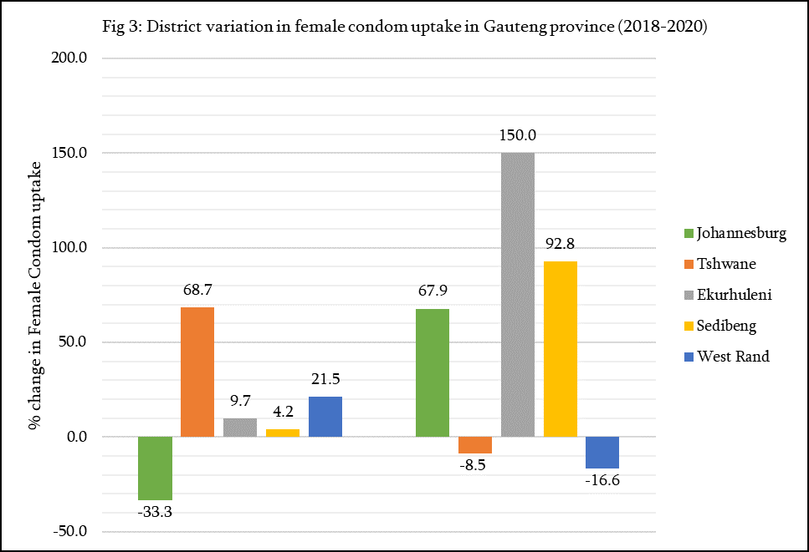
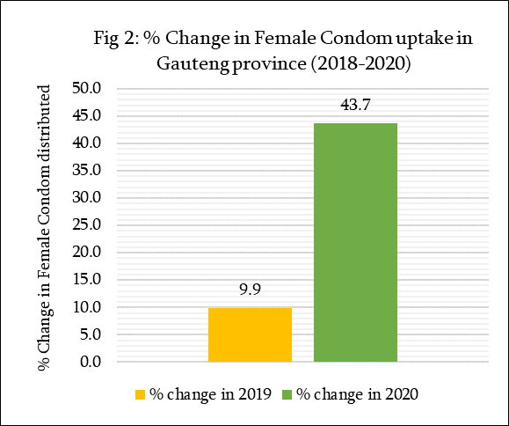
RESULTS: Female condoms
JOHANNESBURG HEALTH DISTRICT RESEARCH 2024
% change in 2019 % change in 2020

Slide 7
Limitations & Strengths:
JOHANNESBURG HEALTH DISTRICT
2024 RESEARCH CONFERENCE
DHIS data quality eg lack confounders both for VMMC and female condoms
Impossibility to disentangle demand and supply effects of female condom during COVID-19
Female condom uptake cannot be conflated with correct and consistent use
              However, the large sample size validates the generalizability of the findings
              Lack of similar studies for comparison of findings hence a precedent study
CONCLUSION
Overall, Gauteng province experienced a remarkable surge in female condom uptake and a disruption in VMMC in 2020 during COVID-19. This study suggests that different healthcare services and geographical areas were impacted differently by COVID-19, which warrants equity in service access and delivery support policies for HIV, sexual and reproductive health for both men and women post-COVID-19 and during future emergencies.

Slide 8
RECOMMENDATIONS
JOHANNESBURG HEALTH DISTRICT RESEARCH 2024
Stockpiling of female condoms during further outbreaks/emergencies
Further qualitative research to investigate the reasons/factors that influenced the surge in female condoms during COVID-19 (2020).
Behavioral change communication interventions will assist to improve female condom uptake in the Tshwane and West Rand districts to match the increase in other districts.
Stakeholder commitment to return VMMC to pre-COVID-19 growing rates to sustain the gains in fighting HIV transmission.
Continuum of essential HIV services during future health emergences

Slide 9
REFERENCES
JOHANNESBURG HEALTH DISTRICT
2024 RESEARCH CONFERENCE
1. Pinkerton SD, Abramson PR. Effectiveness of condoms in preventing HIV transmission. Soc Sci Med. 1997 May;44(9):1303–12.
2. Weller S, Davis K. Condom effectiveness in reducing heterosexual HIV transmission. Cochrane Database Syst Rev. 2002;(1):CD003255.
3. Merson MH, Dayton JM, O’Reilly K. Effectiveness of HIV prevention interventions in developing countries. AIDS. 2000 Sep;14 Suppl 2:S68-84.
4. Ndlovu SMS, Ross A, Ndirangu J. Knowledge of HIV and/or AIDS and HIV testing services among young men in South Africa. Afr J Prim Health Care Fam Med. 2023 Jul 31;15(1):e1–10.
5. Meintjes G, Moorhouse MA, Carmona S, Davies N, Dlamini S, van Vuuren C, et al. Adult antiretroviral therapy guidelines 2017. South Afr J HIV Med. 2017;18(1):776.
6. Gray RH, Kigozi G, Serwadda D, Makumbi F, Watya S, Nalugoda F, et al. Male circumcision for HIV prevention in men in Rakai, Uganda: a randomised trial. Lancet. 2007 Feb 24;369(9562):657–66.
7. Peck ME, Ong KS, Lucas T, Prainito A, Thomas AG, Brun A, et al. Effects of COVID-19 Pandemic on Voluntary Medical Male Circumcision Services for HIV Prevention, Sub-Saharan Africa, 2020. Emerg Infect Dis. 2022 Dec;28(13):S262–9

Slide 10
JOHANNESBURG HEALTH DISTRICT
2024 RESEARCH CONFERENCE
Thank
You!
#JoburgResearch2024

