Slide 1






Hypertension treatment practices and outcomes at health community centres in urban Soweto, South Africa
JOHANNESBURG HEALTH DISTRICT
2024 RESEARCH CONFERENCE
Kuda Nyamupa
#JoburgResearch2024

Slide 2
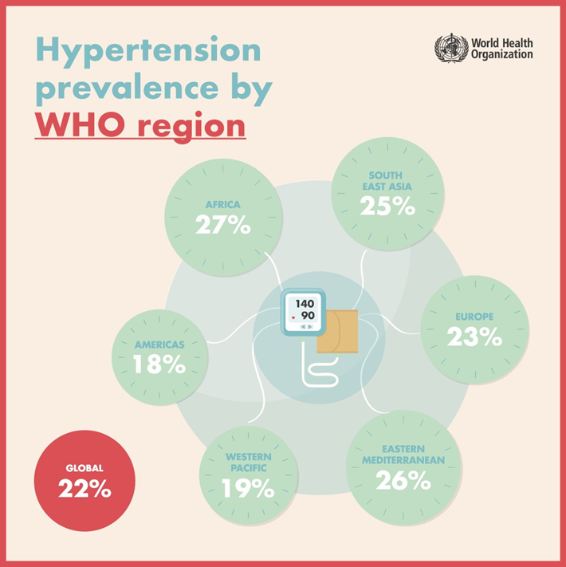
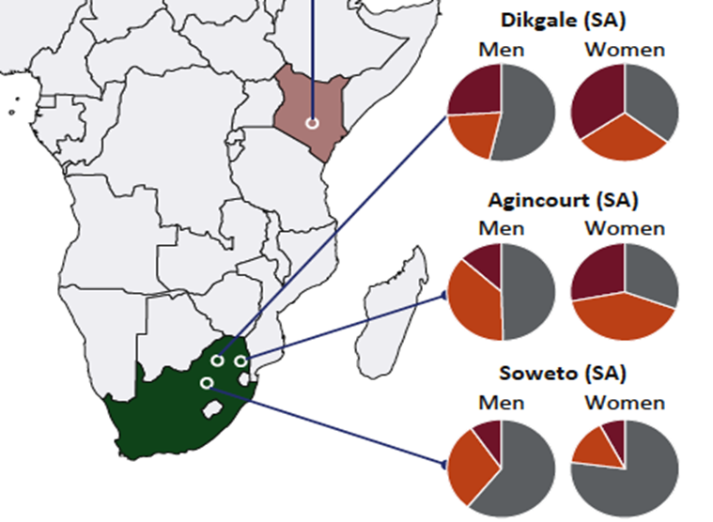
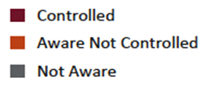

HT is a major public health concern and major contributor to mortality
JOHANNESBURG HEALTH DISTRICT
2024 RESEARCH CONFERENCE
Shift in public health focus from infectious diseases to NCDs
Only 25% of countries in Africa have a framework for achieving population HT control
Of these only 7% meet their BP control goals
#JoburgResearch2024
Notes:
Awareness, treatment and control are particularly low in Soweto and so it was a good site for the study

Slide 3
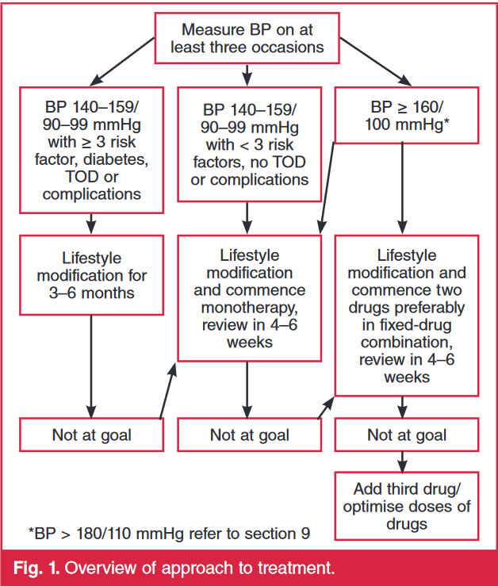
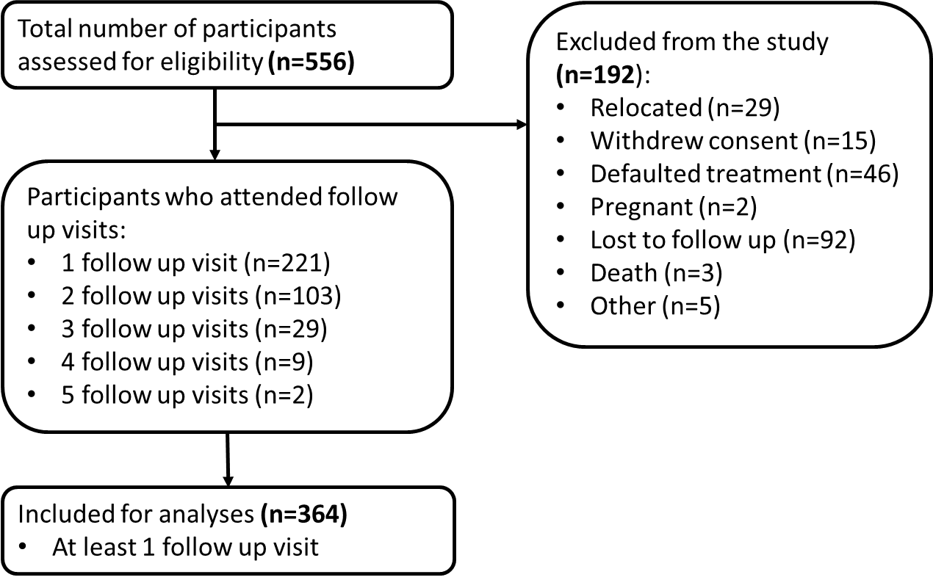
Observational study assessing HT treatment practises at Soweto CHCs
JOHANNESBURG HEALTH DISTRICT
2024 RESEARCH CONFERENCE
Chiawelo, Itireleng, Zola, Mofolo, Orlando, Lillian Ngoyi, Michael Maponya
#JoburgResearch2024

Slide 4
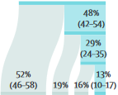
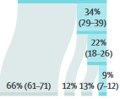
Major outcomes
JOHANNESBURG HEALTH DISTRICT
2024 RESEARCH CONFERENCE
Females (58%) were better at controlling BP at first follow up vs males (40%)
More males (60%) had uncontrolled BP at first follow up v males with controlled BP (40%)
58%
42%
40%
60%
Females
Males
Diagnosed
Treated
Controlled
SSA (Zhou, 2021)
51%
controlled
49%
uncontrolled
There was no difference in control % between patients with 1 vs 2 drugs
50%
50%
52%
48%
46%
54%
1 drug
2 drugs
3+ drugs
Clinic A patients prescribed: 1 Drug - 31%, 2 Drug – 63%
Clinic B patients prescribed: 1 Drug - 51%, 2 Drug – 43%
Clinic B had better control outcomes than Clinic A
43%
57%
58%
42%
45%
55%
Clinic A
Clinic B
Other clinics

Slide 5
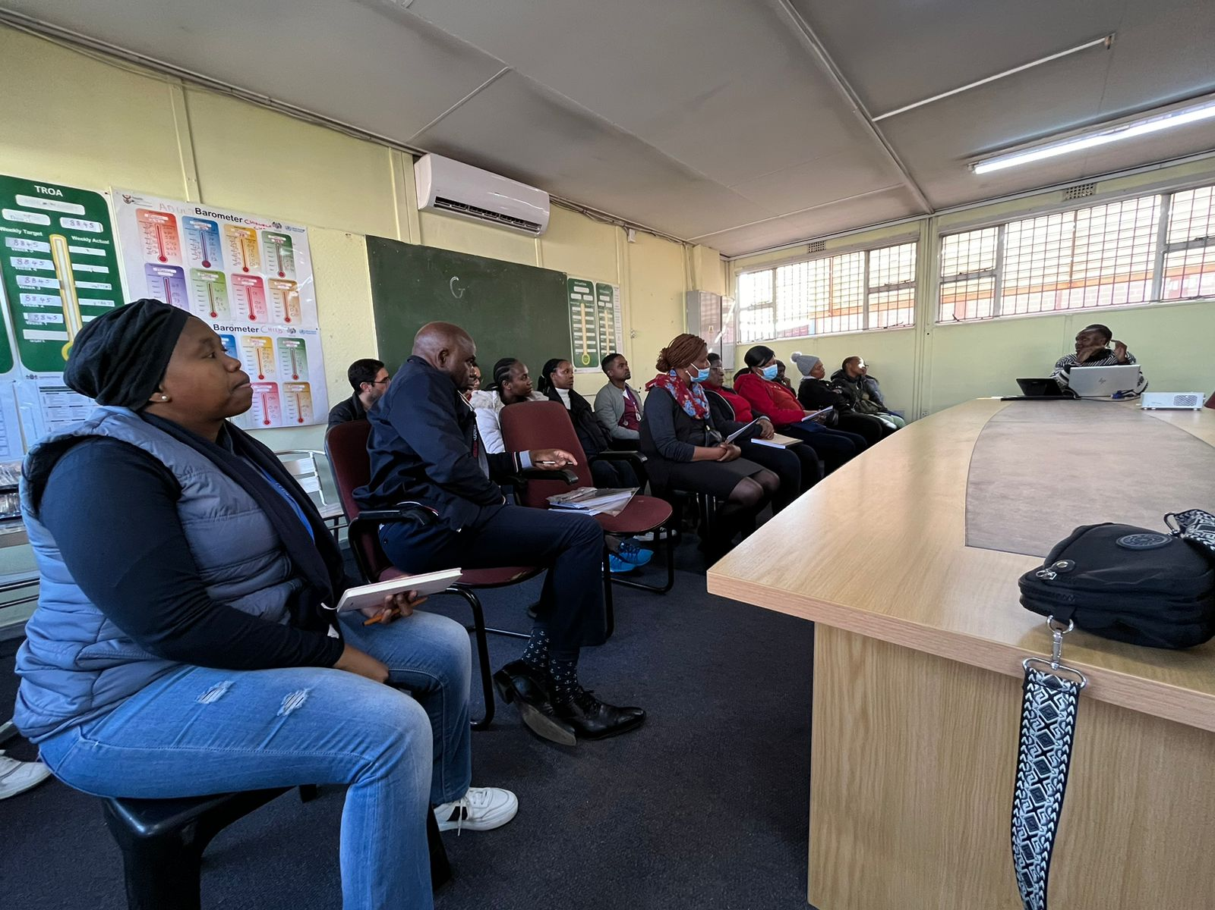
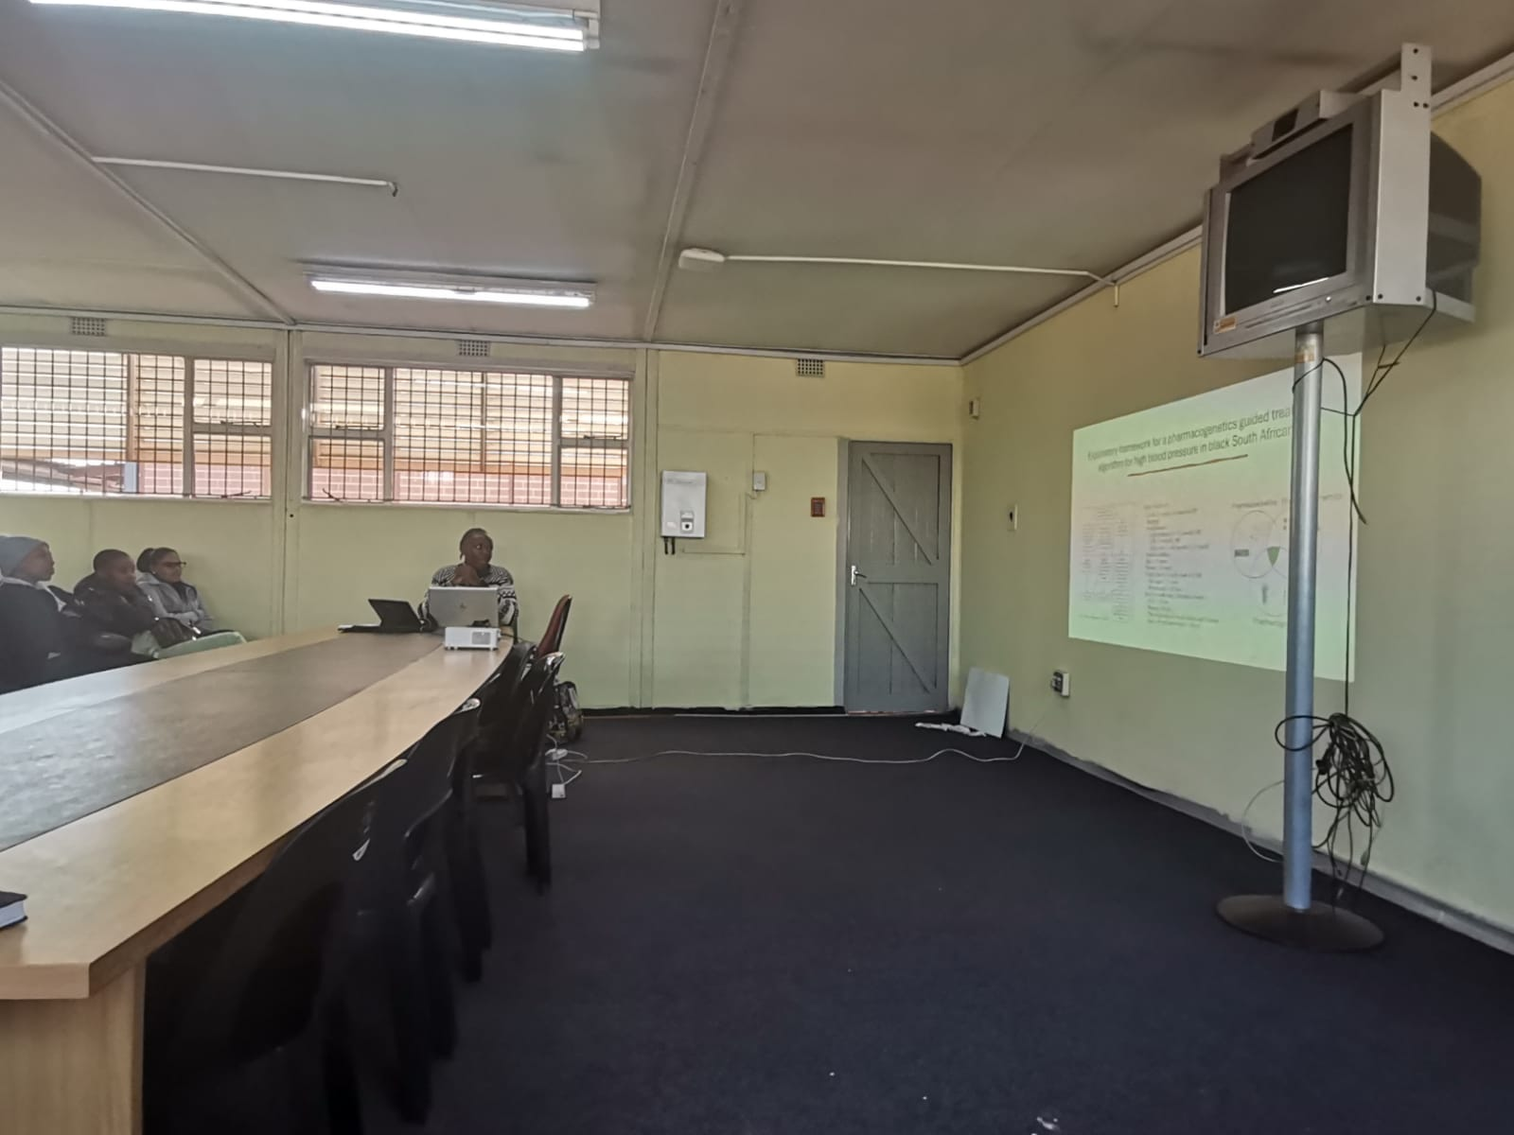
Community feedback
JOHANNESBURG HEALTH DISTRICT
2024 RESEARCH CONFERENCE
Most HT patients are referred from smaller clinics to bigger clinics (Chiawelo and Itireleng) due to complications beyond treatment guidelines
Continuity of care a continuous struggle after patients are sent back to original clinic
  Lost files
  No communication between clinics
Unhealthy lifestyle habits very prevalent especially amongst men
#JoburgResearch2024

Slide 6
Challenges
JOHANNESBURG HEALTH DISTRICT
2024 RESEARCH CONFERENCE
Recommendations
Covid restrictions 2020-2021
Civil unrest 2021
Getting patients to return for follow visits
  Average FU period (114 days)
  48% of excluded patients lost to follow up
Medication compliance
  24% of excluded patients admitted to stopping taking medication
More in-depth analyses on treatment approaches at primary health care level
  More follow ups, interviews/surveys, bigger cohort
Electronic tool/App for maintaining patient information across clinics
  Especially for referred patients. Aids teamwork between clinics
Looking at other regions in the district, urban vs rural areas, different provinces
  Incorporate different strategies
#JoburgResearch2024

