Slide 1


Exploring experiences and perceptions of collaborating with traditional healer practitioners (THPs) in Johannesburg and Sedibeng Districts
Cathrine Chinyandura
#JoburgResearch2024
Notes:
This slide should include Title, Presenter name(s), and date

Slide 2






Presentation outline
Background
Objectives
Methodology
Results
Conclusions
Recommendations
#JoburgResearch2024

Slide 3
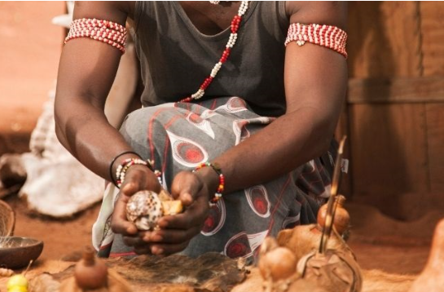
Background
Multidisciplinary and intersectoral collaboration is an important strategy in the strengthening of health systems and implementation of HIV, TB, and STIs programs.
Collaborating with THPs presents an opportunity to increase HIV testing, retention in care, and adherence to antiretroviral therapy (ART).
In South Africa, studies have documented THPs’ role in managing HIV, TB, and STIs, and provision of maternal health services.
WHO recommends the integration of THPs into national HIV programs and collaboration with biomedical care providers.

Slide 4




Study Objectives
    Explore health workers' perceptions of collaborating with traditional health practitioners (THPs).
Identify challenges and opportunities for effective collaboration.
#JoburgResearch2024

Slide 5
Methodology
We conducted in-depth interviews
using a semi-structured interview guide
Study design
1
                5 CLOs
                4 HTS Coordinators
                1 Program Manager
Participants
2
The study was conducted in the Johannesburg & Sedibeng districts
Location
3
Thematic analysis was used to analyze the data using the Nvivo software.
Data analysis
4

Slide 6
Results
Collaboration is feasible
“It is possible to work with THPs as some of them have invited us to conduct HIV testing at their sites. Some really want to work with us”.
Willingness to collaborate
“One lady was excited at the collaboration…it was not the first time I engaged her, we met her when we were piloting HIVSS and that lady a year or two years ago was interested”.
  Access to individuals/groups who do not visit health facilities
“They are popular with amageza (taxi drivers) because there is no queue and they say they are respected”.
  Sharing of knowledge and skills
“It’s not one-way traffic, as much as we can transfer skills and knowledge from them, we have a lot we can learn from them”.

Slide 7
Results
“They are based in the community so we can ride on that and they know all the important stakeholders in the community”.
  Community presence
Holistic care
THPs, these guys touch on everything ……they provide physical, mental, spiritual, and even deal with issues like GBV, which is what patients need.
Patient-centred care
“They meet the patient at his level, and they tailor their treatment plans to patient preferences and needs ”.
Explore new areas of collaboration
You know THPs deal with a lot of matters. This can allow us to explore other areas of collaboration

Slide 8
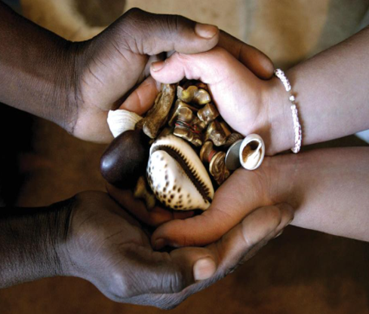
Potential barriers to the collaboration
differing philosophies of care - divergent perspectives on the causes and treatment of diseases
potential regulatory barriers.
institutional - bureaucracy in umbrella bodies
cultural barriers- varying values, and
different capacities
Addressing these challenges is crucial for creating a collaborative environment.

Slide 9

Conclusions
Collaborating with THPs is feasible and has the potential to improve patient care and widen access to care.
As respected, culturally accepted, and trusted community gatekeepers, THPs are an indispensable resource that can act as a bridge between communities and health facilities.
Building effective collaboration requires addressing institutional, administrative, and cultural barriers.
#JoburgResearch2024

Slide 10

Recommendations
    Revive and strengthen health facility committees.
    Create bi-directional referral pathways between THPs and health facilities.
    Provide evidence-based feedback to the THP sector in SANAC.
#JoburgResearch2024

