Slide 1

Validated Guidelines to Manage Burnout and Stress of Dietitians and Nutritionists in the Workplace
Dr. Alpheus “Alpha” Rasekhala
PhD. (Nutritional Sciences, Stellenbosch University)
Supervisor: Prof. Xikombiso Gertrude Mbhenyane
Co-supervisor: Prof. Renée Blaauw

Slide 2
Presentation Outline
Aim
Methodology
Results
Guideline Development
Validation of Guidelines
Recommendations
Conclusion

Slide 3
Aim of the study
This study aimed to determine burnout and stress levels and develop guidelines to promote job satisfaction among dietitians and nutritionists practising in South Africa.

Slide 4
Methodology
Exploratory sequential study design was used to acquire an in-depth understanding of the topic
Johannesburg district office participated in phase 1 and phase of the study

Slide 5
Methodology Phase 1
Aim
To adapt and contextualise the research instruments
Design
Quantitative
Outcome
Period
Contextualised and adaption of the questionnaires
4 months
Statistics
Data analysis
Sample 36 dietitians,1 dual registration and 1 Nutritionist conveniently selected

Slide 6
Methodology Phase 2
Aim
Phase 2 - Step 1- Determine the prevalence
Phase 2-Step2- Explore the relationship and compare findings
Design
Outcome
Period
4 months phase 2 step 1- and 1-month phase 2 step 2
Statistics
Data analysis
Quantitative -Convenience sample based on voluntary response (Step 1) (277 participants) and qualitative (Step 2) approaches (3 FGD and 10 participants)
Prevalence of Stress and Burnout and levels of job satisfaction
Contributing factors to stress and burnout

Slide 7
Methodology Phase 3
Aim
To design, develop and validate the guidelines
Design
Delphi technique (23 experts recruited)
Outcome
Period
Draft guidelines
6 months
Statistics
Data analysis
Graphic designer consulted

Slide 8
Methodology Phase 4
Aim
Design
Qualitative approach ( 6 Supervisors and 8 practitioners)
Outcome
Period
Final guidelines
2 months
Statistics
Data analysis
Pilot test: To conduct direct face-to-face testing of the guidelines

Slide 9
Results Phase 1
Both face validity and content validity testing were performed.
Cronbach alpha was used to test for both reliability and repeatability and internal consistency of the tools
CBI and DNSS both reached an excellent reliability, α=0.934 and α=0.969, respectively,
and the JSS reached a high-reliability level, α= 0.738.
The sub-scales of CBI have reached excellent reliability for Client Related Burnout, α=0.942, and the personal and Work-Related Burnout sub-scales reached high reliability, α= 0.847 and α = 0.744, respectively.

Slide 10
Results Phase 2-Step 1

Slide 11
Results Phase 2-Step 1

Slide 12
Results Phase 2-Step 1

Slide 13
Atlas.ti Code Phase 2 step 2
27 codes were identified during analysis with Atlas.ti
The deductive approach was used for this phase and the idea of themes came from the literature review.
10 main themes grouped as structural/ organisational factors and 9 themes for individual support.

Slide 14
Phase 2 step 2
Structural/ organisational interventions within the work environment (10) | Individual support concepts (9)
Imbalance between job demands, skills and resources | Self-support
Improved communication | Relaxation skills
Professional recognition, appreciation, and respect | Loss of support, conflict with colleagues
Team building | Mindfulness or Stress Management
Support of flexible work schedule | Self-care
Modifying Work process | Self-development
Work-home support | Interprofessional development and collaboration
Socioeconomic relationship between a worker and an employer | Imbalance between job demands
Improved physical environment of the workplace | Work environment competitiveness
Tenders

Slide 15
Guidelines Development
Mental Health and Well-being: A Socio-Ecological Model was used(Michaels et al., 2022).
The study developed guidelines with 14 themes, grouped into individual, organizational and relationship domains

Slide 16
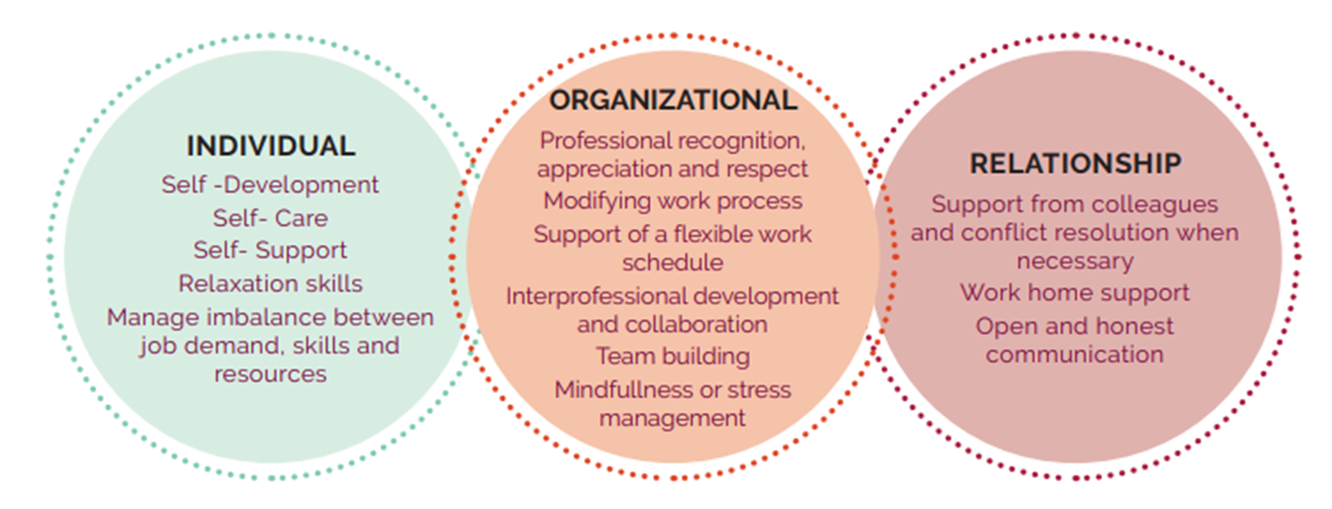
Phase 3-Guidelines

Slide 17
Phase 4
Validation Practitioners and Supervisors
Six main themes
• Guidelines design
• Responsibilities
• Resources
• Outcomes
• Benefits
• Influence
The guidelines were positively accepted by the practitioners and their supervisors.

Slide 18
Recommendations
Recommending that workplaces with dietitians and nutritionists should adopt the guidelines.
Additional studies are needed to address individual and organisational barriers that increase the risk of burnout.
The interventions to reduce burnout among dietitians and nutritionists should include advocacy for better resource provisions and support so that patient care and healthcare infrastructure can be improved.
Understanding the relationship between job satisfaction and the work environment will allow organisational management to focus on improving structures within the work environment that could lead to individuals feeling empowered and improving their job satisfaction levels.

Slide 19

Conclusion
This research established that South African dietitians and nutritionists are moderately burnt-out, slightly job-satisfied, and, lastly, moderately stressed.
Contextualized guidelines were developed.

