Slide 1



YouthCAN
YouthCAN – Co-design African Needs:
Exploring strategies to increase the uptake of a SARS-CoV-2 vaccine in youth
Janan Dietrich, Lerato Tsotetsi, Gugulethu Tshabalala, Stefanie Vermaak
YouthCAN
Notes:
Full list for Glenda:
ADVISORY BOARDS:
Global Alliance for Chronic Diseases (GACD)
Black Womxn Caucus Board (BWC)
Scientific Advisory Board Center for HIV/AIDS Vaccine Immunology and Immunogen Discovery (CHAVI-ID) with Scripps
GARDP (Global Antimicrobial Research and Development Partnership)
HeLTI Council
National Research Foundation Board
Presidency National Order Advisory Council
SAMRC Board
Scientific Advisory Board RI-MUHC, McGill Research Institute
Strategic and Technical Advisory Group for Tuberculosis (STAG-TB)
Wits Council
BOARDS:
Access to Advanced Health Institute (AAHI) Board
African Potential Trust
HCRISA
COMMITTEES:
D43 Training Advisory Committee
Glasgow HIV 2022 Scientific Committee
Global Evidence Local Adaptation - GELA - project International Advisory Group
Global HIV Vaccine Enterprise at the IAS - International AIDS Society
HVTN(NIH/HIV Vaccines Trials Network - of conflict of interest sub-committee
Moderna Fellowship Program Global Steering Committee
NSTF Awards Adjudication Committee/Panel
UCT - Institute of Infectious of Disease And Molecular Medicine (IDM)
WHO STAG for TB
Wits - Honorary Degrees Committee
Wits Council Risk
PRINCIPAL INVESTIGATOR
HVTN Co-Principal Investigator

Slide 2
RATIONALE
Youth were largely blamed for COVID-19 transmissions.
WHO’s resources were not locally tailored and did not take the context of African youth into account.

Slide 3
AIM
To explore vaccine hesitancy by determining exposure to community rumours, or social media “news”, or misinformation, and the impact of this information on vaccine confidence.

Slide 4
Research Design
Observations and Transect
walks
Focus Groups
Look out for areas
where youth frequent
Infrastructure and
atmosphere of the
community
Conduct focus
groups with youth
from both
communities
Youth aged 15-24

Slide 5
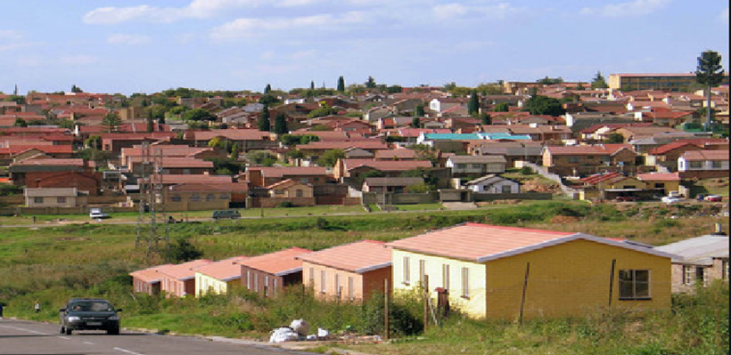
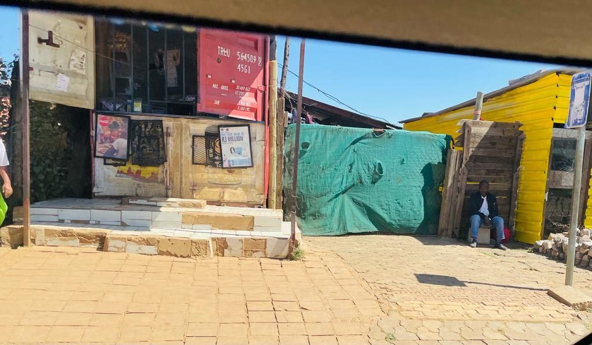

Study Communities
SITE A – Diepkloof
Diepkloof is an urban area making up a large part of Soweto.
SITE B - Motsoaledi
Motsoaledi is an informal settlement in the Soweto area.

Slide 6
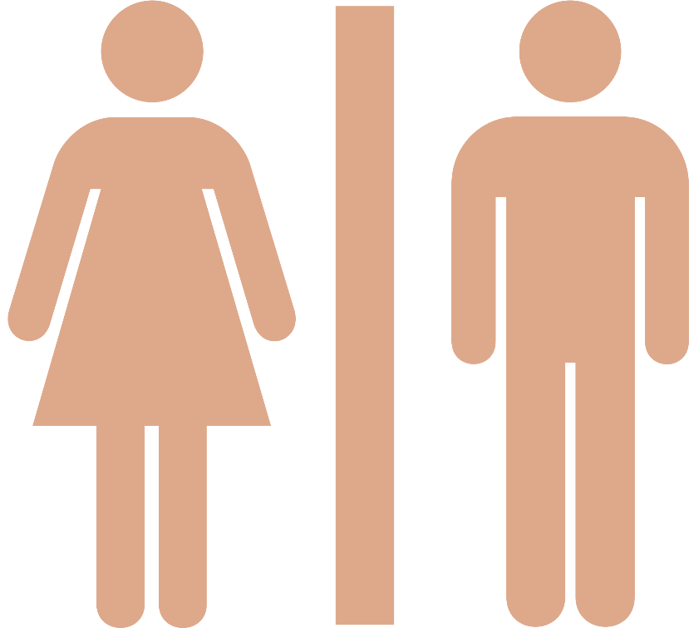
RESULTS DEMOGRAPHICS
n= 32
n= 32

Slide 7
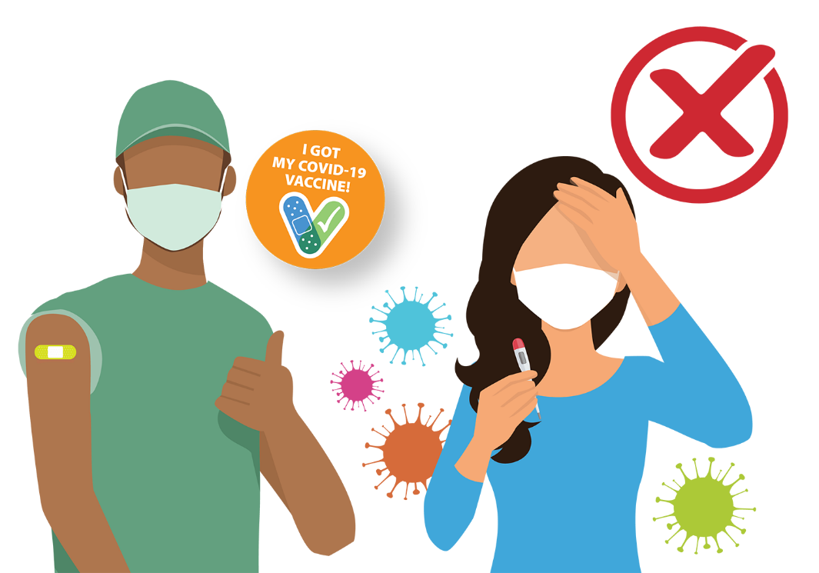
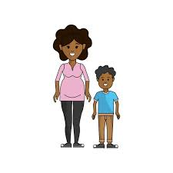

RESULTS
Willingness to vaccinate
INCENTIVES
Majority of participants were not willing to vaccinate.
Factors Influencing Vaccination Decision making
PARENTS
RUMOURS AND MISCONCEPTIONS
Notes:
Majority of participants across all age groups were not willing to vaccinate (in one group only 1 participant was vaccinate in a group of 6 and she reported having done so only because she was taken by her parent).
Immunization vs COVID-19 vaccine
Males 20-24 felt they didn’t have a choice to get immunized
Females 15-19 felts that they could trust immunization because it has been around for a long time and no child has died from it. Where as with the COVID-19 vaccine it is deemed as untrustworthy because its new and they have witnessed people experience adverse symptoms from it.

Slide 8


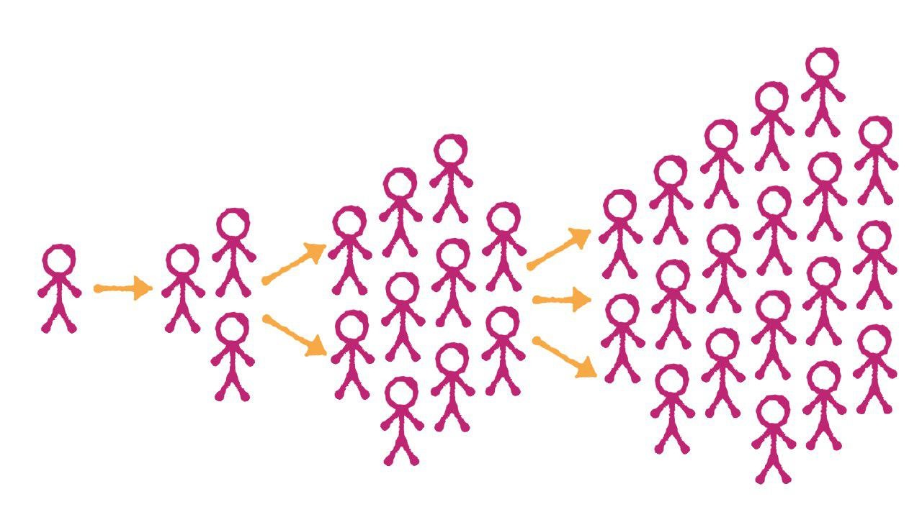
RESULTS
Sources of information about vaccines
Notes:
Education/Awareness about vaccines
Majority of the participants were unaware of other vaccines available to them
Majority have not received any other vaccines
Majority of participants knew where to go get the COVID-19 vaccine should they choose to do so
Some female participants had scientific knowledge of the COVID-19 vaccine were still unwilling to get vaccinated.
Majority of the participants had questions about the vaccines and its benefits and still had confusion on how it actually does to protect them
Majority of the participants acknowledged that the biggest source of knowledge is Social Media and that some of the information may be fuelled by rumours.

Slide 9
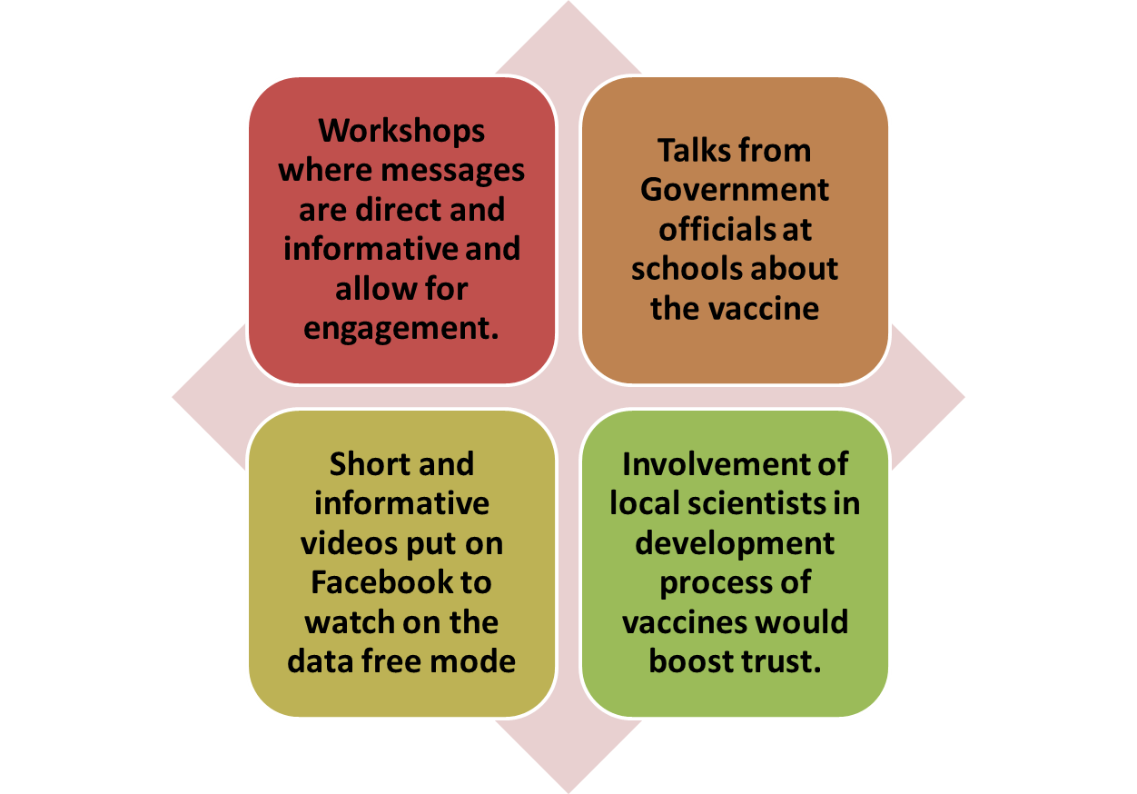
RESULTS
INTERVENTION FOR FUTURE VACCINE UPTAKE

Slide 10
RECOMMENDATIONS
YOUTH ENGAGEMENT
The results emphasise the need for youth inclusion in discussions regarding any essential health policy changes
MISCONCEPTIONS
There is a need to intercept rumours that surface in the community from the main source in order to correct the youth’s knowledge and understanding of the COVID-19 vaccine to inform decision-making practices.
HEALTH EDUCATION
Information needs to be disseminated from familiar and reliable sources.
Youth tailored educational content delivered through platforms that are easily available in the community.

Slide 11







Acknowledgements

