Slide 1
Assessing cervical precancer treatment rate among women utilising the Johannesburg public sector through record linkage of laboratory data
Johannesburg Research Conference
20 April 2022
Presenter: Amilcar Juggernath
Registrar - Public Health Medicine
Wits School of Public Health / Gauteng Department of Health

Slide 2
Background Epidemiology – Cervical cancer
Incidence
World (2020) – 604 237
South Africa (2020) – 10 702
Risk factors
HPV infection
HIV co-infection
Age-standardised death rate
World – 7.3 per 100 000
South Africa – 19.6 per 100 000

Slide 3
Background Cervical cancer screening cascade
LLETZ
1-step management process
cervical smear
colposcopy
OR
punch biopsy
2-step management process

Slide 4
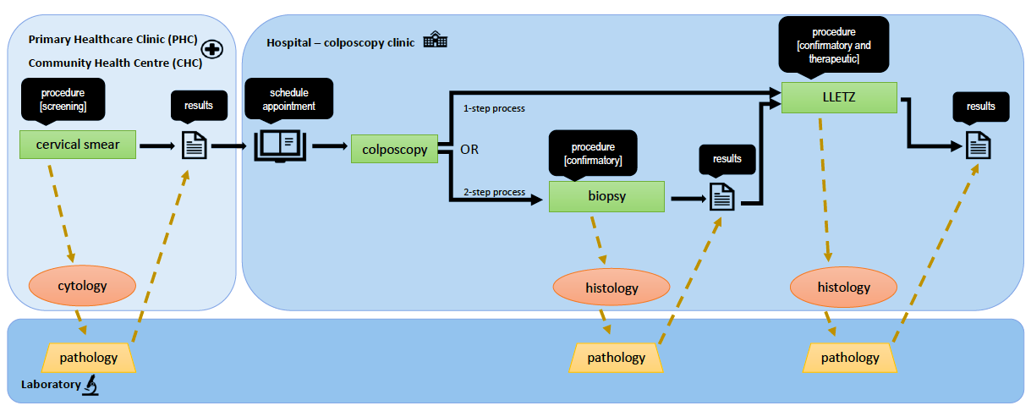
Background Cervical cancer screening cascade

Slide 5
Aims and objectives
Using NHLS data and record linkage –
In women who had a cervical smear in Johannesburg in 2017..
a) Determine:
HSIL prevalence
Follow-up rate
Confirmatory test rate
Treatment rate
b) Determine
Cervical smear to follow-up
Cervical smear to confirmatory test
Confirmatory test to treatment
Cervical smear to treatment
c) Compare proportions and times across
Age
HIV status
Screening facility type
Screening subdistrict

Slide 6
Methods
Study design: Retrospective cohort
Study setting: Johannesburg district, public sector facilities
Study population: Women who had a cervical smear in 2017. No sampling
Data source: NHLS CDW
cytology, Johannesburg, 2017
histology, Gauteng, start 2017 – end 2019
Data management: record linkage using Python

Slide 7
Methods Record Linkage
Steps
Compare
Score
Match or non-match
Variables compared
Name
Surname
Age
Date of birth

Slide 8
Methods Final dataset
 | Personal details | Screening test (cervical smear) | Follow-up 1 | Follow-up 2
0 | name surname age | date facility result | date facility procedure type result | date facility procedure type
1 | Amilcar Juggernath 35 | 20/01/2017 Hillbrow CHC HSIL | 25/06/2017 CMJAH punch biopsy HSIL | 05/01/2018 CMJAH LLETZ
2 | Mary Kawonga 40 | 09/07/2017 Wendywood Clinic HSIL | - | -
3 | Pam Michelow 42 | 12/12/2017 Randburg Clinic HSIL | 05/11/2019 RMMC LLETZ HSIL
*hypothetical data, not from dataset

Slide 9
Methods Data analysis
participant description
logistic regression
significance testing – Kruskal-Wallis, Wilcoxon rank-sum

Slide 10
Results Participant summary
Screened
67 208
Age
median: 40 years
IQR: 32 - 50
HIV status
Positive: 20 003 (30%)
Negative: 20 955 (31%)
Unknown: 26 250 (39%)
Screening facility type
PHC 44 200 (66%)
CHC 8 306 (12%)
Hospital 8 087 (12%)
Other 6 615 (10%)
Screening subdistrict
A 8 802 (13%)
B 8 065 (12%)
C 5 645 (8%)
D 15 597 (23%)
E 6 280 (9%)
F 14 615 (22%)
G 8 204 (12%)

Slide 11
Results Follow-up rates across the cascade
Cervical smear
67 208
Cytology HSIL
4 182 (6.2%)
Follow-up
1 112 (19%)
Loss to follow-up
3 070
Cytology not HSIL
63 026
Histology HSIL
766 (69%)
Histology not HSIL
346
1-step management
2-step management
Treated
475 (62%)
Confirmatory test
291 (38%)
Treated
144 (49%)
Loss to follow-up
147

Slide 12
Results Time intervals between procedures
Interval | n | Median (days) | IQR (days)
Screening test to first follow-up | 1 112 | 131 | 80 - 189
Screening test to confirmatory test | 291 | 123 | 51 - 175
Confirmatory test to treatment | 144 | 125 | 84 - 210
Screening test to treatment | 619 | 151 | 101 - 246

Slide 13
Results Factors associated with HSIL prevalence
Age groups (ref. 15-30):
30-39 (aOR: 1.37; 95% CI: 1.21-1.55)
40-49 (aOR: 1.23; 95% CI: 1.08-1.40)
HIV status (ref. negative):
positive (aOR: 3.02; 95% CI: 2.75-3.31)

Slide 14
Results Factors associated with follow-up
Facility type of screening test (ref. PHC)
CHC (aOR: 1.28; 95% CI: 1.03-1.58)
Hospital (aOR: 1.54; 95% CI: 1.26-1.90)
Subdistrict of screening test (ref. A)
B (aOR: 2.68; 95% CI: 2.02-3.54)
E (aOR: 0.42; 95% CI: 0.29-0.60)

Slide 15
Results Factors associated with treatment
Facility type of screening test (ref. PHC)
CHC (aOR: 1.34; 95% CI: 1.04-1.72))
Hospital (aOR: 1.63; 95% CI: 1.28-2.09)
Subdistrict of screening test (ref. A)
B (aOR: 2.47; 95% CI: 1.70-3.58)
D (aOR: 1.80; 95% CI: 1.30-2.49)
F (aOR: 1.78; 95% CI: 1.26-2.53)
G (aOR: 1.48; 95% CI: 0.09-0.15)
E (aOR: 0.47; 95% CI: 0.28-0.78)

Slide 16
Results Factors associated with time intervals
Characteristics | Screening test to first follow-up | Screening test to confirmatory test | Confirmatory test to treatment | Screening test to treatment
 | p-value | p-value | p-value | p-value
Age group | 0.7142 | 0.7743 | 0.3765 | 0.0114
HIV status | 0.7709 | 0.0506 | 0.5406 | 0.9750
Screening test facility type | 0.0394 | 0.0012 | 0.7225 | 0.0404
Screening test subdistrict | 0.0001 | 0.0008 | 0.2198 | 0.0010
Management steps | 0.0016 | - | - | 0.0001

Slide 17
Discussion
Screening coverage: 47% (WHO target 70%)
Follow-up rate: 27%
Treatment rate: 16% (WHO target 90%)
Better treatment rates at facilities providing all services across the cervical cancer screening cascade
Best treatment rate in subdistrict B
Shorter time to treatment with one-step management process

Slide 18
Limitations
laboratory specimens only
temporal and geographical scope
inaccuracy of record linkage process

Slide 19
Ethics and approvals
Wits HREC (M)
Ref: M200648
NHLS AARQA
Ref: PR20298
Records anonymised after linkage

Slide 20
Acknowledgments
Supervisors
Dr Mary Kawonga
Prof. Pamela Michelow
Dr Chodziwadziwa Kabudula
Co-author
Prof. Leena Thomas
Research Report submitted in partial fulfilment of MMed (Public Health Medicine)

