Slide 1
MATERNITY CASE RECORDS
By:
Dr K Lai Hong
Dr F Samodien
Dr R Rajin

Slide 2
Outline
Background
Contents of the maternity case record
The future of the maternity case record
References

Slide 3
Background
Maternal Mortality Ratio 119 per 100 000 live births in 2017
Maternal Deaths are preventable
  Major causes of maternal deaths:
    non-pregnancy-related infections
    obstetric haemorrhage
    complications of hypertension in pregnancy
Basic ANC was introduced in 2007
References
1.Sibiya, M.N., Cele, R.J. and Ngxongo, T.S.P., 2015. Assessment of the use of the new maternity case record in improving the quality of ante natal care in eThekwini District, KwaZulu-Natal. International Journal of Africa Nursing Sciences, 2, pp.53-58.
2.MOODLEY, J., Saving Mothers 2014-2016: Seventh triennial report on confidential enquiries into maternal deaths in South Africa.

Slide 4
Background (continued)
What is the Maternity Case Record?
  Introduced in 2010
  One of the key interventions to improve the care of pregnant women
  Comprehensive record to be used uniformly
  Continuity of care
  To be used by all PHC facilities
  Client-held record
  Official communication tool between different levels of care and health facilities
  References
  1. Edition, F., GUIDELINES FOR MATERNITY CARE IN SOUTH AFRICA.

Slide 5
The Contents of the MCR
Antenatal care
Follow-up Notes
Intra-partum notes
Surgery Notes
Delivery Notes
Discharge Notes
Recommendations

Slide 6
Principles of Antenatal Care
Attempts to ensure, by antenatal preparation, the best possible pregnancy outcome for woman and their babies. This may be achieved by:
  Screening for pregnancy problems
  Assessment of pregnancy risk
  Treatment of problems that ay arise during the antenatal period
  Giving medications that may improve pregnancy outcome
  Provision of information to pregnant woman
  Physical and psychological preparation for childbirth and parenthood

Slide 7
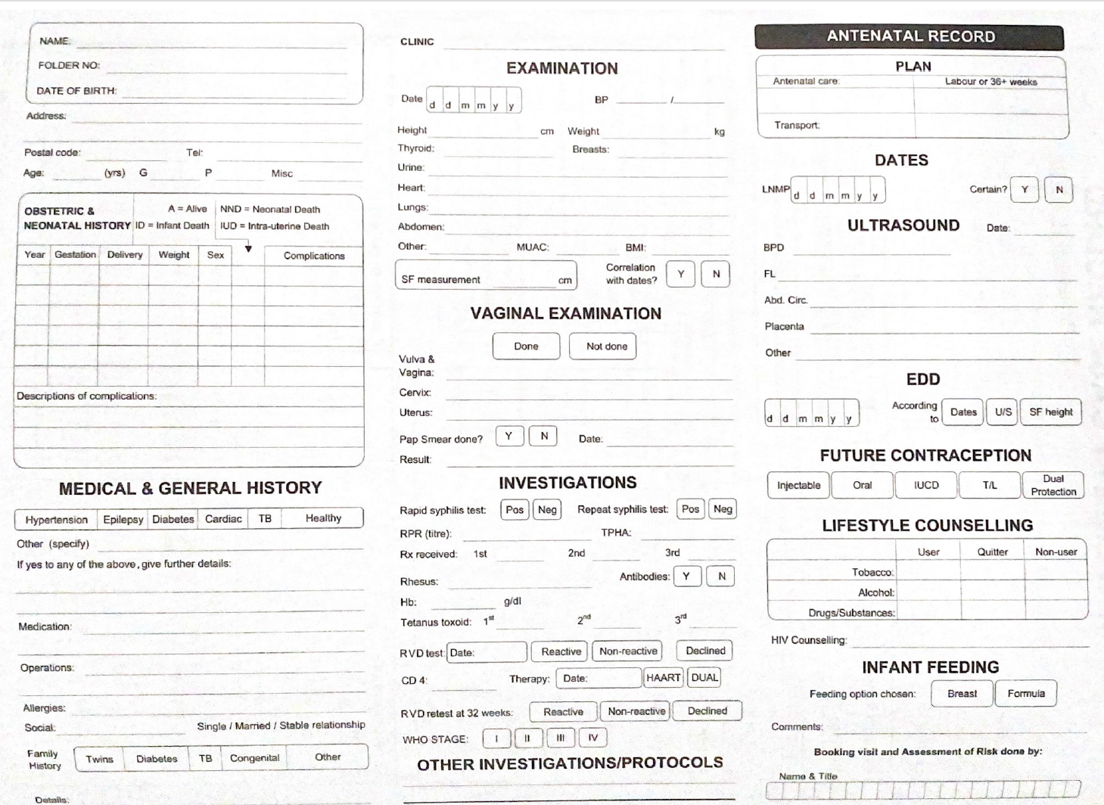
ANC

Slide 8
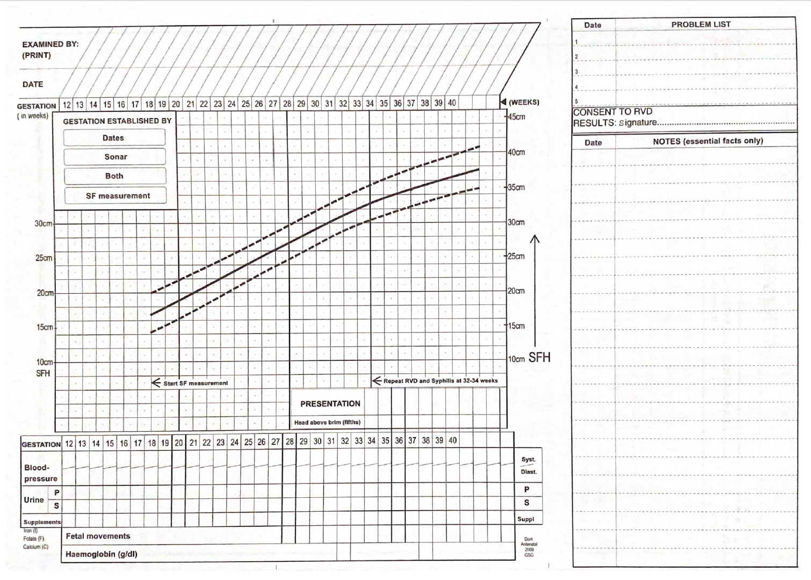

Slide 9
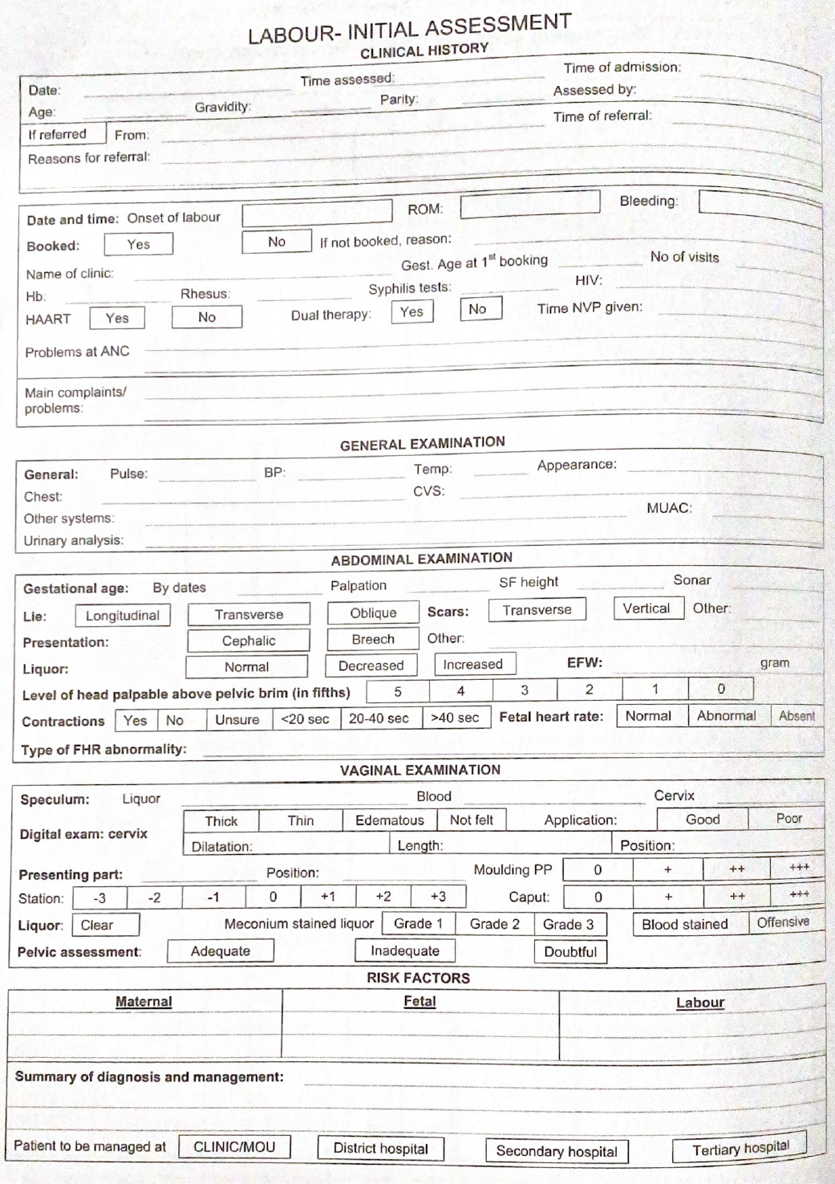
Intra-partum

Slide 10
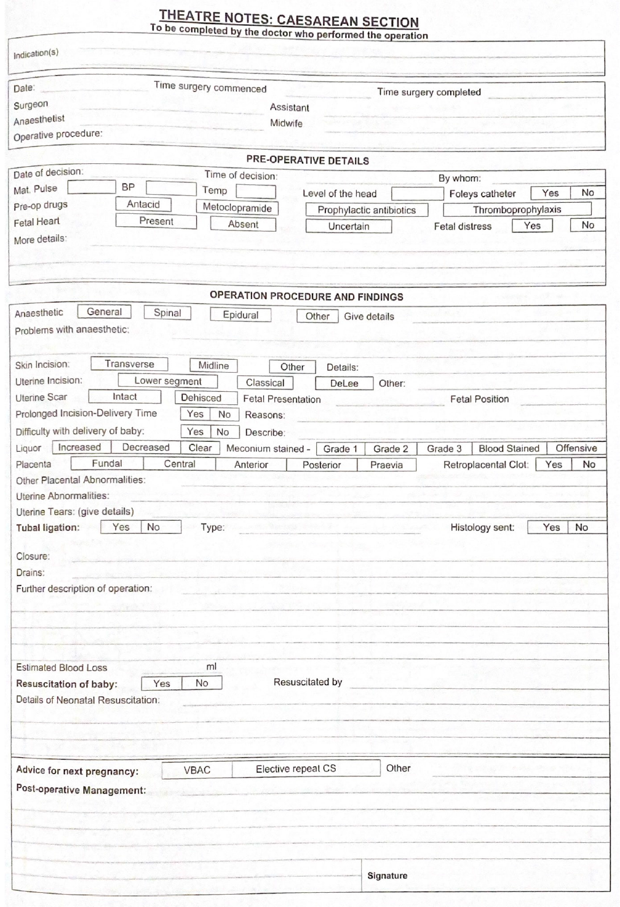
THEATRE
notes

Slide 11
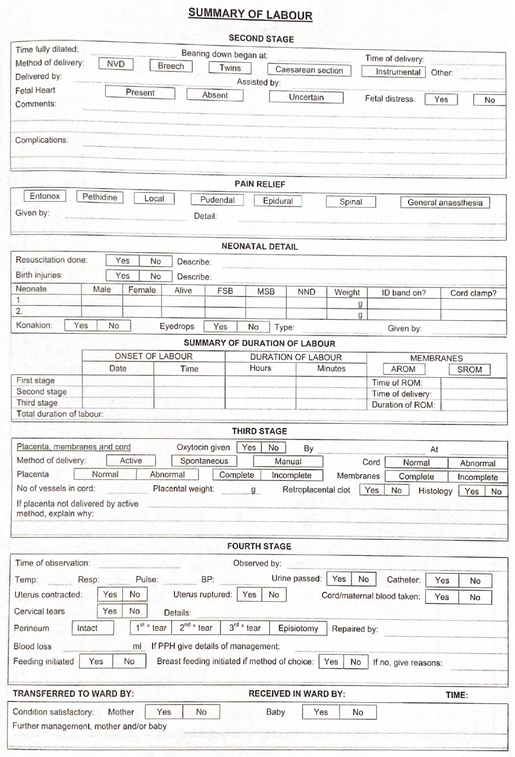
LABOUR
SUMMARY

Slide 12
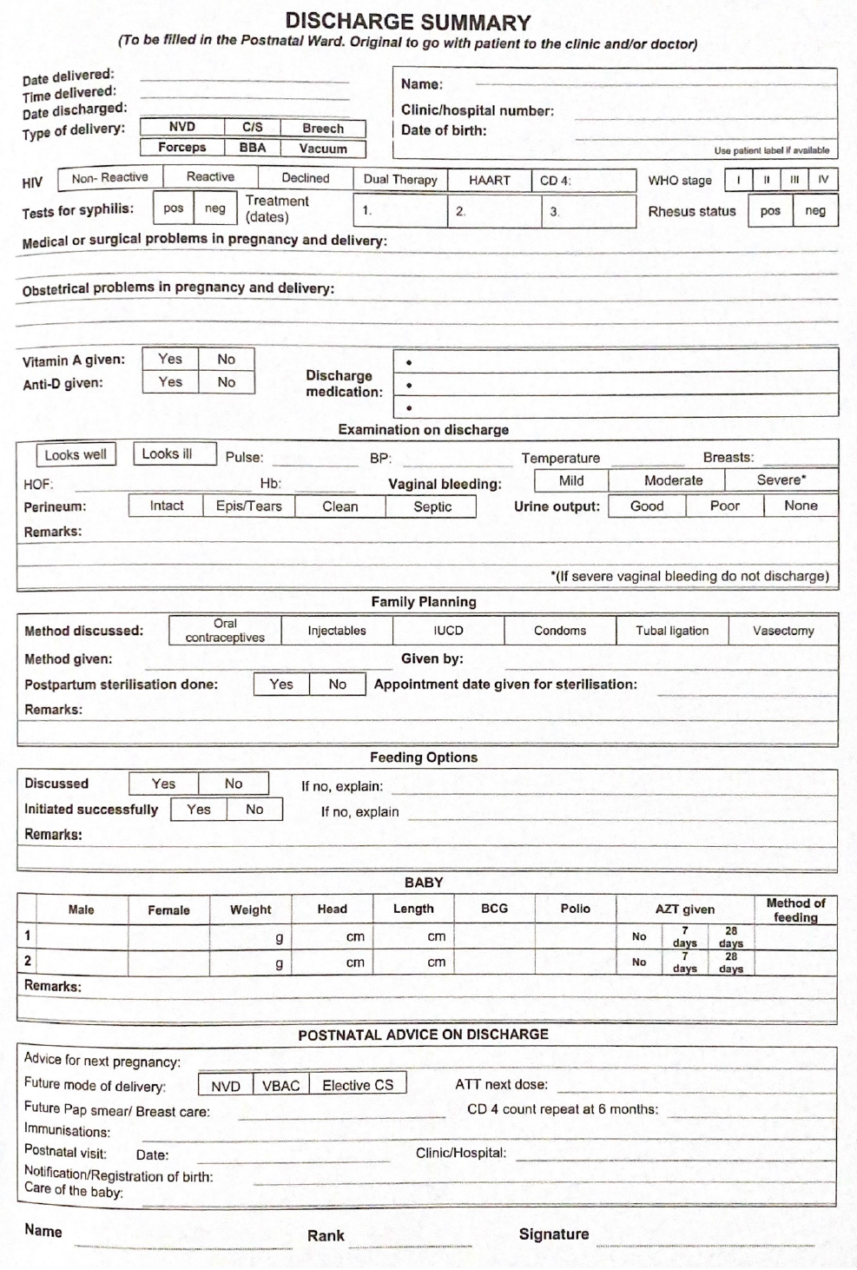
DISCHARGE
SUMMARY

Slide 13
New Maternity Case Record
Currently being rolled out

Slide 14
What has changed?
Cover page
More information about the patient
Danger signs
Screening for mental health care
More space for notes (8 BANC visits)
Updated HIV information antenatal card updated
Duplicated antenatal card
Early warning charts updated
Mental health and respectful care prompts
Fetal kick chart
Basic ultrasound reports and reports page
New observation chart for doubtful labour
New interim partogram
CTG evaluation tick boxes
Summary of labour (new definition of second stage)
Shock index added
Robson classification for CS
More space for puerperium notes
Pre-discharge safety checklist
New discharge summary
Separate booklet for anaesthetic charts, notes and consent forms
Perinatal Mental Health Projects.(2018).Maternity Case Record version 2018. Retrieved from https://pmhp.za.org/wp-content/uploads/Western-Cape-Maternity-Case-Record-Version-19-June-2018.pdf

Slide 15
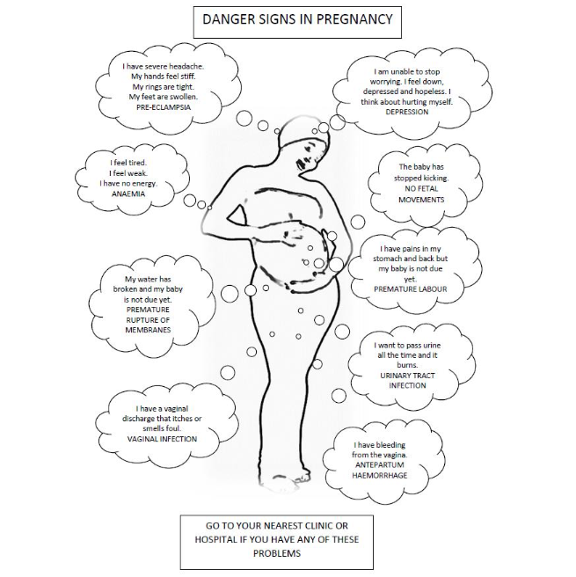
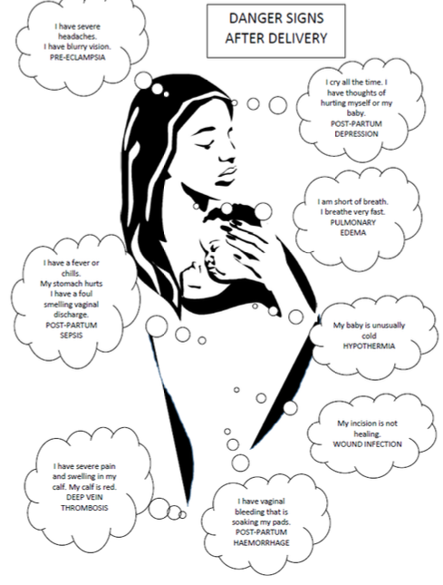

Slide 16
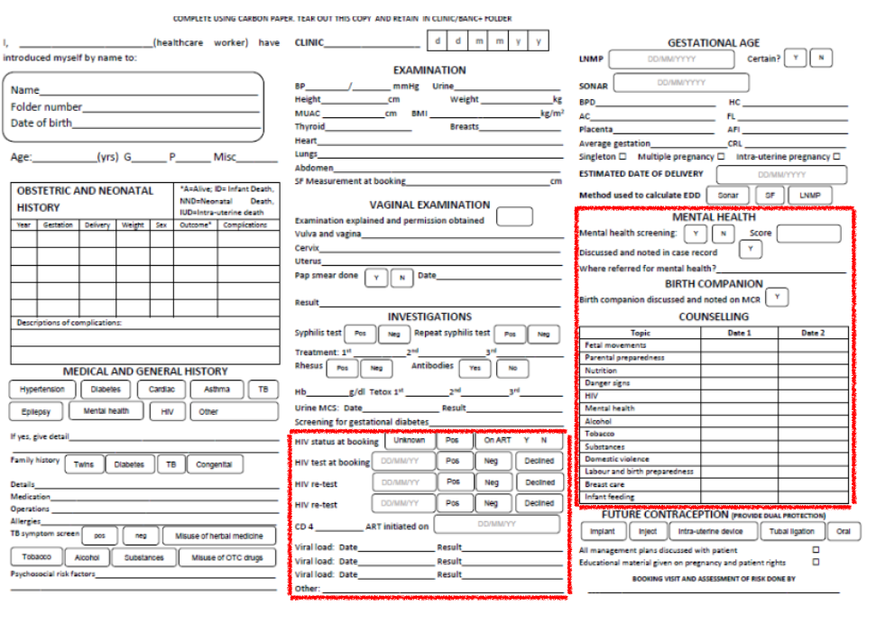
NEW
ANC

Slide 17
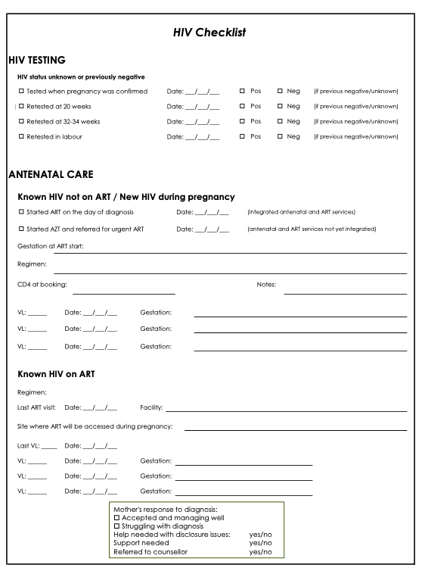
HIV
CHECKLIST

Slide 18
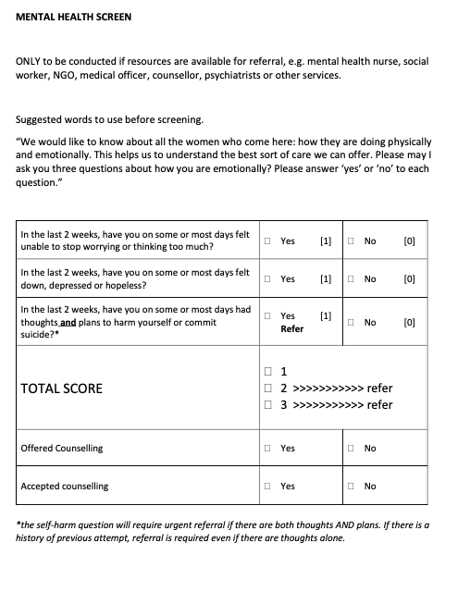
MENTAL HEALTH
SCREEN

Slide 19
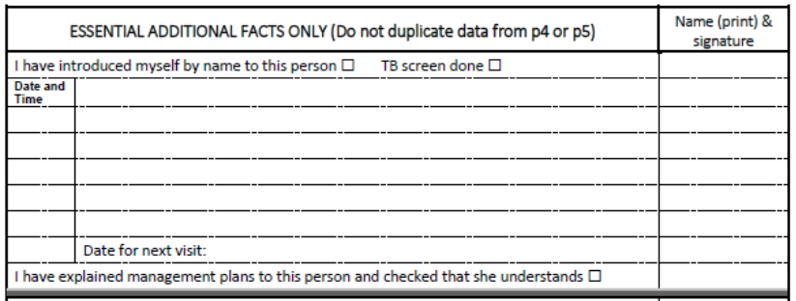
HEALTHCARE WORKER ACCOUNTABILITY

Slide 20
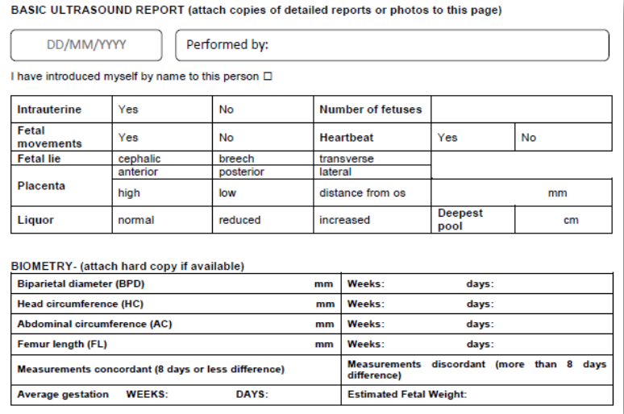
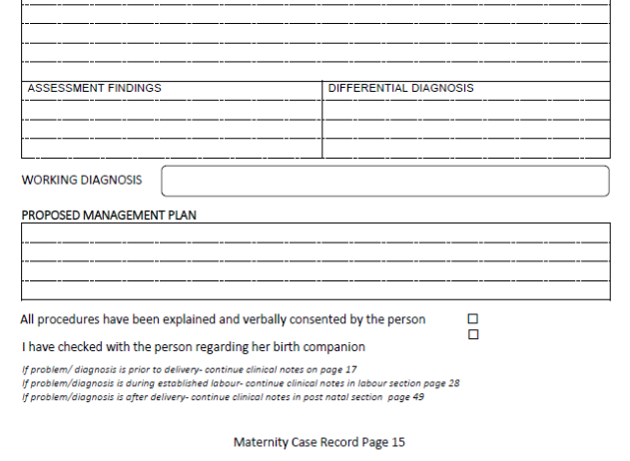
ULTRASOUND

Slide 21
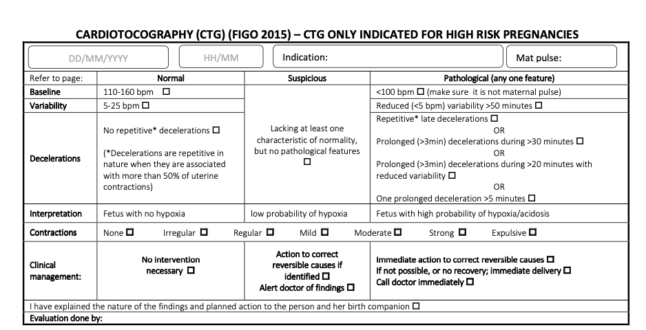
CTG

Slide 22
References
Sibiya, M.N., Cele, R.J. and Ngxongo, T.S.P., 2015. Assessment of the use of the new maternity case record in improving the quality of ante natal care in eThekwini District, KwaZulu-Natal. International Journal of Africa Nursing Sciences, 2, pp.53-58.
MOODLEY, J., Saving Mothers 2014-2016: Seventh triennial report on confidential enquiries into maternal deaths in South Africa.
Edition, F., GUIDELINES FOR MATERNITY CARE IN SOUTH AFRICA.
Perinatal Mental Health Projects.(2018).Maternity Case Record version 2018. Retrieved from https://pmhp.za.org/wp-content/uploads/Western-Cape-Maternity-Case-Record-Version-19-June-2018.pdf
Midwives Society of South Africa (unknown date). Maternity Case Record version 2018. Retrieved from https://midwivessociety.co.za/resources/
https://www.who.int/reproductivehealth/publications/maternal_perinatal_health/robson-classification/en/
http://www.statssa.gov.za/?page_id=1854&PPN=Report-03-06-03&SCH=7896

