Slide 1
Important Forms in Primary Healthcare
Shezaad Atcha
Richard Hurley
Aadilah Jogee

Slide 2
The J88

Slide 3
J88 BACKGROUND…
The J88 form is a document generated by the Department of Justice
It is to be utilised in the South African courts as the preferred method of adducing evidence in criminal matters
The form is in regard to an injury the complainant sustained
The J88 form serves as a crucial piece of evidence in cases where interpersonal violence has taken place
For example: Rape, Assault or attempted murder cases etc…

Slide 4
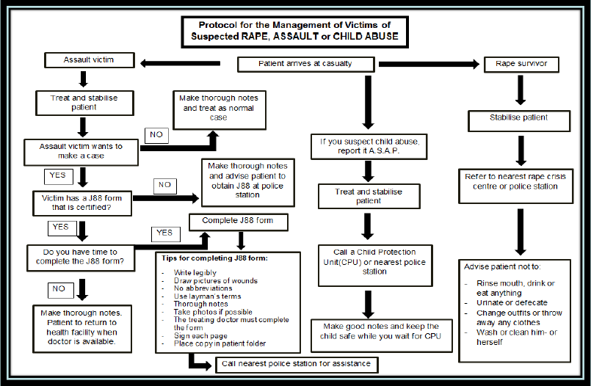
WHEN SHOULD THE J88 FORM BE FILLED?

Slide 5
J88 – PRINCIPLES FOR CORRECT COMPLETION?
Patient should firstly register a case docket via the case investigating officer
Patient should give informed consent by means of a signed and witnessed form SAP 308 (a legal requirement in sexual assault cases)
Patient should then present to HCP for examination, if previously examined, to then fill out j88
The SAP 308 form must be retained by the doctor in the patients file
According to the South African Justice system, the J88 form should be filled out by an accredited healthcare practitioner

Slide 6
GENERAL GUIDELINES FOR COMPLETION OF J88 FORMS
Diligent and in Full
In your own handwriting and signature
No acronyms (e.g. NAD) or unofficial abbreviations
Languages: English or Afrikaans
Exact descriptions, medical and legal relevance
Location of injury indicated on diagrams
Alterations countersigned and dated
No blank areas – if areas are not applicable, reasons should be stated
Black pen

Slide 7
HEARSAY INFORMATION
May submit report in other ways than J88
May include with reference
May attach:
  Clinical notes
  Laboratory reports
  X-ray reports
  Referral notes

Slide 8
CORRECT TERMINOLOGY: AVOID LEGAL TERMS
Legal terminology
  Rape – Genital, oral, anal penetration
  Sexual assault – penetration excluded
  Consent – force, unconscious, alteration in consciousness, intoxication, younger than 12 years, mentally incapable, severity in injury, number of anatomical genital sites injured

Slide 9
COMPLETION OF THE J88 FORM

Slide 10
PART I
Information obtained from SAPS 308 if patient isn’t present, else should be provided by SAPS on the form

Slide 11
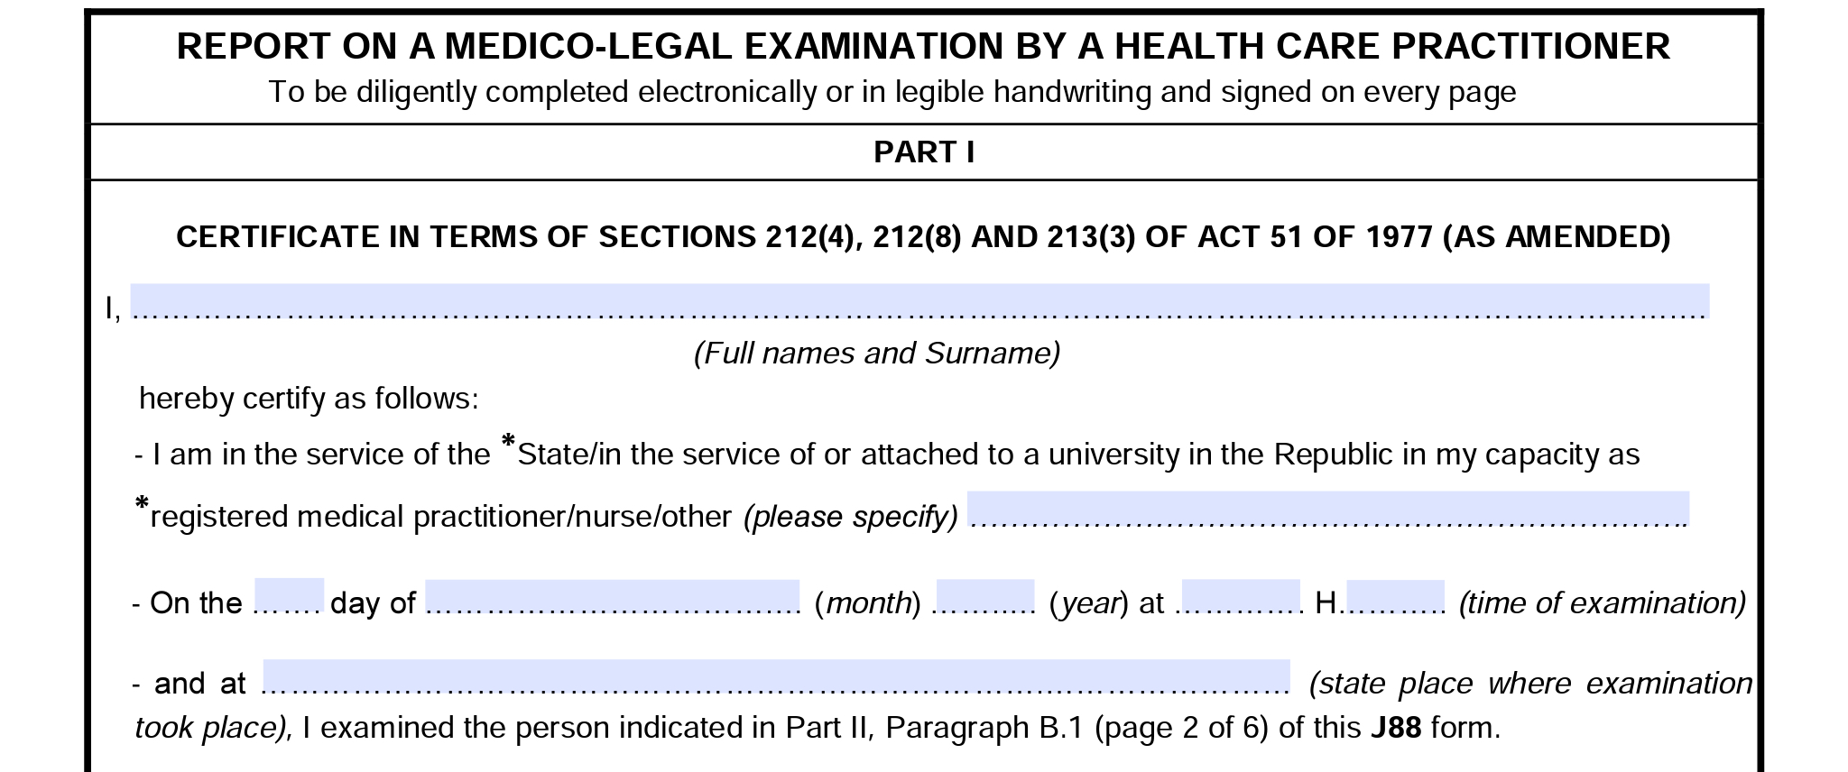
PART I
Certificate in terms of SECTIONS 212(4) and 213(3) of ACT 51 0F 1977 (as amended
Enables the court to admit the J88 as evidence without the need of the HCP to read it into evidence
HCP may still be called if deemed necessary
Forms part of the J88

Slide 12
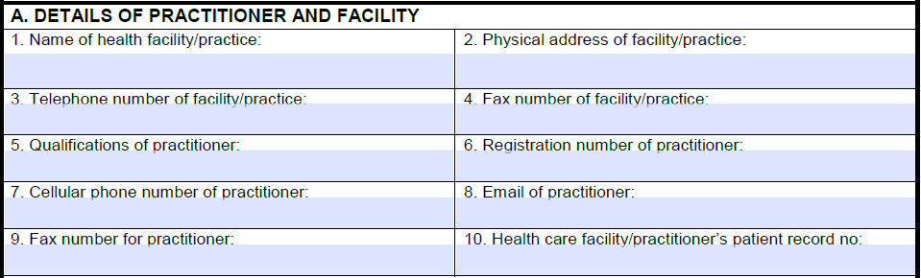
PART II
Ensure that sufficient contact details are available so you can be reached in future
Only if comfortable, no legal repercussions for not including

Slide 13
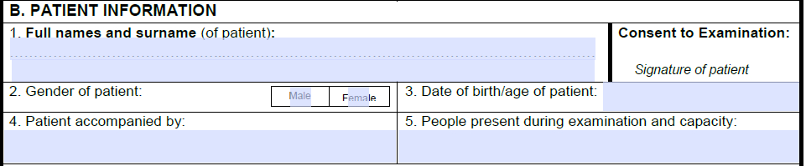
12 years or older and of sufficient maturity
Parents/guardian
SAPS 308 if not present at time of completion
Verify identity as well as possible
Physically present at the consultation/examination:
Support persons
Personnel
Interpreter
Chaperone
Students
Person who brings patient to the facility (SAPS/Social worker/Family member)

Slide 14
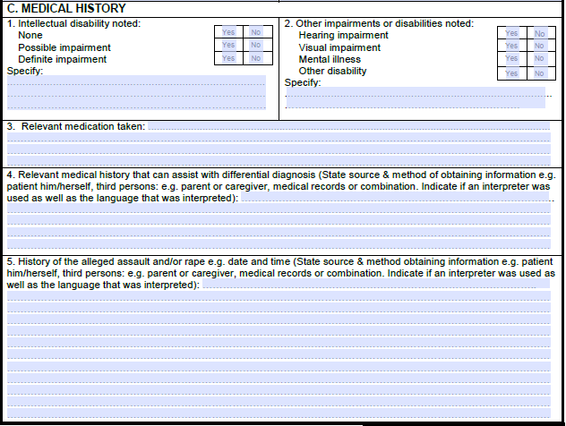
Normal intellectual function
Obvious mental disability
Any concern about disability, but needs to be assessed by expert in field
Tick when impairment present
May suggest additional evaluation if deemed necessary
• Interaction
• Side-effects
• Influence clinical appearance
• Affect mental function
• Consent during incident
• Consent for procedures
• Accuracy of history
• Cooperation with examination
• Provides differential diagnosis
Medication which is relevant to the assessment/ incident.
Complete list of medications should be listed in clinical notes.
Any medical information that is relevant to the medico legal evaluation:
• Differential diagnosis
• Reasoning
• Pathology
• Legal definition
• Conclusion • Etc
State who provided the information as this has relevance to people present at the time.
Unlikely that HIV is relevant.
Complete medical history should be noted in clinical notes.

Slide 15
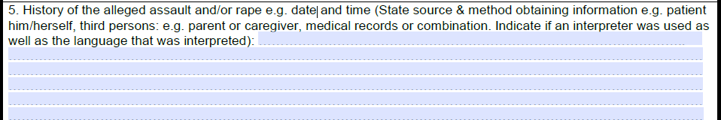
Write down information that can be medically assessed and is medically relevant. Do not write too much.
Assault:
Weapon used
Mechanism of force
Relevant actions before, during and after the incident
Rape:
Date and time
Place incident occurred (outside/inside)
Surface incident occurred
Penetration
Ejaculation
Objects used etc.
Use patient’s own words- particularly children
Again, state who gave this information, as this has relevance to people present at the time.
This medical history and history of the incident, directs the physical examination and evidence collection.
THE HISTORY IS THE MOST IMPORTANT PART OF THE EVALUATION:
IS THE HISTORY SUPPORTED BY THE FINDINGS?
IS THE FINDINGS POSSIBLE IN LIGHT OF THE HISTORY?

Slide 16
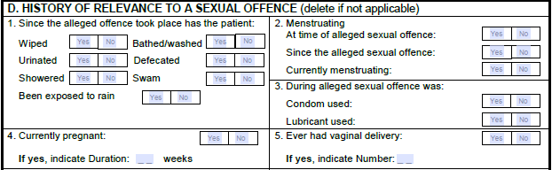
Tick the relevant responses

Slide 17
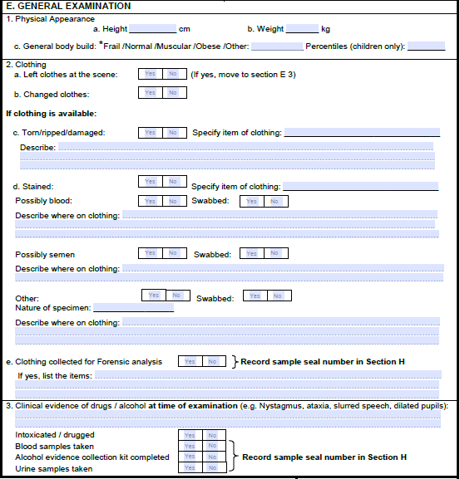
Appearance of the patient including anthropometry
Damage to also be noted as it will also aid in the development of the patient’s history.
Change of clothing to be noted and if so to report to saps and note the change.
May need to swab clothing if it may not be taken as evidence. Also note to take in foreign material and the need to swab semen if noted.
If staining is noted, it may support history and also relevant to swab the stained clothes for DNA evidence.
Objective assessment is noted in this section

Slide 18
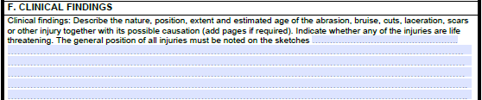
NB! Number each of your clinical findings and add the corresponding number to the diagram on which it is drawn
Noted is what was seen, felt, heard, smelt, percussed etc…- at the time of examination

Slide 19
Wound Descriptions
Describing wounds found during clinical examination
May give an idea as to the likely cause/mechanism of injury
Most common examples include incised and abrasion wounds

Slide 20
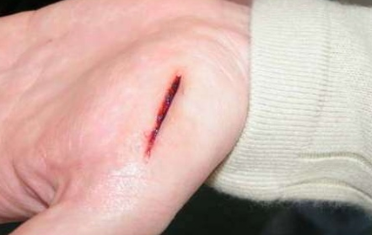
Incised wounds
Usually as a result of sharp force trauma, most commonly from a knife
Wound displays, clean and sharp edges
Stab wounds are classified as wound that is deeper than the length of the wound on the skin

Slide 21
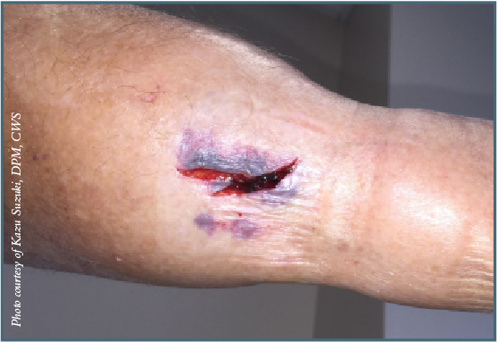
Lacerations
Tearing of skin, displaying irregular edges and accompanied often by bruises
May get tissue bridging
Caused by blunt objects

Slide 22
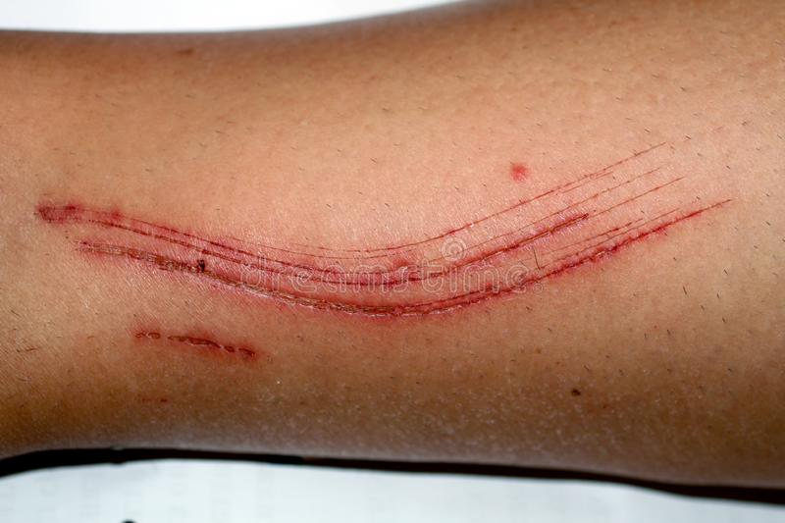
Abrasions
Superficial skin injury, usually to the superficial epidermis
Can be caused by sharp objects (scratches)
May get grazes/scrapes- contact with rough surfaces, eg. tar
Imprint abrasions also seen
Contusions/ bruises:
  Day 0-1: red/purple
  Day 2: blue/brown
  Day 3: green/brown
  Day 4-5: green
  Day 7-10: yellow
  Starts to disappear thereafter

Slide 23
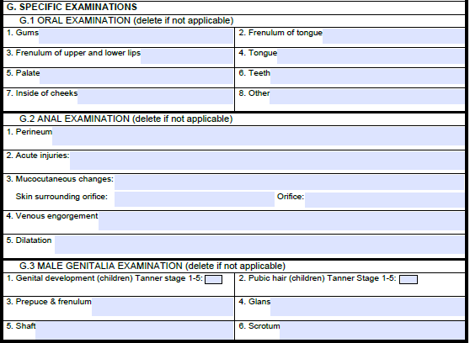
This section becomes important in general assaults and penetration in reports of rape cases.
Important to note the frenula, both the tongue and that of the upper and lower lips..
Acute injury
Structural change/healed injury
Consequences of sexual contact
All other causes for clinical picture
Note any other structures in the mouth if not noted in previous sections.
Acute injury to note TEARS.
T- Tears
E-Ecchymosis
A- Abrasion
R-Redness
S-Swelling
Note number, size and location
Note congestion and dilation from doing the prone knee-chest position to distinguish from bruising and dilation
Male genitalia: note the acute injuries with special note of the Tanner staging, penis and scrotum as well as the frenulum.

Slide 24
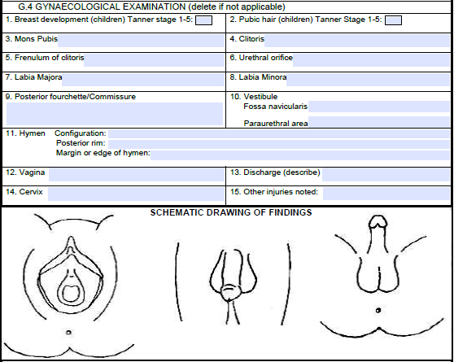
Note the physical appearance at time of examination I.E. Tanner Stage.
Common injury sites are below the 3 to 9 o’clock lines.
Fossa Navicularis and posterior fourchette are most common sites of injury.
Discharge to be noted in children and sent off for culture to note if there was sexual contact.
Configuration: crescent, annular, septate or redundant remnants. Note also the posterior rim if it is present or not and the margins if scant, narrowed or areas of absence.

Slide 25

Note the serial numbers of the kits used, the laboratory numbers if used. Note any additional medical specimens such as any collected drugs, any additional cultures and discharges noted

Slide 26

Any additional aids used

Slide 27
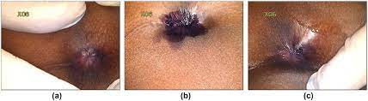
Toluidine Blue Staining
A dye with a high affinity for staining tissues containing DNA and RNA
Effective in picking up subtle injuries in the ano-genital areas
Can be used in paeds as well
Has been shown to have a higher yield of detecting genital injuries as compared to using the naked eye alone (studies showing improvements of >20% in some cases)

Slide 28
As stated earlier, additional documents and pages can be added to the J88 form. State the number of pages added where the space was insufficient and note on each of the additional pages:
Station
CAS number
Name of Patient

Slide 29

Conclusion must be factual, kept medical and have appropriate legal language.
Also include whether clinical findings are in keeping with the history, for example wounds vs mechanism of injury
Consider where relevant:
Additional causes for the picture that has been portrayed in the document
The probability, likelihood and possibilities of the document portrayed
Avoid specifics in the conclusion such as knife, addresses, specific people, keep to only what can be observer on the individual
Reference specific parts of the document that has led to this conclusion.

Slide 30

This section is important to continue the chain of evidence; can only be handed to the investigating officer through a formal transfer.

Slide 31
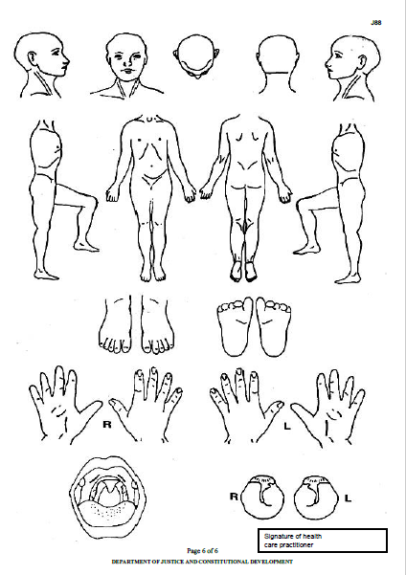
Draw diagrams as per findings of the examination. These can be numbered according to the list of clinical findings

Slide 32
ONCE COMPLETED…
Complete in duplicate or photocopy
Keep one copy within the patients records at the healthcare facility
The original copy should be handed over directly to the investigating officer
Forms not to be handed over via patients as it compromises the integrity of the findings.

Slide 33
WHEN CAN THE HCP REFUSE THE J88?
The HCP can refuse:
  When dealing with another medical emergency
  When the medical practitioner is of the view that they do not have the necessary experience/expertise to assist the patient accordingly
  If the HCP does not wish to fill in the J88, when obliged to complete the J88, they must stabilize and refer to centre, health establishment or service provider that will complete the J88.

Slide 34
OUTCOMES OF FILLING IN THE J88 FORM
Patient/victim satisfaction
J88 as a useful piece of evidence = more convictions of criminals
Closer relationship between the SAPS and HCP’s – work together to protect people and build a safer community

Slide 35
Evidence collection kits
Can be stored at certain health facilities, otherwise is to be provided by SAPS
Kits are manufactured by company called Acino Forensics, with kits available for sexual assault cases, paediatric cases and various other kits such as clothing collection and blood alcohol collection
Each kit comes with a physical user guide which is also available for download via the Acino website

Slide 36
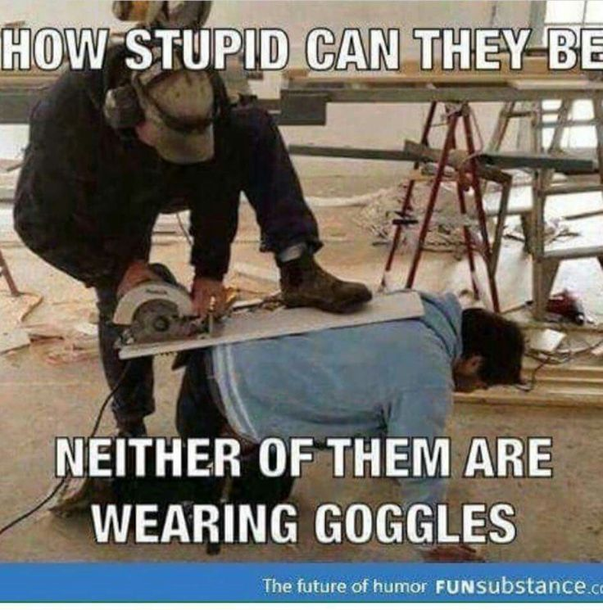
Injury on Duty forms

Slide 37
Injury on Duty Forms
Underwritten by the compensation for occupational injuries and diseases act of 1993
“If an employee meets with an accident resulting in his disablement or death such employee or the dependants of such employee shall, subject to the provisions of this Act, be entitled to the benefits provided for and prescribed in this Act.”
“Accident” meaning an accident arising from the employee’s employment, resulting in personal injury, illness or the death of the concerned employee

Slide 38
Procedure
Employer and employee to complete w.Cl.2 form
First medical report form (W.Cl.4 form) to be completed by a medical practitioner

Slide 39
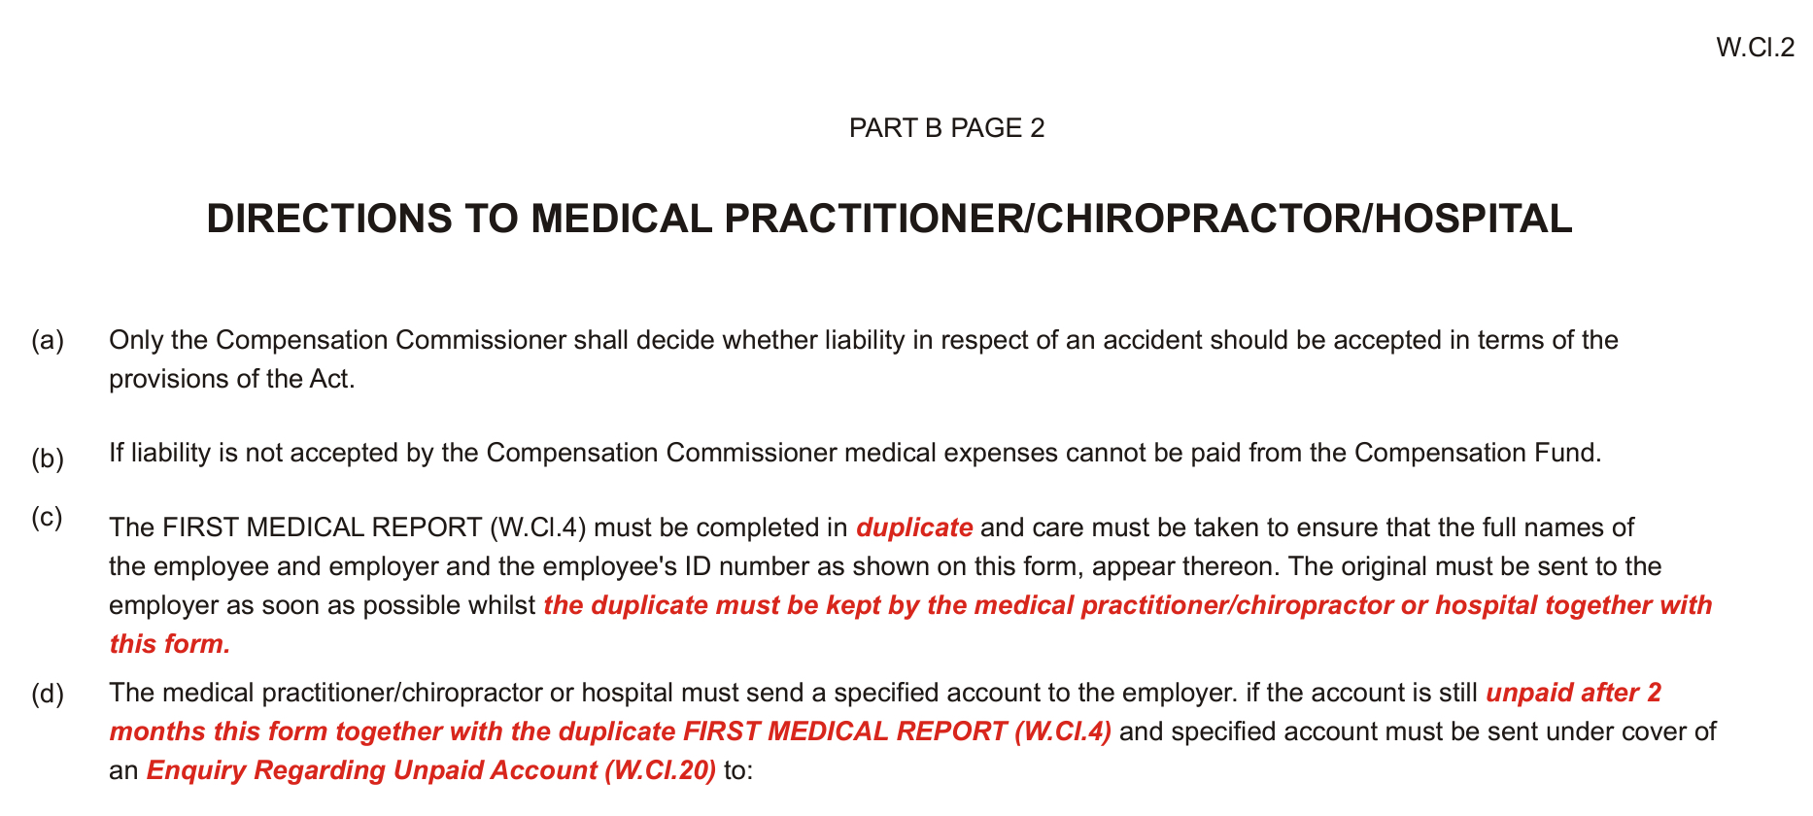
W.Cl.2 form

Slide 40
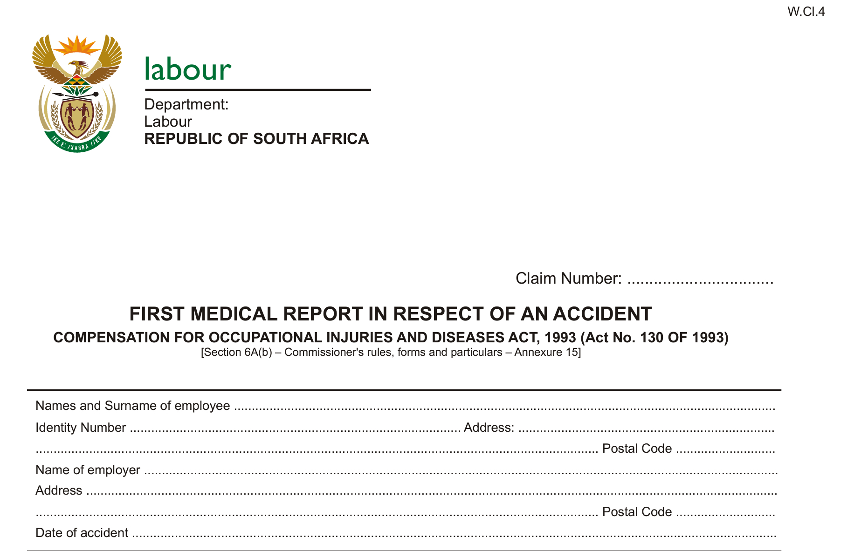
W.Cl.4 form
Demographics
Date of accident

Slide 41
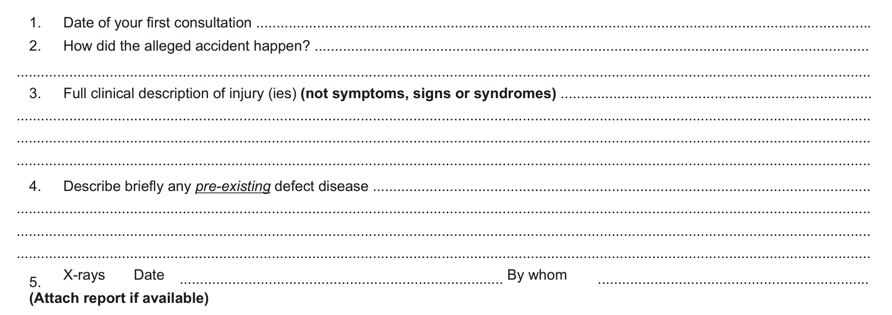
W.Cl.4 form
Short report of accident
List your clinical findings
Notes of any pre-existing conditions

Slide 42
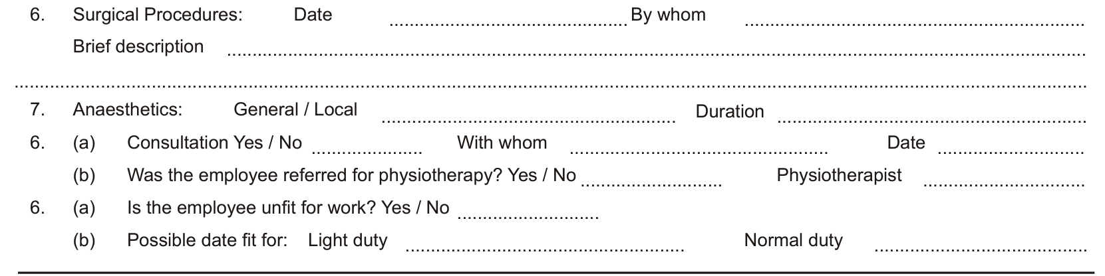
W.Cl.4 form
Any procedures done, eg. suturing
List any other practitioners if consulted

Slide 43
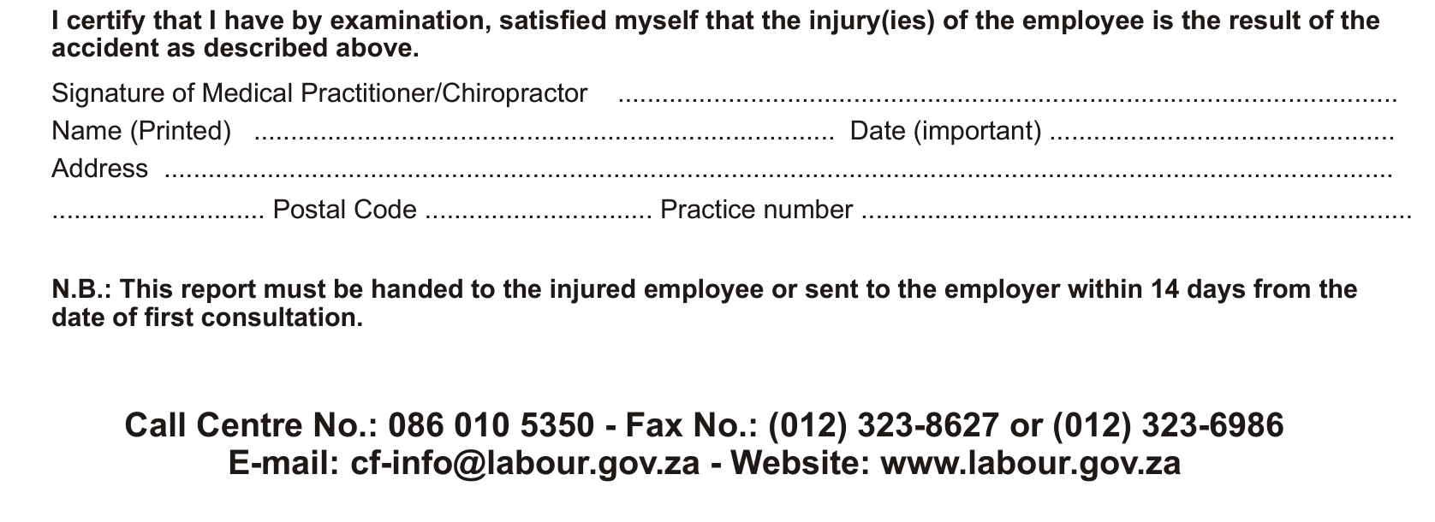
W.Cl.4 form
Your information
Must be submitted within 14 days (by employee to employer for submission to Dept of Labour)

Slide 44
W.Cl.5 form
If the occupational injury or illness is ongoing, this is to be submitted either as a final report (once the condition is stabilized and requires no further care), or as an update report (usually monthly) for submission to the Dept of Labour
As with W.Cl.4, section for demographic information (at the top) and a section for HCP details (at the end)

Slide 45
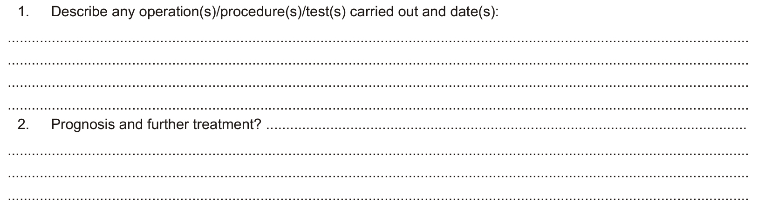
W.Cl.5 form
List any procedures/tests done since the first medical report (W.Cl.4)
Any ongoing care/treatment requirements

Slide 46
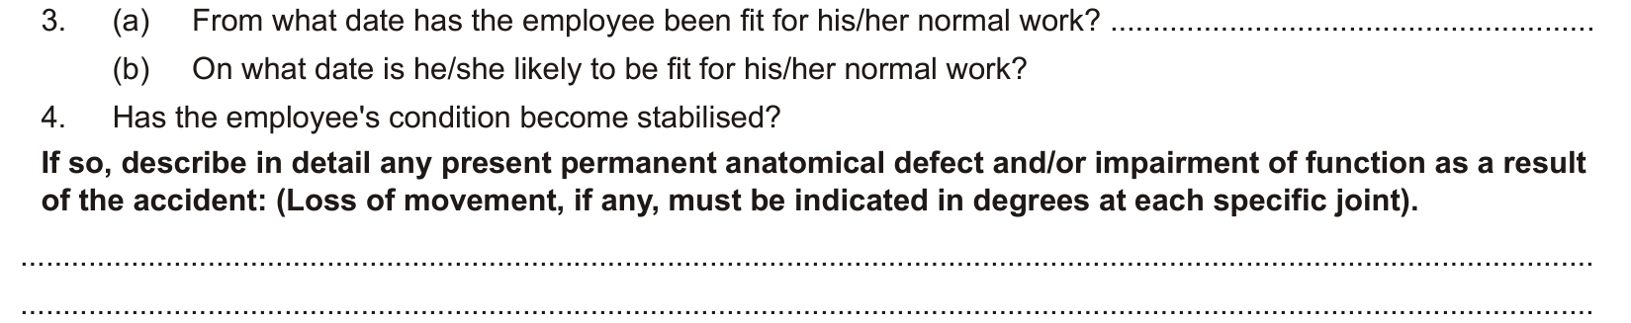
W.Cl.5 form
Relevant dates
Whether condition is stable
Any permanent sequelae as a result of the accident

Slide 47
SASSA Disability Grant Forms

Slide 48
Disability Grant Forms
Multiple requirements for applicants (incl age of 18y-65y)
Medical assessment form filled in by HCP
HCP states whether applicant should qualify/ should not qualify, according to clinical findings
Final decision lies with SASSA
No publicly available predefined list of conditions

Slide 49
References
https://www.hrw.org/legacy/reports/1997/safrica/Safrica-06.htm
V Rozzi (2014), Laceration or incised wound: Know the difference, American College of Emergency Physicians
JM Kotzé & H Brits (2018) Do we miss half of the injuries sustained during rape because we cannot see them? An overview of the use of toluidine blue tissue stain in the medical assessment of rape cases, South African Family Practice, 60:2, 37-40, DOI: 10.1080/20786190.2017.1386868
Jina, R, & Kotzé, J M. (2016). Improving the recording of clinical medicolegal findings in South Africa. SAMJ: South African Medical Journal, 106(9), 872-873. https://dx.doi.org/10.7196/samj.2016.v106i9.11081
JM Kotze ET all (2014). Medico-legal documentation: South African Police Services forms, Department of Justice forms and patient information (Parts 1-3), South African Family Practice 2014; 56(5):16-22
http://www.kznhealth.gov.za/forensic/J88guidelines.pdf
https://www.justice.gov.za/forms/other/J088.pdf
Rowe K, Botha H, Mahomed H, Schlemmer A. Justice through the J88: The doctor's role in the criminal justice system. S Afr Med J. 2013 Jun;103(7):437.
R Mogale ET al. “If it is a tear let it be a tear, not a laceration”: Form J88 as evidence in prosecution of violence against women in South Africa, African Safety Promotion Journal, Vol. 13, No. 2, 2015
J88: not just another medical form, Juniors Doctor South Africa, volume 5 issue 2, October 2014
https://www.samedical.org/images/attachments/Article%20for%20SAMA%20Insider%20-%20J88%20-%20Are%20you%20allowed%20to%20refuse.pdf
https://www.labourguide.co.za/injuries-on-duty/177-claiming-procedure-for-injuries-on-duty
https://www.dreamstime.com/photos-images/skin-abrasion.html
https://www.acepnow.com/article/laceration-incised-wound-know-difference/

