Slide 1
Head Injury and CVA
M. Dandara , T. Khumalo

Slide 2
Head Injury

Slide 3
Definition
Head Injury is defined as any trauma sustained to the :
Scalp ( contusion , abrasion or laceration )
Skull ( fractures : simple , linear , depressed, and compound fracture )
Brain ( primary and secondary brain injury )
Alternatively, it can be defined as an alteration in the mental or physical functioning related to a blow to the head and loss of consciousness doesn't need to occur.

Slide 4
Aetiology
In the South African setting an estimate of 89 000 cases of head injuries are reported annually , with the commonest causes being :
Motor vehicular accidents , bicycle or vehicle pedestrian mishaps (50%)
Falls (25%)
Violence (20%), being struck by or against objects , GSW, stabbing

Slide 5
Risk Factors
There are major risk factors for head injuries:
Extremes of age
Male gender
Alcohol and drug abuse
Wars and violence
Contact and extreme sports driving motor-cycles without helmets
Construction work

Slide 6
Common Complications
Seizures
Infections
Nerve damage
Cognitive disability
Sensory problem
Post concussion syndrome
Psychosocial problems
Coma and death

Slide 7
Management of a head injury
ASSESS AND STABILIZE
Airway
Patent and protected
GCS <9/15 requires definitive airway
Blocks and harness, not just collar!
Aim is oxygenation
Protect the C‐spine with blunt trauma
Pad the bed – no spine‐boards
Circulation
Avoid hypotension
Aim: SBP >90mmHg or MAP>70mmHg
Establish IV Access
Stop the bleeding
Splint fractures
Breathing

Slide 8
Management continued . . .
CALCULATE GCS
ASK ABOUT AND RECORD:
Type of head injury (e.g. MVA/PVA/Fall/stab etc )
How it happened
Alcohol drugs
Amnesia of events
Vomiting
Loss of consciousness /headache/dizziness
Previous brain injury
Medications
MEASURE & RECORD VITALS
Blood pressure
Pulse
Respiratory rate
EXAMINE THE PATIENT FROM HEAD TO TOE

Slide 9
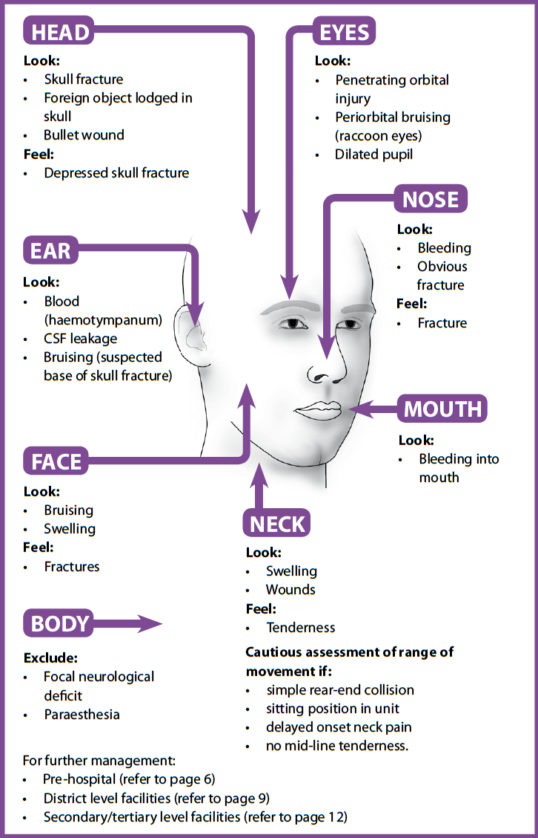
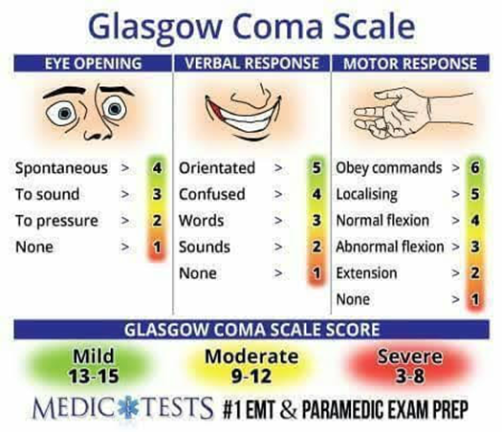

Slide 10
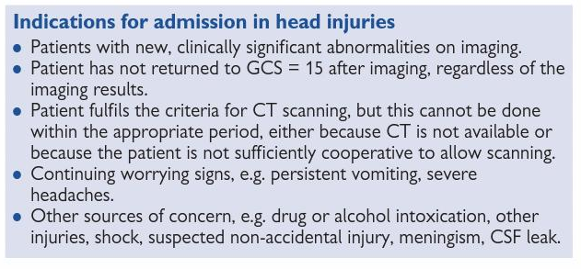
Criteria for admission, ct and neurosurgical intervention

Slide 11
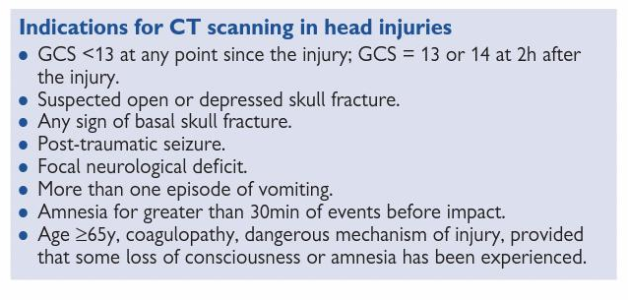
Indications for CT Scan

Slide 12
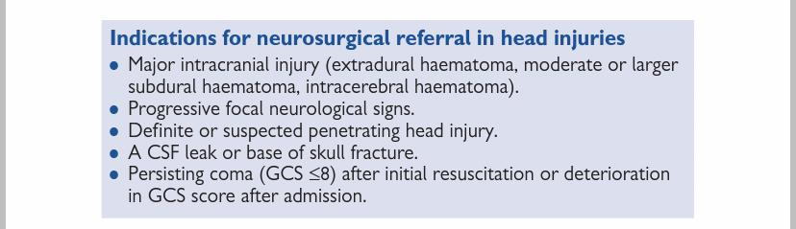
Indications for neurosurgical referral

Slide 13
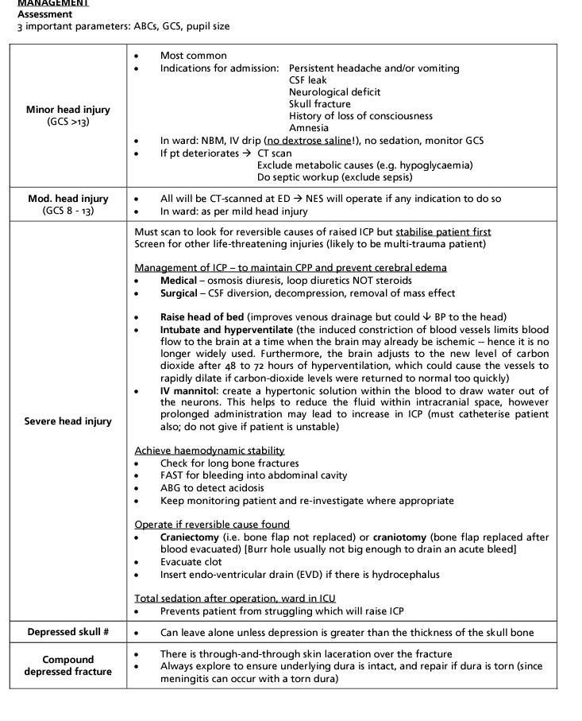

Slide 14
CVA

Slide 15
What is a stroke ?
A stroke, cerebrovascular accident (CVA), is a medical emergency that occurs when blood supply to the brain is interrupted or reduced by a clot or hemorrhage .
Why is it an emergency?
Strokes prevent the brain from receiving oxygen and nutrients. This can result in brain death within minutes .
Treatment is time sensitive, and delays can increase the risk of permanent brain damage or death.
Swift and early management is required.
TIME IS BRAIN !

Slide 16
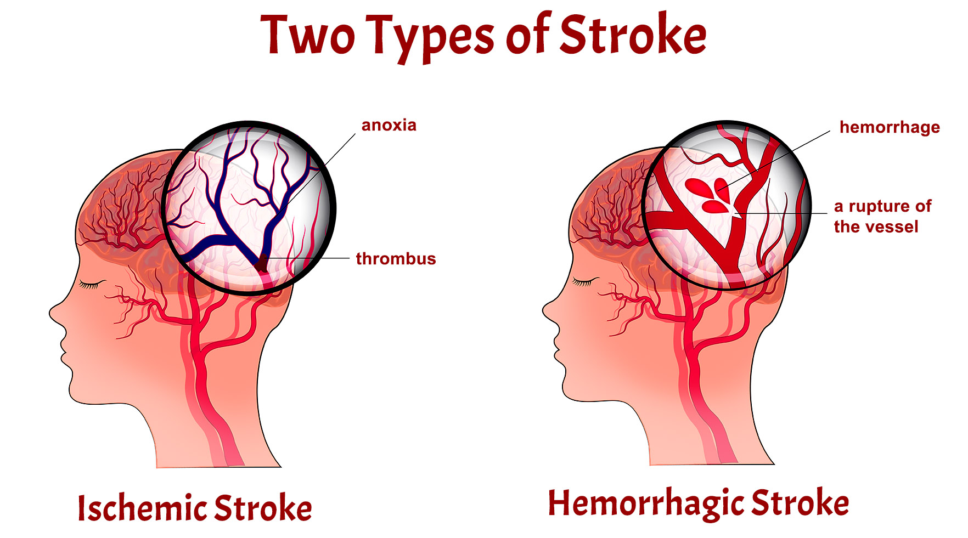

Slide 17
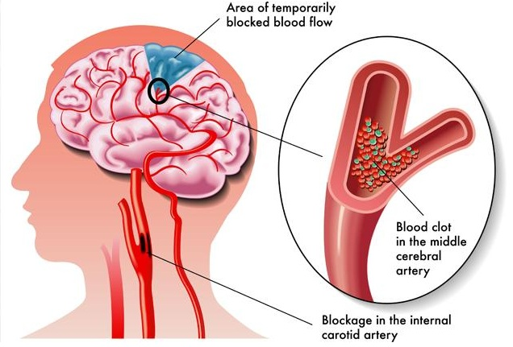
Ischaemic stroke
Most common type
Occurs when a major blood vessel in the brain is blocked
Blood clots
Plaque

Slide 18
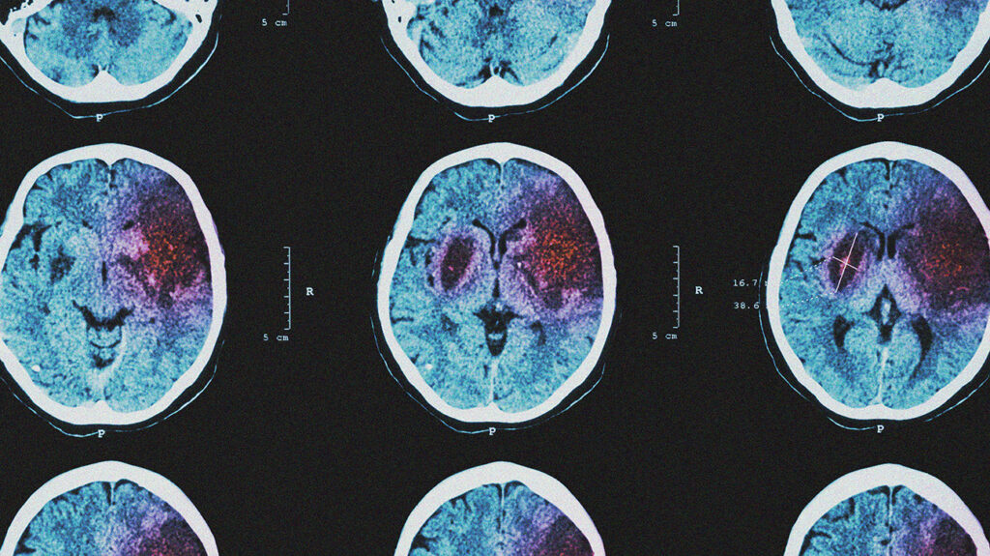
Hemorrhagic stroke
Occurs when a blood vessel burst or ruptures spilling into nearby tissues .
The leaked blood puts pressure onto the brain cells and damages them
Types of hemorrhagic stroke
Intracerebral hemorrhage
Subarachnoid hemorrhage

Slide 19
Transient ischemic attack
Aka “Mini Stroke “
Differs from major types of stroke because blood flow to the brain is blocked for a short time (less than 5 minutes) .
What is it ?
A warning sign of future stroke → Strong predictor of stroke within the next year
Most people progress from a TIA to a major stroke in 1 year if left untreated.
Also, a medical emergency
Difficult to differentiate from a major stroke.
Symptoms resolve within 24 hours

Slide 20
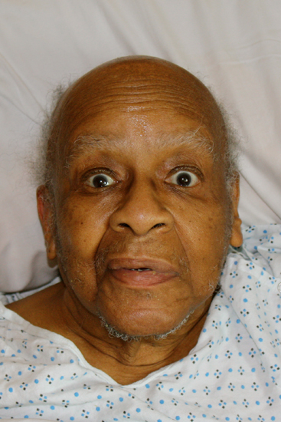
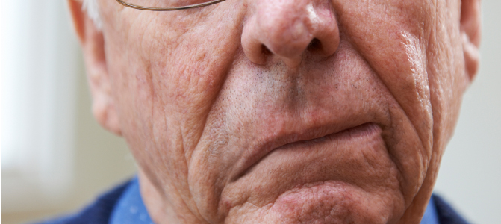
Recognizing a patient with a stroke
Sudden onset neurological loss +
Weakness , numbness / paralysis or face or limbs
Sudden onset blurred vision in one or both eyes
Difficulty speaking or double vision
Dizziness / loss of balance
Headache (severe & abrupt)

Slide 21
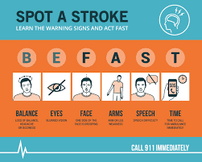
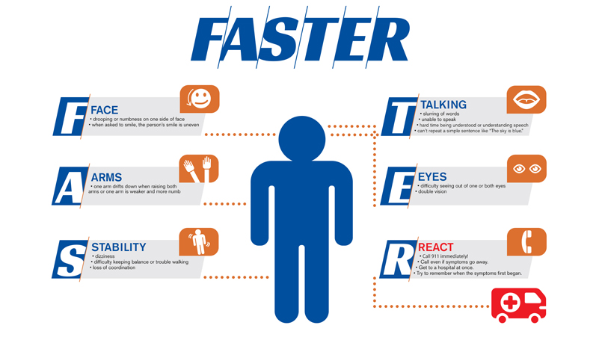
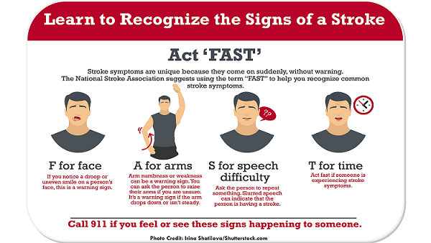
Warning signs !
F – Face Drooping
A- Arm Weakness
S – Slurred Speech
T – Time to call 911

Slide 22
Stroke mimics
Brain : Mass lesions , hemorrhage , contusion
Epilepsy : Post ictal state
Hyponatremia , Hypoglycemia , Hyperglycemia
Intoxication , Infection
Neurological : Migraine , Multiple Sclerosis
Dissection , Disc prolapse
Other : Conversion disorder (DOE),

Slide 23
Risk Factors for CVA : modifiable
High blood pressure
Heart disease
Diabetes
Smoking
Birth control pills
History of TIAs
High red blood cell
High blood cholesterol and lipids
Lack of exercise
Obesity
Excessive alcohol use
Illegal drugs
Abnormal heart rhythm
Cardiac structural abnormalities

Slide 24
Risk factors for stroke : unmodifiable
Older Age
Race
Gender
History of prior stroke
Heredity or genetics
Infectious disease : HIV

Slide 25
Management of a patient with a CVA
ASSESS AND STABILIZE
Airway
Patent and protected
GCS <9/15 requires definitive airway
Blocks and harness, not just collar!
Aim is oxygenation
Protect the C‐spine
Pad the bed – no spine‐boards
Circulation
Avoid hypotension
Aim: SBP >90mmHg or MAP>70mmHg
Establish IV Access
Stop the bleeding
Splint fractures
Breathing

Slide 26
Management continued . . .
CALCULATE GCS
ASK ABOUT AND RECORD:
Loss of consciousness /headache/dizziness
Medications
MEASURE & RECORD VITALS
Blood pressure
Pulse
Respiratory rate
EXAMINE THE PATIENT FROM HEAD TO TOE
Previous brain injury

Slide 27
Management of a CVA in the PHC setting
Acute Management
Airway , Breathing , Circulation & Disability
Measure blood glucose
Hypoglycaemic coma
Hyperglycaemic coma
Vitals → Check blood pressure
Refer immediately if raised , do not attempt to lower
NPO
Refer all patients with CVA promptly within 3 hours

Slide 28
Medication used in a patient with cva PHC setting
Aspirin 300mg , oral (Pre-referral dose)
Unless:
Unconscious
Cannot swallow
Long term anticoagulation therapy
Shows signs of subarachnoid bleed (neck stiffness/ headache)
Will be transferred and treated with a thrombolytic within 3 hours .

Slide 29
Escalation of care in Patients with cva
Refer all stroke patients !
Secondary prevention for adults → Initiated at a higher level of care
Non-contrast CTB
Haemorrhage → Consult neurosurgery
No haemorrhage → Consider Acute ischaemic stroke
Consider thrombolysis (antiplatelet therapy)

Slide 30
Thrombolysis: Indications
Clinical diagnosis of acute ischaemic stroke
Patient older than 18 years
Time of onset < 4 hours and 30 minutes

Slide 31
Thrombolysis : contraindication
Haemorrhage
Clinical presentation suggestive of SAH
Neurosurgery , head trauma or stroke in past three months
Uncontrolled HPT : SBP > 185 ; DBP >110
Previous intracranial haemorrhage
Known Intracranial arteriovenous malformation , neoplasm or aneurysm
Confirmed / suspected Endocarditis
Known bleeding diathesis (INR >1.7 & Platelets <100
Hgt <2.8 and >22.2

Slide 32
Secondary prevention
Antiplatelet therapy
Aspirin 75 – 100mg daily , oral
OR Aspirin 150mg daily , oral
Lipid lowering therapy
Hypertensive therapy
Diabetes mellitus therapy

Slide 33
What can you do in PHC for patients at risk of stroke ?
Optimise existing medical conditions
Hypertension
Diabetes Mellitus
Dyslipidaemia
Cardiac Conditions
Encourage regular physical exercise
Appropriate weight loss advice
Smoking cessation
Physiotherapy
Social
Disability Grant

Slide 34

The END

