Slide 1
INTIMATE PARTNER VIOLENCE/CHILD ABUSE
Dr Mbali Skosana
Dr Lebohang Sehlabo
Dr Bandile Msimanga

Slide 2
Definition
Intimate partner violence (IPV) is a serious, preventable public health problem.
The term “intimate partner violence” describes physical violence, sexual violence, stalking, or psychological harm by a current or former partner or spouse. This type of violence can occur among heterosexual or same-sex couples and does not require sexual intimacy.

Slide 3
Types of IPV
IPV can include any of the following types of behavior:
Physical violence is when a person hurts or tries to hurt a partner by hitting, kicking, or using another type of physical force.
Sexual violence is forcing or attempting to force a partner to take part in a sex act, sexual touching, or a non-physical sexual event (e.g., sexting) when the partner does not or cannot consent.
Stalking is a pattern of repeated, unwanted attention and contact by a partner that causes fear or concern for one’s own safety or the safety of someone close to the victim.
Psychological aggression is the use of verbal and non-verbal communication with the intent to harm another person mentally or emotionally and/or to exert control over another person.

Slide 4
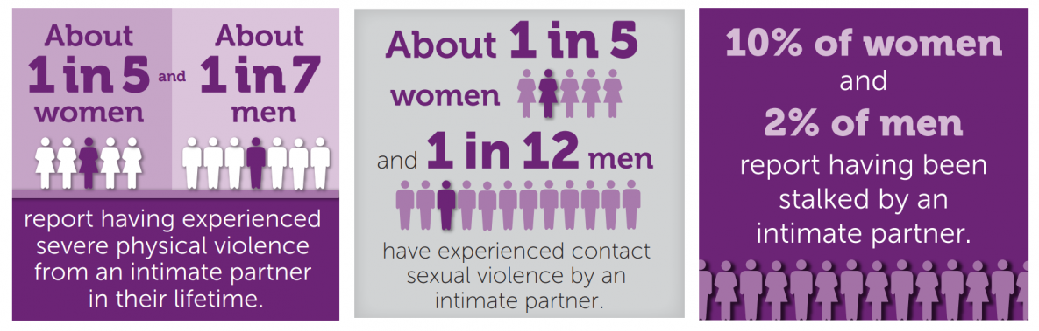
Epidemiology
A South African study found that 42% of females aged 13–23 years reported ever experiencing physical dating violence.
A survey of male college students in Ethiopia found that 16% reported physically abusing an intimate partner or non-partner, and 16.9% reported perpetrating acts of sexual violence.

Slide 5
Why Don’t Women Leave Violent Partners?
Fear of retaliation
Lack of alternative means of economic support
Concern for their children
Lack of support from family and friends
Stigma or fear of losing custody of children associated with divorce;
Love and the hope that the partner will change.

Slide 6
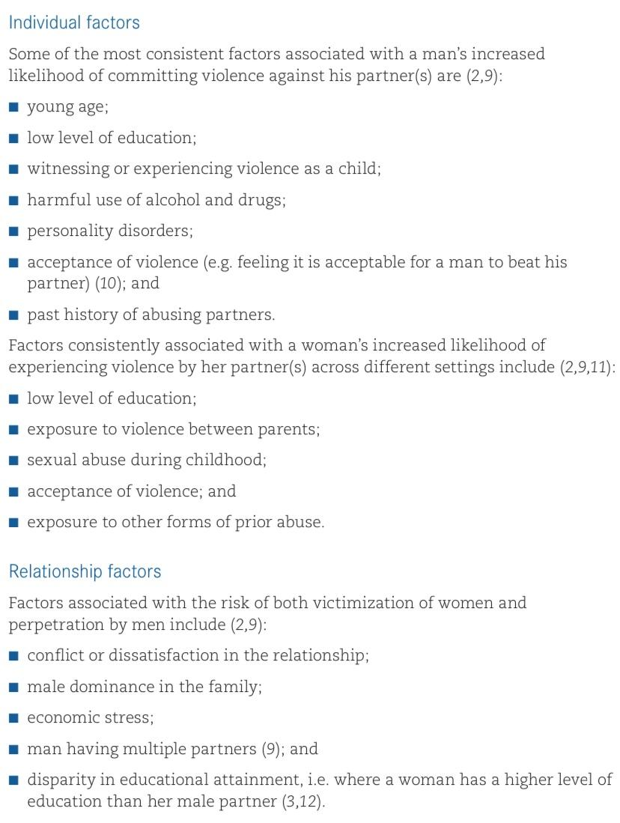
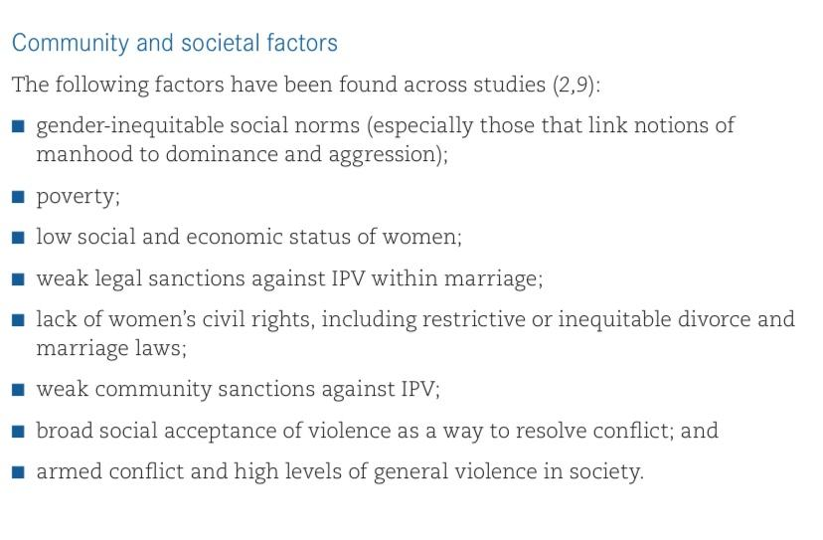
Causes & Risk Factors for IPV

Slide 7
Why Don’t Doctors Ask?
Don’t know what to do
Don’t realise how common
Afraid of emotional reaction
Assumptions about who gets abused
Assume they have to manage every aspect
Cultural norms
Frustration that women don’t leave
Time pressures

Slide 8
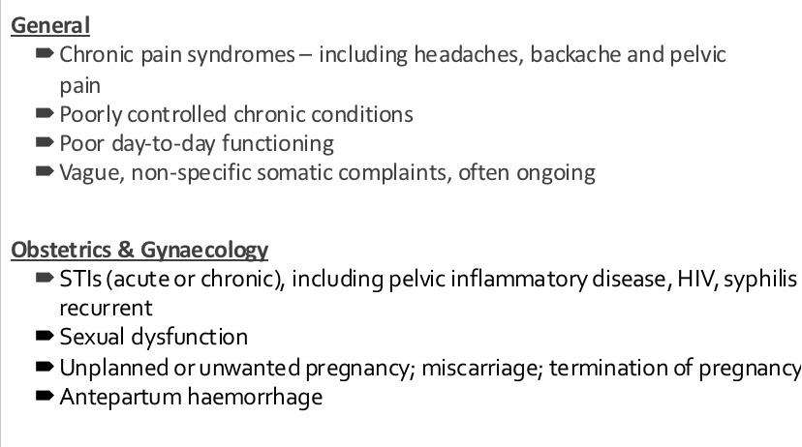
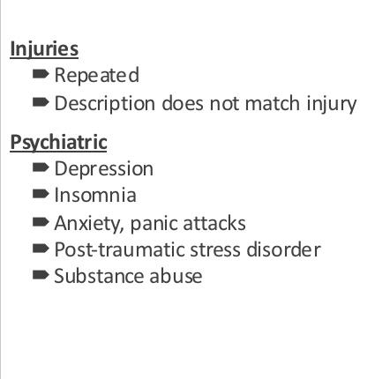
Consequences of IPV

Slide 9
Partner Behaviour
An accompanying partner who dominates the conversation, answers on behalf of the patient and/or refuses to leave the room

Slide 10
Now What?
ASK THE PATIENT
Start broad
“Is everything all right at home?”
“Are you unhappy in your relationship?”
“Are you having any difficulties with your partner?”
Normalise
“I am going to ask you a question that I ask all my patients, because it is so common. Are you being abused by your partner?”
“Have you ever felt afraid of your partner?”
“Has your partner every threatened you/tried to control you?”

Slide 11
Empower Patient – 6 Rs
Realise that abuse is happening (be aware of cues and red flags)
Recognise and acknowledge the patient’s concerns
Relevant clinical assessment
Risk assessment
CRisis plan
Refer as needed for medical, social, psychological or legal assistance

Slide 12
Recognise
Establish a relationship, confidentiality
Acknowledge patient’s story
Assure her that abuse is unacceptable and she should not be blamed
Do Not
Invalidate her complaint
Impose your own cultural frame of reference

Slide 13
Misconception: You should tell the patient to leave her partner
Never do this
Risks patient’s life and your life
Give her options which empower her to choose
Tell her you will respect her wishes

Slide 14
Relevant Clinical Assessment
What did she come her for in the first place?
What other symptoms have risen in the interview?

Slide 15
Risk Assessment
Refer
Shelter
Family support
NGO
Social worker
Medical specialist
Does the woman fear for her life or safety?
Is she being threatened with serious harm?
Are there children involved in the abuse?
Is the abuse escalating?
Is a weapon involved?
Does the partner abuse substances?

Slide 16
Legal Options
Document
Option 1
Protection order – provides for all forms of abuse and is indefinite
Magistrate’s court – specifically for IPV
Option 2
Lay a charge
Police station, will come with a J88. E.g. assault, damage to property, sexual assault etc.
Clear descriptions
Verbatim quotes
Photos
Drawings

Slide 17
Conclusion
Your main goal is referral
You will not have to face every single aspect in a given case
IPV is a complex and chronic “illness”
It can present through any discipline
It is impractical to screen all women, therefore know the red flags well
Your job is to empower through empathy and information

Slide 18
National Crisis Helpline (Lifeline) 0861 322 322
Lifeline Email Counselling: lifelinecounselling@gmail.com
Stop Gender-Based Violence Helpline 0800 150 150
People Opposed to Women Abuse 011 642 4345
Family and Marriage Society of South Africa 012 460 0733
National Network on Violence Against Women 012 321 4959

Slide 19
Child Abuse: Definitions
Abuse: deliberate harm or ill-treatment of a child
Assault or injury
Sexual abuse or allowing sexual abuse of a child
Bullying by another child
Labour exploitation
Exposure to behaviour that causes psychological or emotional harm
Neglect: caregiver not fulfilling basic parental responsibilities
Physical, intellectual, emotional and social needs met

Slide 20
Children’s Rights
Basic human rights:
The right to equality and non discrimination
The right to privacy and dignity
Section 28
The right to family/parental care or appropriate alternative care if removed from the family setting
The right to basic health care/social services
To be protected from abuse or maltreatment
To be protected from child labour

Slide 21
Responsibility as healthcare workers
Our responsibility as healthcare workers or any other organs of the state is to:
Respect children’s rights
Protect children’s rights
Promote and fulfil children’s rights

Slide 22
Prioritising their best interests
Allowing the child participate, be listened to and have their views taken seriously
Providing access to information and health education
Provide freedom and security
Protection from abuse and neglect
Provide privacy and confidentiality

Slide 23
Risk Factors
Child Characteristics | Speech and language disorders, learning disabilities, conduct disorders, and non-conduct psychiatric disease •Congenital anomalies, intellectual disability (mental retardation) or other handicaps, or chronic or recurrent illnesses •Attention deficit disorder with hyperactivity children •Prematurity and low-birth weight, although the data are conflicting •Unplanned pregnancy •Unwanted child

Slide 24
Environment | Unrelated adolescent or adult male caregiver in the household •Domestic or intimate partner violence •Animal cruelty •Acute or chronic family stressors (eg, divorce or interpersonal conflict, illness, or job loss) •Living in poverty •Social isolation (distant or absent extended family)

Slide 25
Caregiver Features | •Young or single parents •Parents with lower levels of education •Unrealistic expectations for child; poor knowledge of child development •Negative perception of normal child behaviors •Caregiver was abused or neglected as a child, leading to abuse or neglect of their own children as a learned behavior •Substance or alcohol abuse •Psychiatric illness (eg, depression, impulse disorder)

Slide 26
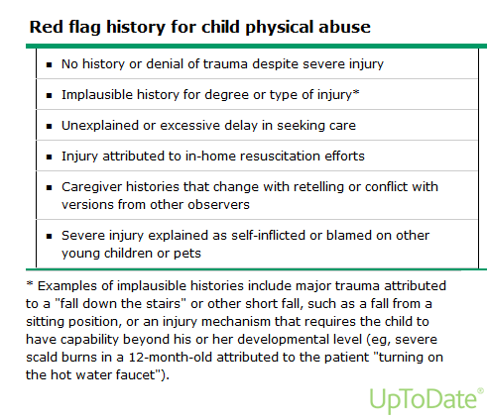
Child Abuse: Recognising

Slide 27
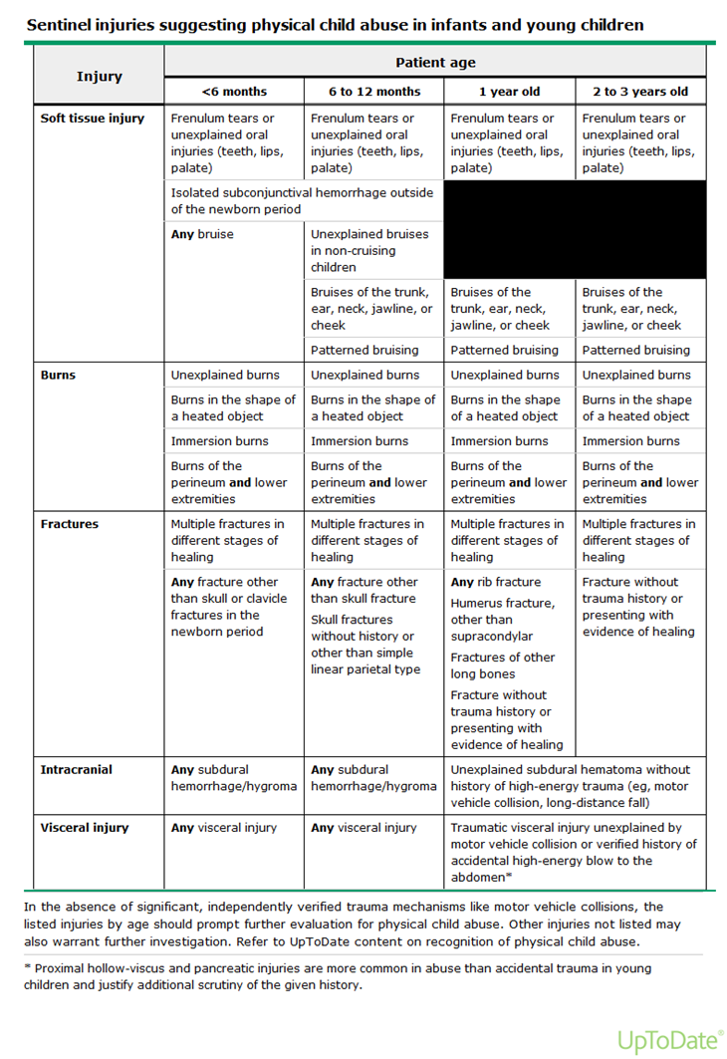

Slide 28
Reporting Child Abuse
Who can report:
Correctional official, health practitioner, social services personnel, persons working at child/youth centre
What should be reported:
Deliberate physical abuse/injury
Sexual abuse
Neglect

Slide 29
Reporting Child Abuse
When to report: when there’s evidence of abuse but suspicions thereof need to be followed through
Physical injuries: bruises, scratches/cuts, fractures, head injuries
Emotional or behaviour signs: aggression, anxiety, irritability, sadness, active or passive bullying, socially/age inappropriate sexual behaviour
Development: physical/psychological failure to thrive, withdrawal, poor speech development eg stuttering
Neglect: malnutrition, developmental delay, disorientation, poor intellectual development

Slide 30
Reporting Child Abuse
Where to report:
Child protection agencies (Childline SA, Child welfare SA)
Provincial department of social services
Police department
How to report:
Prescribed form is the form 22

Slide 31
Provincial department of social development 0800 428 428
Childline SA 0800 055 555
Child welfare SA 0861 4 24453 or email info@childwelfaresa.org.za

Slide 32
References
1. Breiding, M. J., Basile, K. C., Smith, S. G., Black, M. C., & Mahendra, R. R.
(2015). Intimate partner violence surveillance: uniform definitions and
recommended data elements, Version 2.0. Atlanta (GA): National Center
for Injury Prevention and Control, Centers for Disease Control and
Prevention.
. 2. Garcia-Moreno C et al. WHO multi-country study on women’s health and
domestic violence against women: initial results on prevalence, health
outcomes and women’s responses. Geneva: World Health Organization,
2005.
3, Jack S.P., Petrosky E., Lyons B.H., et al. Surveillance for Violent Deaths—
National Violent Death Reporting System, 27 States, 2015. MMWR Surveill
Summ 2018;67(No. SS-11):1–32. DOI: http://dx.doi.
org/10.15585/mmwr.ss6711a1external
4, Uptodate.com. 2021. UpToDate. [online] Available at: <https://www.uptodate.com/contents/physical-child-abuse-diagnostic-evaluation-and-management [Accessed 21 April 2021].

