Slide 1
COMMON DERMATOLOGICAL CONDITIONS IN PHC
ANN VAN STADEN
NABILA LORTAN

Slide 2
OVERVIEW
BASIC ANATOMY AND PHYSIOLOGY
PRINCIPLES OF DIAGNOSIS
BASIC DEFINITIONS OF LESIONS
PRINCIPLES OF TREATMENT
COMMON CONDITIONS

Slide 3
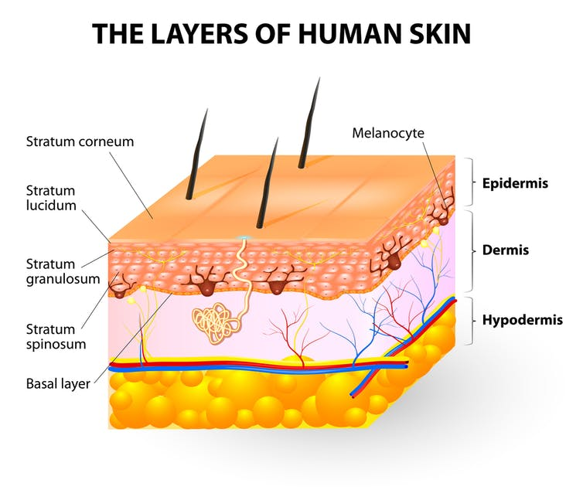
BASIC ANATOMY AND PHYSIOLOGY
  Anatomy of the skin
  FUNCTIONS OF THE SKIN

Slide 4
PRINCIPLES OF DIAGNOSIS
HISTORY- DURATION, SITE, SPREAD, INDEX, PREVIOUS RX, CONTACTS, OCCUPATION/HOBBIES, PSYCHOSOCIAL IMPACT
EXAMINATION- EXPOSURE, DEMOGRAPHICS, SITE, DISTRIBUTION, LOCATION ON BODY, PRIMARY LESION

Slide 5
DEFINITIONS
PRIMARY LESION- erythema, oedema, wheal, macule, vesicle, bullae, pustule, papule, nodule, plaque, papilloma, patch
Secondary LESION- scales, crusts, infection, pigmentation, lichenification, excoriations, erosions, ulcer, fissure

Slide 6
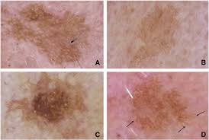
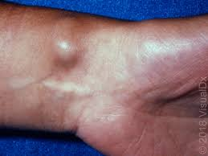
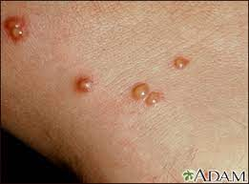
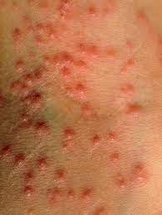
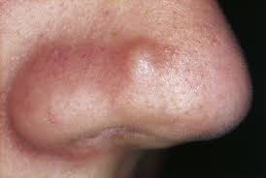
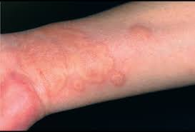
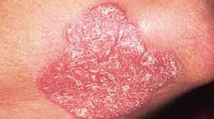
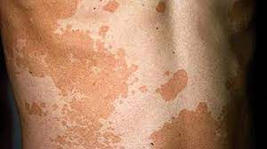
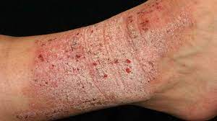
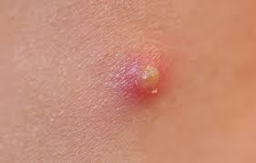

Slide 7
PRINCIPLES OF TREATMENT
TOPICAL - LOTIONS, OINTMENTS, CREAMS, PASTES, WET DRESSINGS, antibiotics
SYSTEMIC TREATMENT- CORTICOSTEROIDS, ANTIBIOTICS

Slide 8
Common DISORDERS

Slide 9
ECZEMA
DEFINITION- immunologically mediated inflammatory skin disorder
CAUSES- external, internal, alone or in combo
SYMPTOMS- rash, itchy, red, dry, seasonal
SIGNS-
  Acute (primary lesion): erythema, oedema and superficial vesicles, can become crusted, wheeping , scaling and pustules if secondary infection (Secondary lesions)
  Subacute- papules and scaling
  Chronic- lichenification, changes in pigmentation

Slide 10
ECZEMA CONT.
CLASSIFICATION
constitutional (endogenous)- hereditary
    Atopic- ass with hayfever, urticaria, asthma and raised Ige (common in infants and children)
      Clinical types: Infantile, Flexural, Follicular, Nummular, Hand and foot
    Seborhoeic- skin regions with large sebum production and large body folds
      Clinical types: Infantile, Scalp, Blepharitis, Eyebrows scaling, Intertrigenous, Ottitis externa, Sun sensitive
Elicited by various factors
    Local causes in skin: dryness, infection, contact dermatitis, venous hypertension, trauma, uvl, sweating
    Systemic: infection (tonsilitis), drugs (penicillin)

Slide 11
ECZEMA CONT.
MANAGEMENT-
    Educate
    avoid triggers
    bathe (Emulsifying agents)
    moisturize (emollient, diluted corticosteroids)
    treat infections
When to refer- resistant to treatment

Slide 12
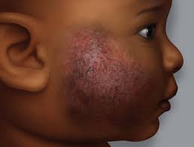
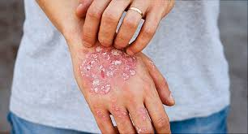
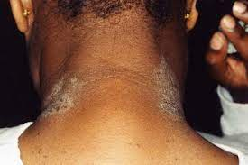
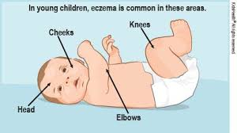
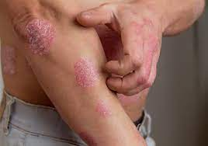
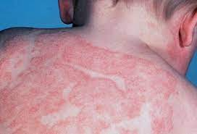
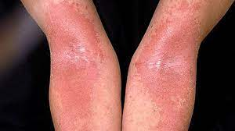
pics

Slide 13
PSORIASIS
DEFINITION: t-lymphocyte inflammatory mediated disease
CAUSES: GENETIC AND ENVIRONMENTAL DISPOSITION
SYMPTOMS: persistent, remissions, itchy, red, scaly
SIGNS-
  PRIMARY LESION- plaque (thick and silvery white), scaly, well circumscribed, raised, red, Auspitz sign, Koebner phenomenon
CLASSIFICATION- plaque, guttate, flexural, arthritic, pustular, nail

Slide 14
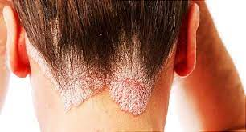
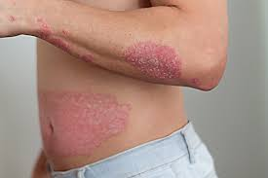
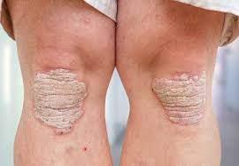
PSORIASIS CONT.
MANAGEMENT:
  topical- coal tar, corticosteroids, calcipotrial (vit D derivative), Tazarotene (vit A )
  Systemic- methotrexate, retinoids, cyclosporin

Slide 15
ACNE VULGARIS
DEFINITION: chronic inflammatory disorder of pilosebaceous follicle
CAUSES: hormonal, genetic, climate, diet, psychological, drugs
SYMPTOMS: large pimples on face having psychosocial impact, pain, infection
SIGNS:
  Primary lesion- comedone (open/ closed), papules, pustules, nodules, cysts, scars
CLASSIFICATION: vulgaris, conglobate, fulminans, cosmetic, occupational

Slide 16
ACNE VULGARIS CONT.
MANAGEMENT:
  Topical- comedeolytic agents- benzac gel, oil free products
  Decrease sebum production
      systemic retinoids (orotane)
      Hormonal (COC)
  Reduce microorganisms and decrease inflammation
      topical- antiseptics, antibiotics
      Systemic- antibiotics and steroids for severe forms

Slide 17
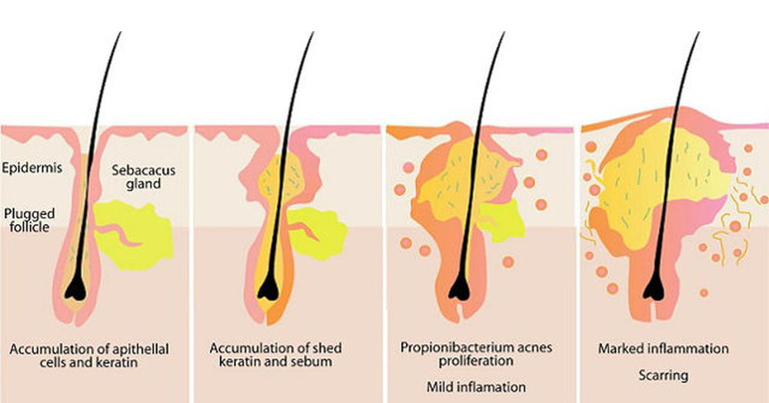
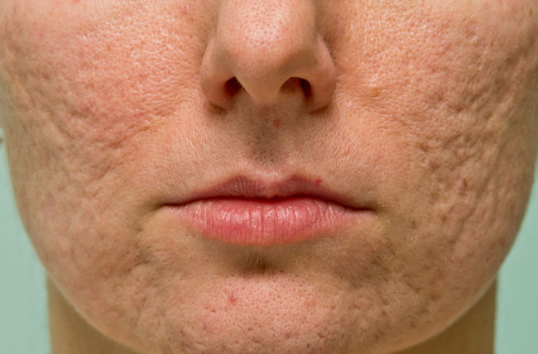
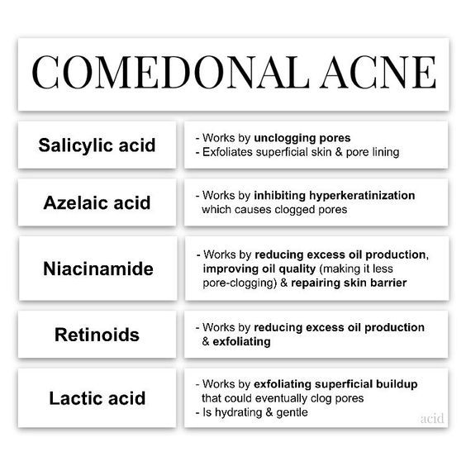
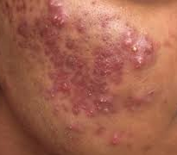
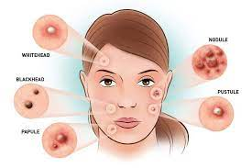

Slide 18
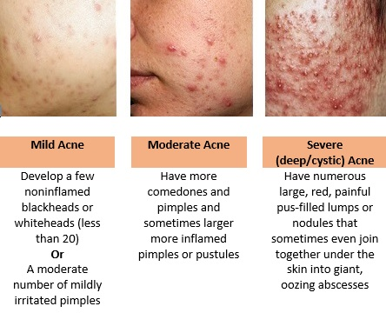

Slide 19
INFECTION RELATED SKIN CONDITIONS
IMPETIGO
  causes- staph aureus/ beta haemolytic strep
  most common in kids, highly contagious, may follow minor trauma, scabies, eczema or occur denovo.
  Lesion: superficial, thin walled vesicle, ruptures to exude a serous (strep)/ purulent (staph) fluid which dries to form crusts
  RX- topical antiseptic/ antibiotic ointment, oral antibiotics
Molluscum Contangiosum
  self limited epidermal viral infection caused by pox virus-
  highly contagious, Occurs in children, sexually active adults, HIV
  Lesion- dome shaped papule with central umbilication through which thick white substance can be expressed
  RX: reassure, irritate and create immune response, topical irritants- lactic and salicycic acid, silver nitrate sticks, cryotherapy, curettage, home remedy- lemon peel soaked in vinegar

Slide 20
INFECTION RELATED SKIN CONDITIONS CONT.
3. TINEA
  dermatophytes(ring worm)- infect keratinized epithelium, hair follicles and nails
  named according to anatomical site (capitis, corporis, manuum, pedis, cruris)
  Lesion: round patches of hair loss with scaling, round active raised scaly edge
  RX- consider underlying causes (DM, HIV), avoid dampness, hygiene NB, topical- ointment- clotrimazole, terbinafine cream; oral- griseofulvin, itraconozole, terbinafine
4. MEASLES
  Caused by rubeola virus, highly contagious
  Cough, conjunctivitis, coryza and fever, Koplik spots
  RX- notify, isolation, symptomatic, self limiting

Slide 21
INFECTION RELATED SKIN CONDITIONS CONT.
CHICKEN POX
  caused by VZV, highly contagious, Constitutional symptoms
  Successive crops of pruritic vesicles, pustules, crusts, scars.
  RX- self limiting, symptomatic rx, isolation
HERPES ZOStER
  reactivation of VZV causing acute dermatomal infection
  Unilateral pain, versicolor or bullous eruption
  Rx- systemic steroids for neuritis, oral acyclovir, IV acyclovir for severe disseminated, treat secondary infection, if involves eye- for opthalm referral.
HERPES SIMPLEX
  HSV1 (genital, lips, mouth cornea), HSV2 (genital, perianal)
  Primary infection- gingivostomatitis, secondary infection- fever blisters, cold sores (clusters of vesicles on red base)- dry up within 2 weeks. Recurrent HSV- precipitated by fever, sun exposure. Mainly in immunosuppressed patients
  RX- acyclovir IV/oral for severe infections

Slide 22
INFECTION RELATED SKIN CONDITIONS CONT.
SCABIES
  infestation of the skin by the human itch mite- sarcoptes scabiae. Highly contagious
  Mite burrows into the upper layer of the skin where it lives and lays it eggs
  Symptoms- intense itching and pimple- like skin rash(papular rash- vesicles, tiny blisters and scales).
  Common sites: wrists, webbing, waist, belt line, elbow, buttocks. Spreads by prolonged, direct skin to skin contact
  Rx- cut fingernails, wash bedding and underclothes in hot water, expose all bedding to direct sunlight. Benzyl benzoate 25% lotion- 24hrs. All contacts should be treated, prometherin lotion if benzyl not working
WARTS
  Classification- Common, plane, plantar, venereal. All caused by strains of HPV
  Lesions- pappilomatous warty surface
  RX: Topical irritants- lemon peel and vinegar, salicylic acid, silver nitrated stickes, cryotherapy.

Slide 23
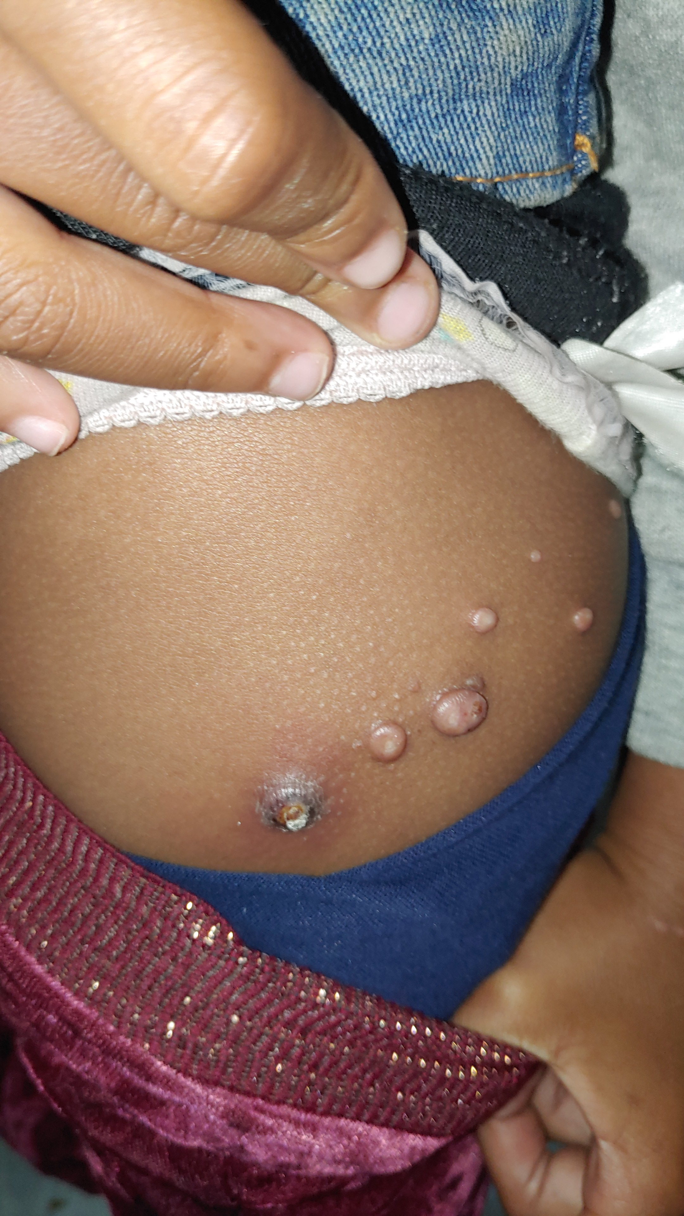
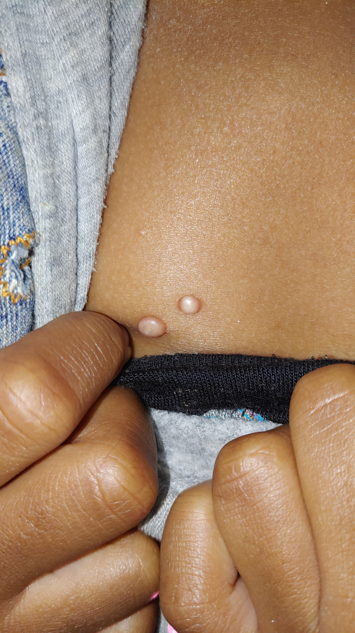
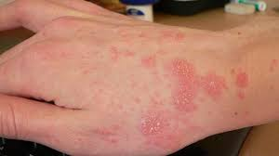
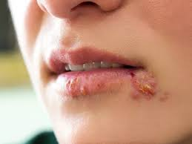
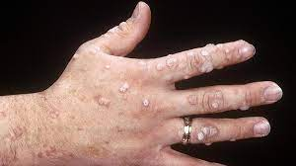
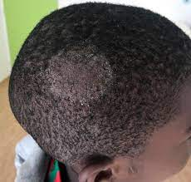
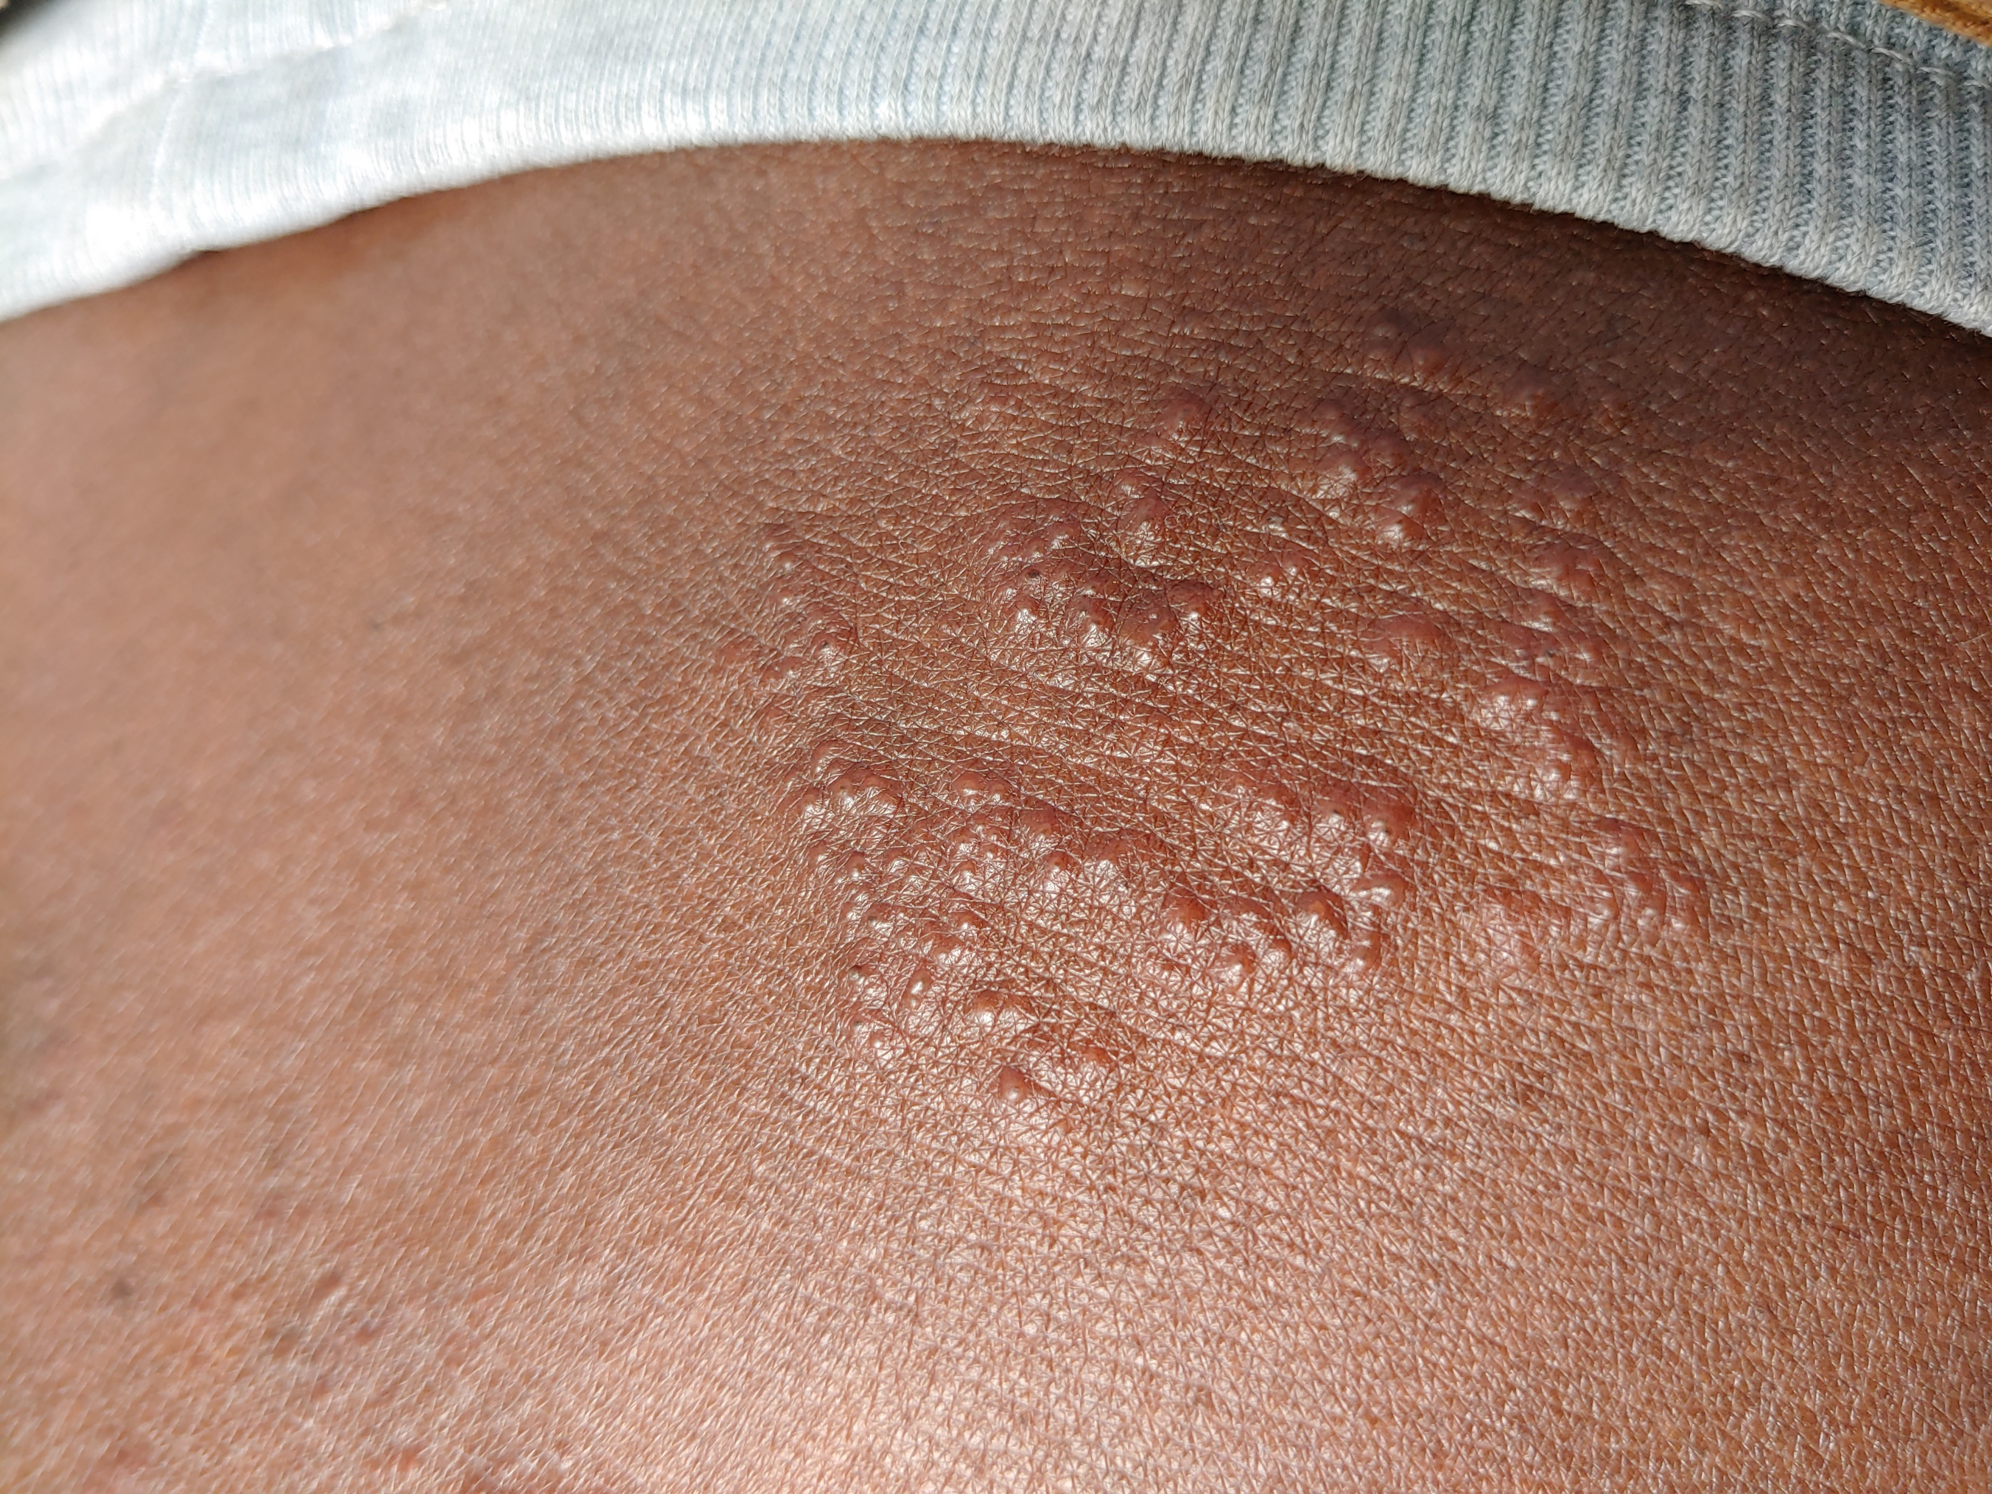
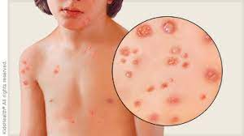
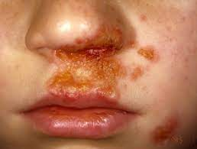
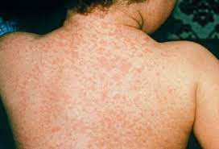

Slide 24
PIGMENTATION RELATED SKIN DISORDERS
TYPES: hyper and hypo
Hypopigmentation- pityriasis alba, vitiligo, albinism.
  Vitiligo
    acquired localised loss of melanocytes due to auto-immune destruction, occasionally associated with Hashimoto’s, pernicious anaemia, DMT1
    Clinically- well circumscribed, usually symmetrical light patches. Start small but coalesce to form irregular, sharply demarcated borders
    RX- unsatisfactory- potent topical corticosteroid cream (not longer than 3/12). PUVA (sorolin- tab/topical), UVA rays, sunscreen, cosmetic covers.
Hyperpigmentation- post inflammatory, chloasma, cosmetic ochronosis
  Malasma
    increased melanin in basal layer epidermis- well circumscribed macules, symmetrical, mainly on forehead, cheeks, nose, upper lip and chin
    Usually due to increased oestrogen/ progesterone in pregnancy and COC’s. Worsened by sun exposure
    RX- avoid sun, sunscreen.

Slide 25
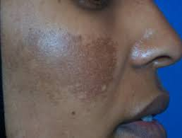
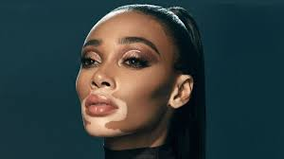

Slide 26
SKIN CANCERS
SCC
  Uncontrolled growth of abnormal squamous cells
  Risk factors- unprotected UV exposure, fair skin, weakened immune systems, over 50, male, precancerous lesions (actinic keratosis)
  Rx- topical, radiation, surgery
BCC
  Most common skin cancer
  Uncontrolled growth of abnormal basal cells
  Risk factors- same as for scc
  Rx- as for scc
Melanoma
  Uncontrolled growth of abnormal melanocytes
  Risk factors- pale skin, light eyes/hair, many/ atypical moles, sun exposure, older age
  Rx- radiation, chemo, surgery
NB!!! ABCDE examination of moles (Asymmetric/border/colour/diameter/evolution)

Slide 27
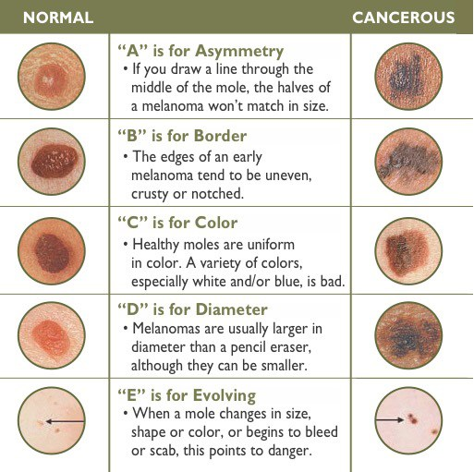
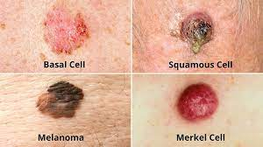
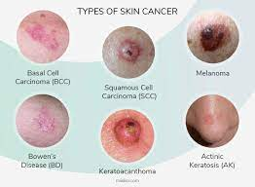

Slide 28
REFERENCES
University of the Witwatersrand , faculty of health sciences. Department of internal medicine. Dermatology notes for gemp iii students, 2018.
Lecture notes: Professor Deepak modi. Head- division of dermatology faculty of health sciences, university of the Witwatersrand and Johannesburg hospital
EM guidance app (version 4.5.4)
Mian M, Silfvast-Kaiser AS, Paek SY, Kivelevitch D, Menter A (2019) A Review of the Most Common Dermatologic Conditions and their Debilitating Psychosocial Impacts. Int Arch Intern Med 3:018. doi.org/10.23937/2643-4466/1710018
Zaenglein AL, Pathy AL, Schlosser BJ, Alikhan A, Baldwin HE, Berson DS, Bowe WP, Graber EM, Harper JC, Kang S, Keri JE, Leyden JJ, Reynolds RV, Silverberg NB, Stein Gold LF, Tollefson MM, Weiss JS, Dolan NC, Sagan AA, Stern M, Boyer KM, Bhushan R. Guidelines of care for the management of acne vulgaris. J Am Acad Dermatol. 2016 May;74(5):945-73.e33. doi: 10.1016/j.jaad.2015.12.037. Epub 2016 Feb 17. Erratum in: J Am Acad Dermatol. 2020 Jun;82(6):1576. PMID: 26897386.
Guttman-Yassky E, Krueger JG. Atopic dermatitis and psoriasis: two different immune diseases or one spectrum? Curr Opin Immunol. 2017 Oct;48:68-73. doi: 10.1016/j.coi.2017.08.008. Epub 2017 Sep 1. PMID: 28869867.
Nair BK. Vitiligo--a retrospect. Int J Dermatol. 1978 Nov;17(9):755-7. doi: 10.1111/ijd.1978.17.9.755. PMID: 365814.
Kurd SK, Gelfand JM. The prevalence of previously diagnosed and undiagnosed psoriasis in US adults: results from NHANES 2003-2004. J Am Acad Dermatol. 2009 Feb;60(2):218-24. doi: 10.1016/j.jaad.2008.09.022. Epub 2008 Nov 20. Erratum in: J Am Acad Dermatol. 2009 Sep;61(3):507. PMID: 19022533; PMCID: PMC4762027.

