Slide 1
Discharge Summary
&
Patient Referral Letter
Dr T. Naidoo
Dr M. Chrysostomou
Dr M. O’ Reilly

Slide 2
Discharge Summary
Writing a discharge summary is traditionally the role of junior doctors (interns)
It is a legal document, yet the importance of these documents is underemphasized
Training is variable, with often insufficient feedback and supervision given

Slide 3
An International Dilemma
Study done by the Royal College of Physicians in 2002,
  17% no diagnosis
  19% no information regarding tests or procedures done,
  21% no details regarding follow-up arrangements.
(Stopford E, Ninan S, Spencer N. How to write a discharge summary. BMJ . 2015: 351 2696 doi:10.1136/sbmj.h2696)
Kripalani et al. (2017)
  17.5% no diagnosis
  21% no medications
  65% no pending results
(Kripalani S, LeFevre F, Phillips CO et al. Deficits in communication and information transfer between hospital-based and primary care physicians: implications for patient safety and continuity of care. JAMA. 2007;297:831–41)

Slide 4

How To Write a Quality Discharge Summary
Details – Patient, doctor, and institution
Past medical history, reason for admission and final diagnosis
Significant findings, procedures, treatment, and services provided
Education provided
Follow-up care plan
Medications

Slide 5
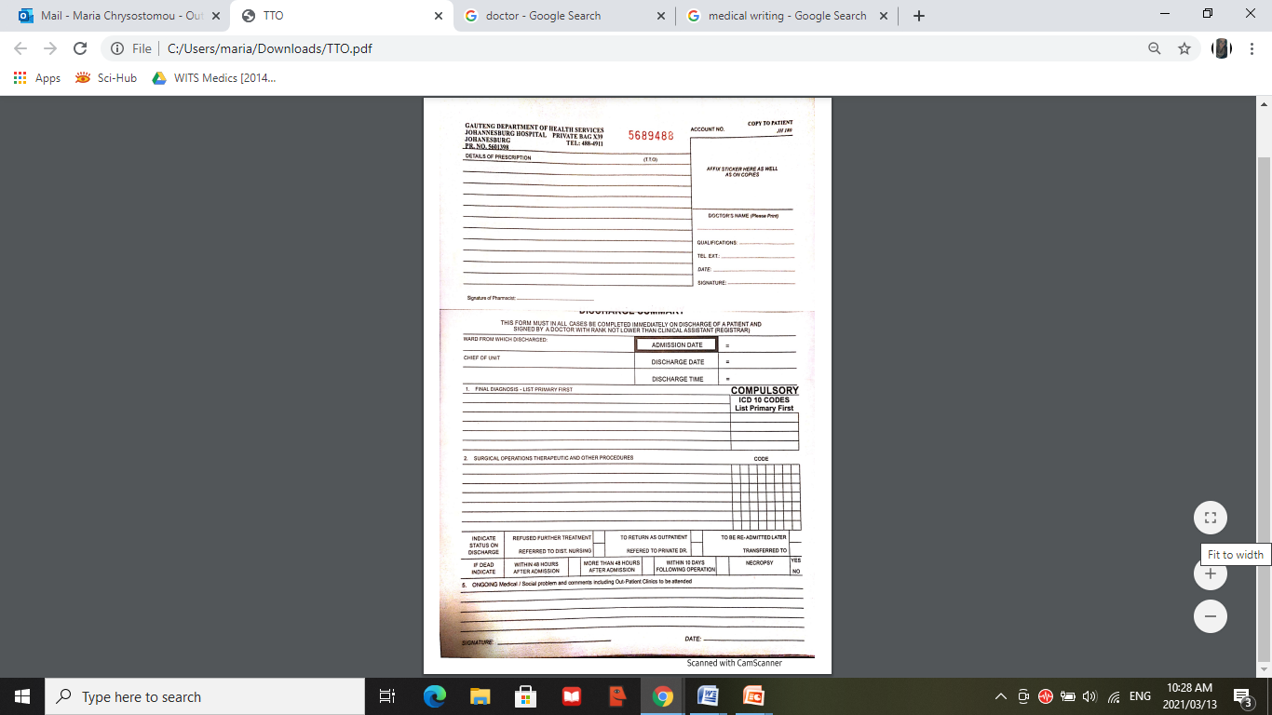

Slide 6
1. Details

Slide 8

1. Details
Patient Details:
  Full name
  Date of birth
  Patient sex and gender
  ID number or hospital number
  Address and contact details
  Safety alerts (Jehova’s witness; allergies)
  Next of kin/emergency contact

Slide 9
Doctor’s Details:
  Name
  HPCSA number
  Qualifications
  Contact number
  Signature

Slide 10
  Hospital and Discharge Details
    Name
    Address and contact information
    Discharging speciality / department
    Discharging consultant / head of department
    Date of admission and discharge (with time)
    Discharge destination and condition at discharge

Slide 11
2. PMH, Reason for admission, Final diagnosis

Slide 13
2. PMH, Reason for admission, Final diagnosis
Relevant past medical history and risk factors
Presentation
Key history of this event leading to the diagnosis and severity of presentation
Final diagnosis

Slide 14
3. Procedures and Findings

Slide 16
3. Procedures and Findings
Significant findings
Procedures and investigations
  Bar codes of any pending blood results or tests
Complications (if any)
Treatment
Services provided

Slide 17
4. Education provided
5. Follow-up care plan
Biopsychosocial approach to ensure holistic management and future care for the patient as well as the family of the patient

Slide 18
6. Medications

Slide 20

6. Medications
All medications that the patient is taking
  Regular medications
  As required (PRN) medications
Name
Dose
Route
Frequency
Duration

Slide 21

Patient Referral Letter
Referral of patients to hospitals, specialists and other institutions is an essential component of primary healthcare
Patients are referred to specialists when investigation or therapeutic options are exhausted in primary healthcare or when specialist advice is needed

Slide 22
Referral letters are sometimes the sole means of communication between doctors and breakdown in this communication could lead to :
  poor continuity of care
  delayed diagnoses
  polypharmacy
  increased litigation risk
  unnecessary re-testing
  patient frustration
  inaccurate information

Slide 23

Several studies of referral letters have reported that specialists are
highly dissatisfied with their quality and content !!!
No explanation
No medical history
No clinical findings
No test results
No details of prior treatment
Clarity & legibility

Slide 24

Key components of Referral letters
Patient Demographics
  Full name
  Date of birth
  Patient gender
  Ethnicity
  ID number
  Full address and postal code
  Contact number
  Relevant contacts

Slide 25
Referring practitioner’s details
  Full Name
  Practice address and postal code
  Practice number
  Contact numbers
  Date of referral
Referral destination
  Name of the receiving doctor and specialty clinic or department
  Name and address of the hospital
  Hospital ward/unit number
Special requirements
  Transport
  Preferred language
  Interpreter required

Slide 26

Presenting complaints
  Symptoms
  Medical conditions
  Events such as trauma
  Response (or lack of response) to treatment
  Abnormal investigation results
History of presenting complaint
  Onset
  Duration
  Severity
  Relevant social / travel /occupational / family history

Slide 27
Past medical history
  Active medical conditions and relevant resolved complaints
  Previous relevant procedures and investigations
  Allergies
Management to date
  Referral to other relevant specialities
  Investigations
  Current treatment (dose and frequency)
  Over-the-counter or traditional medicine
  Patient’s management of their symptoms
Reason for referral
  Clear reason for referral to secondary/tertiary care
  Type of care should be explicitly stated

Slide 28
Urgency of referral
URGENT
SOON
ROUTINE

Slide 29
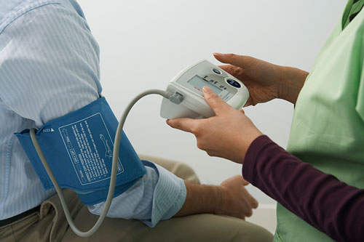
Examination
  Vital signs
  systemic examination
  Calculated assessment scales (if relevant)
Clinical risk factors
  Associated with the medical condition being considered
Investigations and results
  Document all results and pending investigations

Slide 30

Safety alerts
  The risk to self
  The risk to others
Consent to treatment
  Document clearly
Mental capacity assessment
  Who / when / outcome
  Document “best interests decision” clearly

Slide 31
Advanced decisions about treatment
  Clearly documented
  Include signed forms
Lasting power of attorney
  Name
  Contact details
  What role they have been assigned

Slide 32

PRACTICAL EXAMPLE…

Slide 33
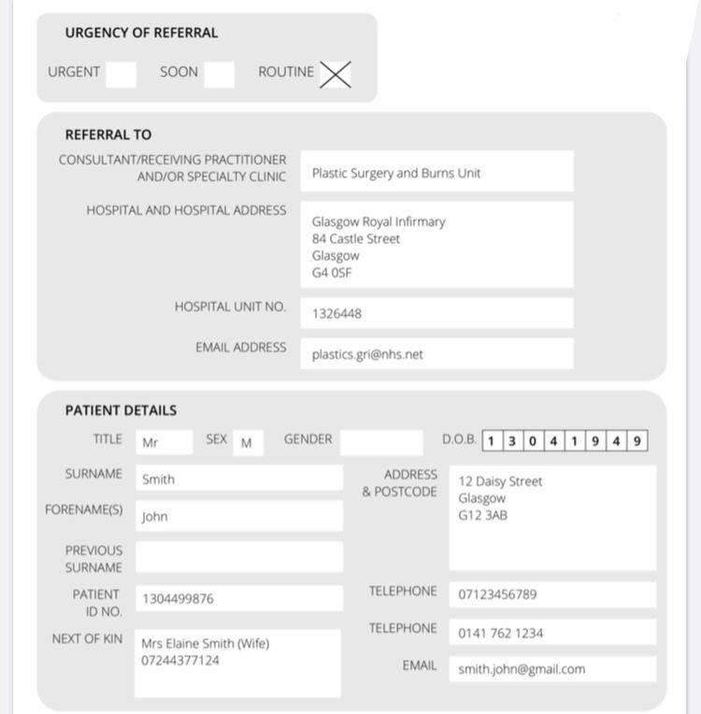

Slide 34
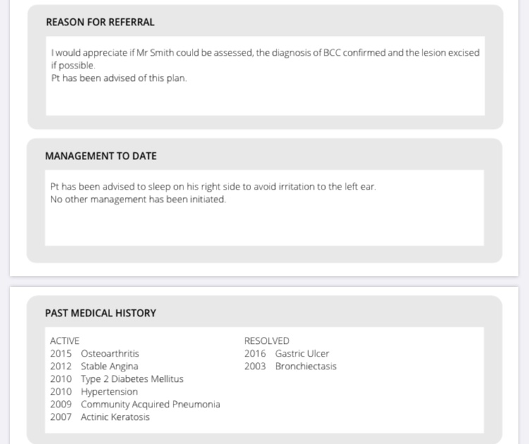

Slide 35
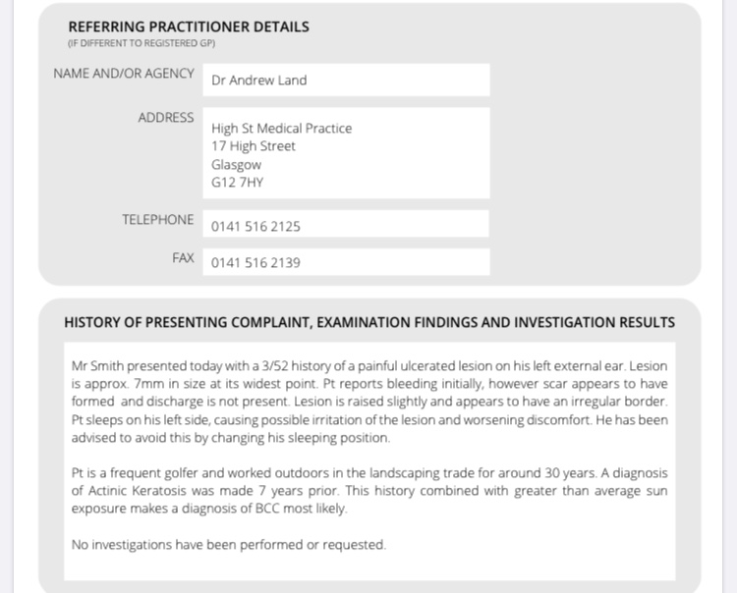

Slide 36
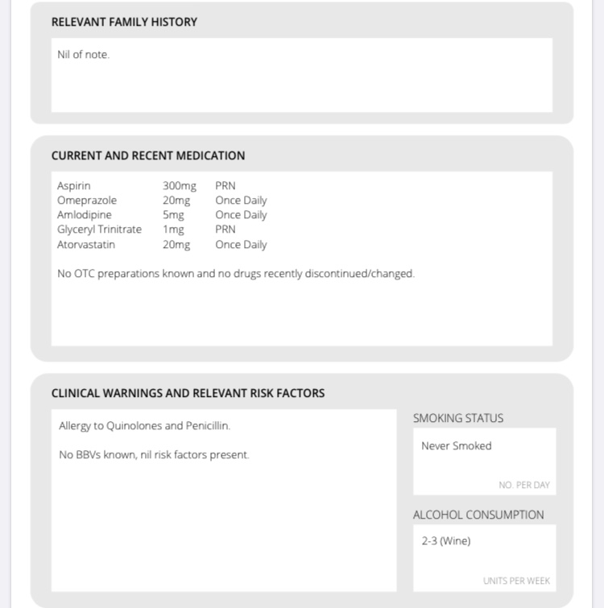

Slide 37
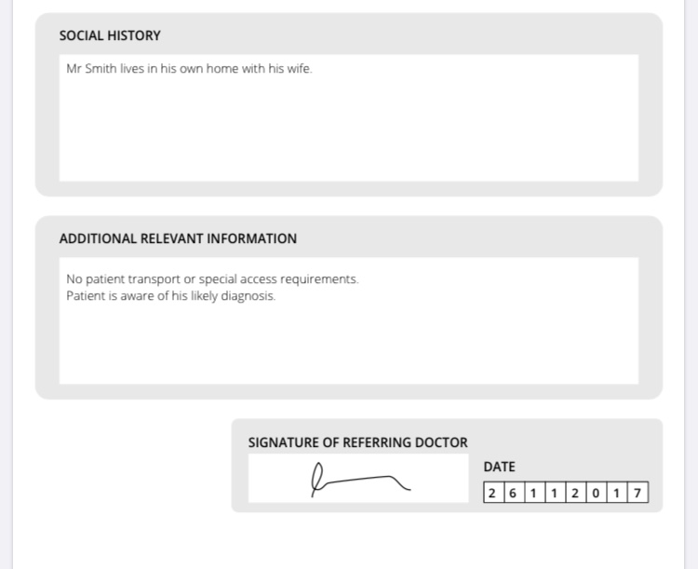

Slide 38
Thank you!

Slide 39
References
Academy of Royal Medical Colleges (July 2013). Standards for the clinical structure and content of patient records.
Charles H Earnshaw, Amanda Pedersen, Jo Evans, Tina Cross, Olivier Gaillemin, Arturo Vilches-Moraga, Improving the quality of discharge summaries through a direct feedback system, Future Healthcare Journal, 10.7861/fhj.2019-0046, 7, 2, (149-154), (2020).
Haider Merchant, Taona Nyamapfene, An evaluation of educational interventions aimed at preparing medical students for discharge summary writing: a rapid review of the literature, Irish Journal of Medical Science (1971 -), 10.1007/s11845-020-02325-0, (2020)
Health and Social Care Information Centre, Academy of Medical Royal Colleges. Standards for the clinical structure and content of patient records [Internet]. London: Health and Social Care Information Centre, Academy of Medical Royal Colleges; 2013 p. 37 – 44.
J Family Med Prim Care.,2013 Apr-Jun; 2(2): 145–148 Structured Printed Referral Letter (Form Letter); Saves Time and Improves Communication R.P.J.C. Ramanayake
Kripalani S, LeFevre F, Phillips CO et al. Deficits in communication and information transfer between hospital-based and primary care physicians: implications for patient safety and continuity of care. JAMA. 2007;297:831–41
Prim Health Care Res Dev. 2018 May; 19(3): 211–222. Published online 2017 Dec 7 Improving quality of referral letters from primary to secondary care: a literature review and discussion paper. Patrick Tobin-Schnittger, Jane O’Doherty, Ray O’Connor, and Andrew O’Regan
Scottish Intercollegiate Guidelines Network (1998). Report on a Recommended Referral Document
Stopford E, Ninan S, Spencer N. How to write a discharge summary. BMJ . 2015: 351 2696 doi:10.1136/sbmj.h2696
Zietlow KE, Gillum M, Hale SL, et al. A novel curriculum to train physician assistant students how to write effective discharge summaries. Medical Education Online. 2019. doi: 10.1080/10872981.2019.1648944, 24, 1.

