Slide 1

COMMON MENTAL HEALTH ISSUES IN PRIMARY HEALTH CARE
TUMELO MASHATOLA
CHARMAINE MAKALENG
MORATUWA MOSIA

Slide 2
HOW WELL EDUCATED ARE OUR COMMUNITY
MEMBERS ABOUT MENTAL HEALTH? IS THERE STILL STIGMA?
HOW EDUCATED ARE WE AS PRIMARY/COMMUNITY HEALTH CARE PROFFESSIONALS ABOUT MENTAL HEALTH?
HOW DO WE ENSURE CONTINUED FOLLOW UP AND EDUCATION SURROUNDING MENTAL HEALTH IN THE COMMUNITY?
WHAT LEGAL PRACTICES AROUND MENTAL HEALTH IN SOUTH AFRICA DO WE NEED TO FAMILIARIZE OURSELVES WITH AS MHCWs?
ARE THERE CULTURAL BELIEFS AROUND MENTAL HEALTH AND BEHAVIOUR THAT WE NEED TO FAMILIARIZE OURSELVES WITH?
HOW COMMON ARE MENTAL HEALTH ISSUES IN OUR COMMUNITIES?
HOW DO WE GO ABOUT CONDUCTING “PSYCHIATRIC” INTERVIEWS WITH KNOWN AND NEW MENTAL HEALTH CARE USERS?

Slide 3


PART OF AWARENESS IS:
CULTURAL AWARENESS

Slide 4
CURRENT LAW GOVERNING DEFINITIONS IN MENTAL HEALTH, THE RIGHTS OF MHCUs, LEGAL PROCEDURES ETC:
No. 17 of 2002: Mental Health Care Act, 2002.
“The objectives of this Act are to:
(1) regulate mental health care in a manner that:
makes the best possible mental health care, treatment and rehabilitation services available to the population equitably, efficiently and in the best interest of mental health care users within the limits of the available resources
co-ordinates access to mental health care, treatment and rehabilitation services to various categories of mental health care users;
integrates the provision of mental health care services into the general 5 health services environment
(2) Regulate access to and provide mental health care, treatment and rehabilitation services to:
voluntary, assisted and involuntary mental health care users;
State patients;
mentally ill prisoners;
(3) Clarify the rights and obligations of mental health care users and the obligations of mental health care providers
(4) Regulate the manner in which the property of persons with mental illness and persons with severe or profound intellectual disability may be dealt with by a court of law.”

Slide 5
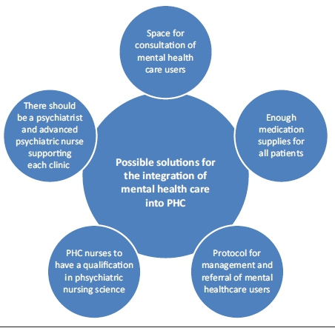
THE ROLE OF PRIMARY HEALTH CARE IN MENTAL HEALTH…
ACCORDING TO A WHO ARTICLE TITLED:
“MENTAL HEALTH IN PRIMARY CARE: ILLUSION OR INCLUSION?” IN A SERIES ON PRIMARY HEALTH CARE PUBLUSHED IN 2018:
THE MAIN OBJECTIVES AND ACTIONS REQUIRED TO SUPPORT INTEGRATION OF MENTAL HEALTH SERVICES IN PRIMARY CARE INCLUDE:
Empowering and engaging individuals and community.
Overcoming the myths and prejudices and for reducing stigma and discrimination.
Empowering and engaging people with mental disorders in key aspects of service planning and decision making is essential such as self-care, carer support, community support groups and training of community care providers Shifting care from institutions to communities with improved community-based services.
Ensuring that primary care services are supported by specialist services in hospitals to take referrals, with an efficient referral and back-referral system.
“Challenges affecting the implementation of the Policy on Integration of Mental Health Care into primary healthcare in KwaZulu-Natal province
(Esther N. HlongwaI; Maureen N. SibiyaII, 2019)

Slide 6
WHAT ARE THE COMMON MENTAL HEALTH ISSUES WE SEE IN PRIMARY HEALTH CARE?
- Common age groups: 19 – 35
- Commonly used substances: Marijuana,
Crystal Meth, CAT, Nyaope
- Commonly male > female
- Commonly associated with poor home environments and multiple psychosocial stressors
SUBSTANCE-INDUCED PSYCHOTIC/MOOD DISORDERS
MOOD DISORDERS
PSYCHOTIC DISORDERS
BEHAVIOURAL PROBLEMS ASSOCIATED WITH SUBSTANCES OR INTELLECTUAL DISABILITIES
SUBSTANCE USE DISORDERS
UNDERLYING PERSONALITY DISORDERS
CO-MORBID ANXIETY DISORDERS
ELDERLY ASSOCIATED – DEMENTIA

Slide 7
PRIMARY MENTAL HEALTH CARE IN ACTION…
CONSULTATION IN A CLINIC SETTING/ THE PSYCHIATRIC
INTERVIEW
ENCOUNTERING A NEW OR KNOWN PSYCHIATRIC PATIENT/MENTAL HEALTH CARE USER
DEALING WITH THE FAMILY OF A MHCU – BASIC COUSELLING AND
ADVICE
REFERRAL WHEN NECESSARY – TO A DISTRICT/TERTIARY LEVEL IN CONTACT WITH RELEVANT SPECIALISTS AND IN LINE WITH ADMINISTRATIVE PROTOCOL
MENTAL HEALTH CARE ACT FORMS – KNOWING THE BASIC OVERVIEW AT A PRIMARY/DISTRICT LEVEL

Slide 8
THE PSYCHIATRIC INTERVIEW:
GENERAL DEMOGRAPHICS
MAIN COMPLAINT – may be from patient themselves, family, law enforcement or EMS
EXPLORING MAIN COMPLAINTS:
MOOD CLUSTER – MOOD, SLEEP, INTEREST, ENERGY, CONCENTRATION, APPETTITE,
FEELINGS OF GUILT, HOPELESSNESS OR WORTHLESSNESS, SUICIDALITY. OTHER
SYMPTOMPS OF MANIA – RACING THOUGHTS, GOAL DIRECTED BEHAVIOUR
PSYCHOTIC CLUSTER – HALLUCINATIONS (VISUAL & AUDITORY MORE COMMON),
EXPLORE DELUSIONS, SPECIAL POWERS/MESSAGES
ANXIETY CLUSTER – FEARS, PHOBIAS, FEELINGS OF WORRY, TENSION, HISTORY OF PANIC ATTACKS
TRAUMA – ESPECIALLY RELEVANT IN OUR COUNTRY. HISTORY OF HEAD INJURY, ASSAULT ETC.
ICTAL CLUSTER – HISTORY OF SEIZURES, DISSOCIATION
THERE ARE MANY MORE CLUSTERS BUT THIS SUMMARY IS USEFUL ESPECIALLY IN THE
RESTRICTED TIME FRAMES WE FACE IN THE CLINICS.
4. PAST PSYCHIATRIC HISTORY
5. PAST MEDICAL AND SURGICAL HISTORY + ALLERGIES AND MEDICATIONS
6. SOCIAL HISTORY WITH HABITS (EXPLORE SUBSTANCE USE AS FAR AS POSSIBLE)
7. BRIEF ACCOUNT OF CHILDHOOD AND SCHOOLING AND PAST RELATIONSHIPS (FOR PERSONALITY D/O OVERVIEW)

Slide 9
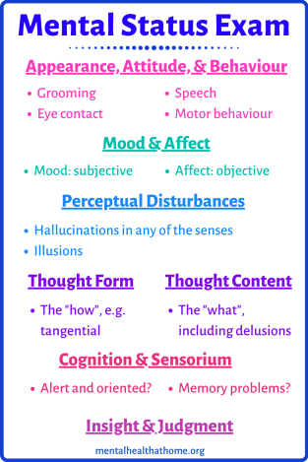
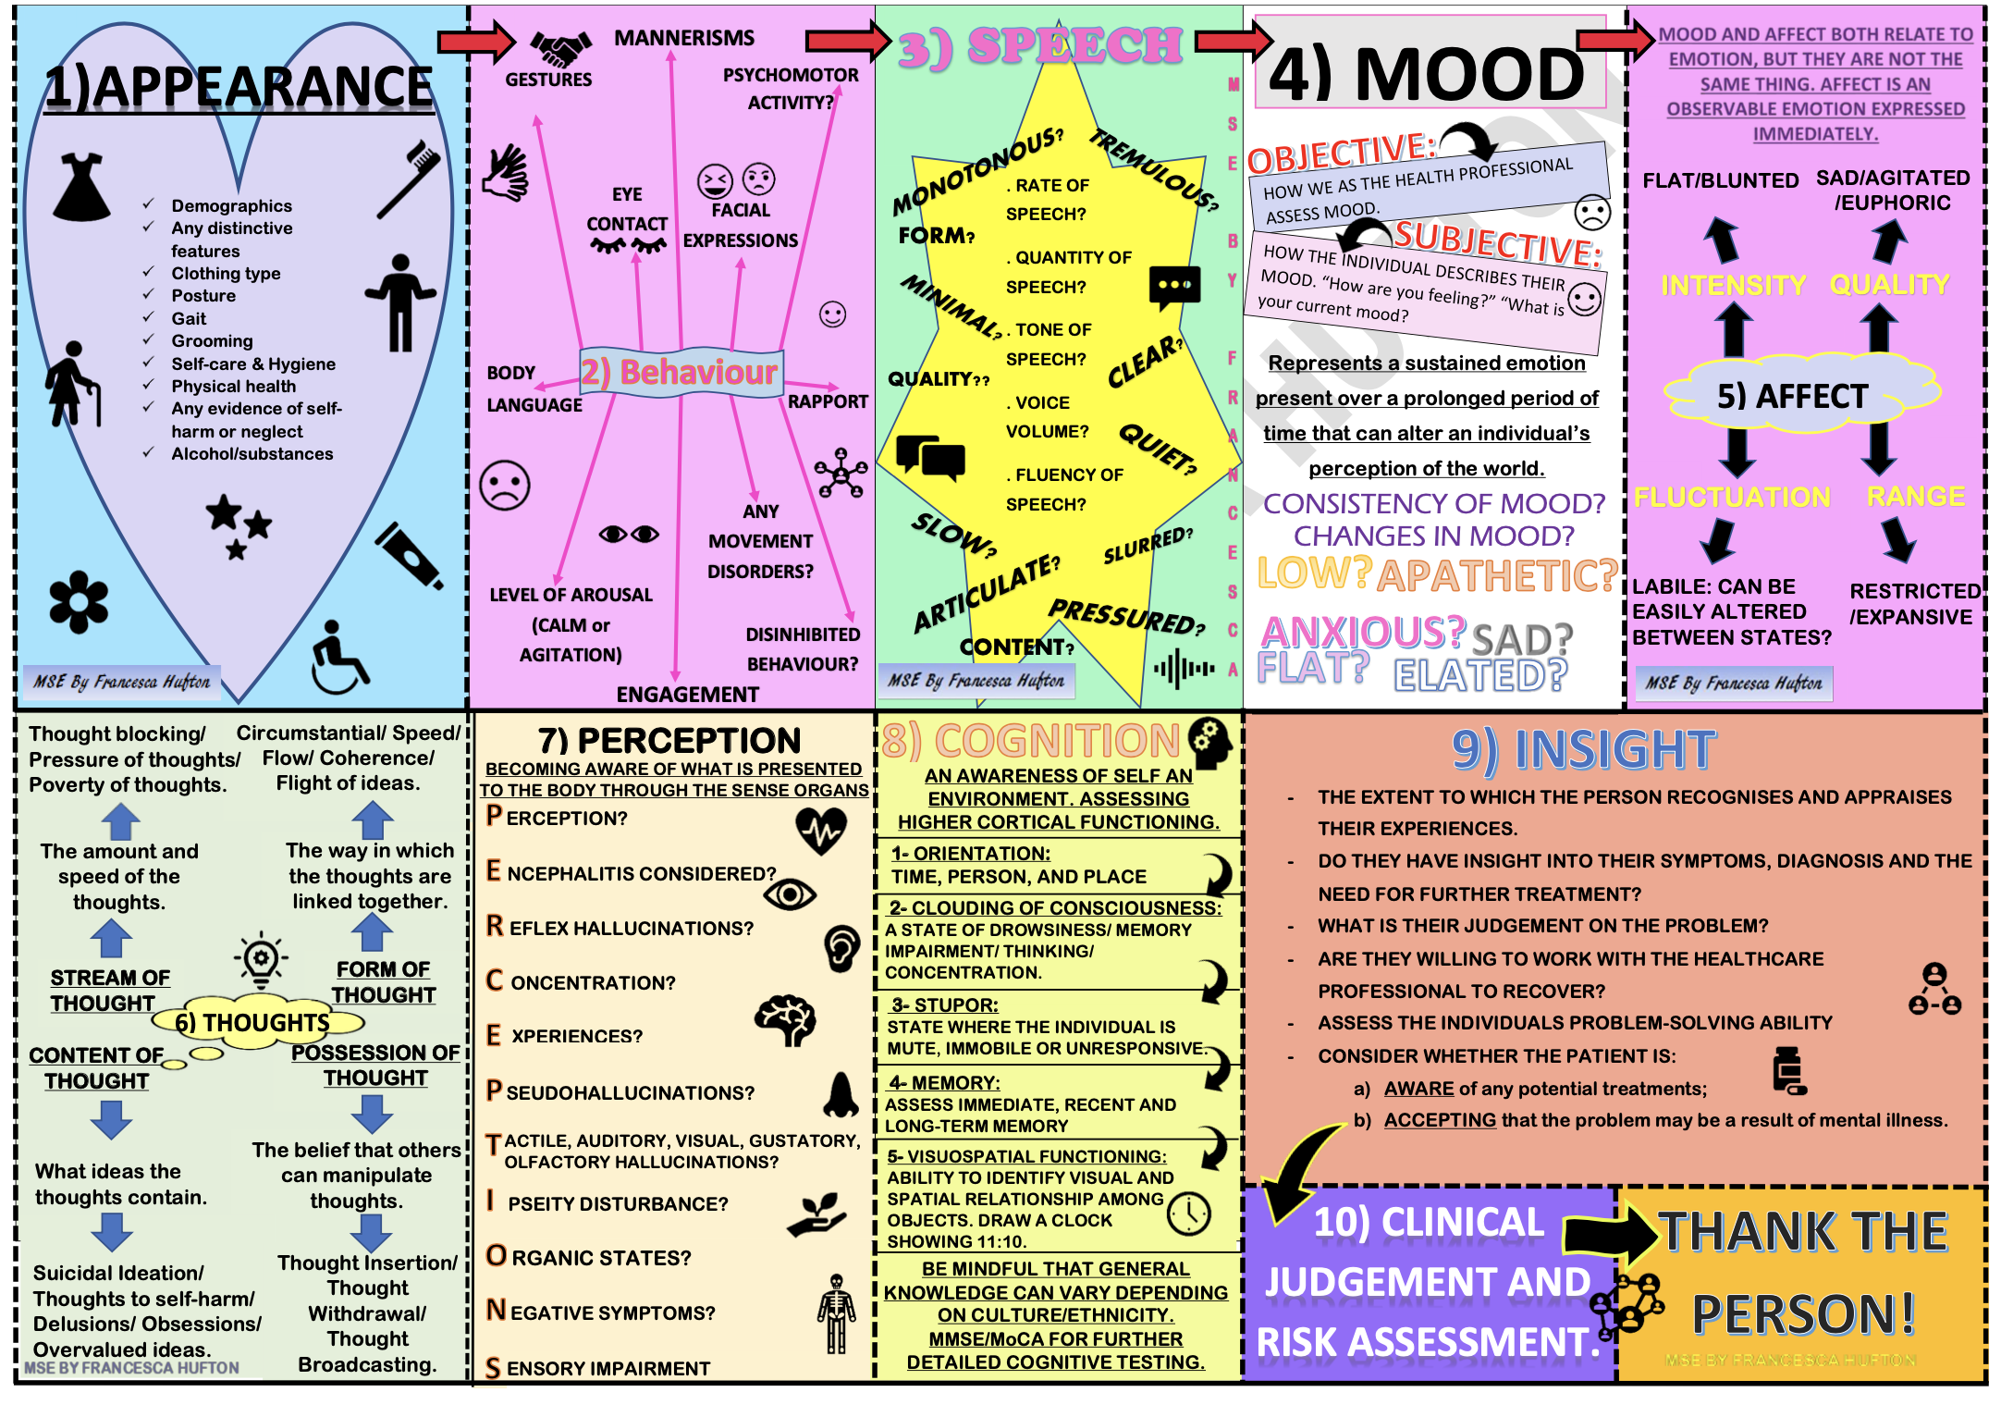
The mnemonic ASEPTIC can be used to remember the components of the MSE:
A - Appearance/Behaviour
S - Speech
E - Emotion (Mood and Affect)
P - Perception (Auditory/Visual Hallucinations)
T - Thought Content (Suicidal/Homicidal Ideation) and Process
I - Insight and Judgement
C - Cognition

Slide 10
IMPORTANT NOTES REGARDING A REFFERAL WITHIN A PHC OF A NEW MHCU TO A PSYCHIATRY DEPARTMENT:
The exclusion of an organic cause for psychotic/mood symptoms (especially in an INDEX presentation) is required prior to referral to psychiatry.
In order to do that, the following is required:
A thorough history – psychiatry interview – and examination of the patient is required
An assessment – biopsychosocial – is required to determine any stressors and underlying triggers
A thorough history of behaviour and family history from an available and knowledgeable family member
Baseline bloods: FBC/ U & E/ CRP/ CMP/ LFT/ B12/ FOLATE/ TPHA/ TSH
A multi-drug urine test
Consider delirium and/or possible sepsis more strongly in the elderly
All of the above are useful to you as the primary health care provider as well as to the psychiatrist in
order to determine the cause of the presenting complaint and how to manage further. Often psychiatry is more hesitant and may not accept the patient without the above done.

Slide 11
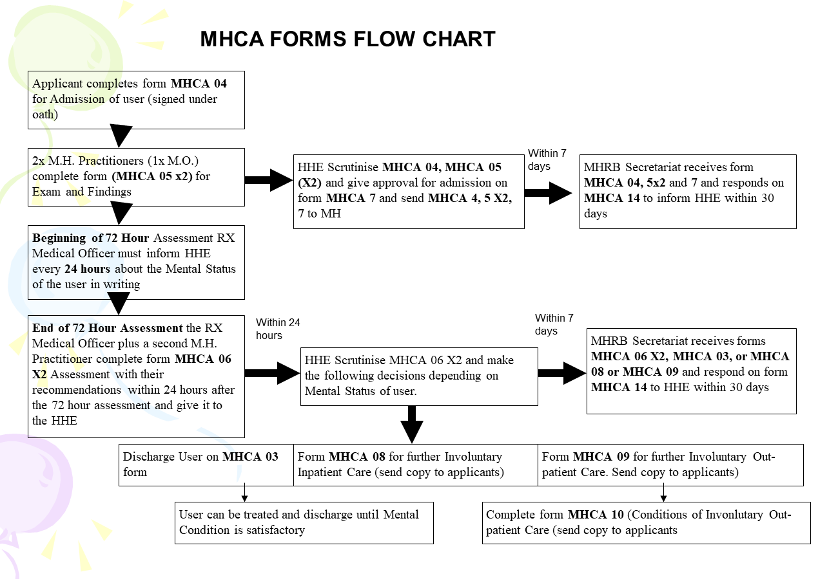

Slide 12
Psychotic disorders
Brief psychotic disorder
Delusional disorder
Schizophreniform disorder
Schizoaffective disorder
Schizophrenia
Catatonia
Substance/medication induced psychotic disorder
Psychotic disorder due to another medical condition
Other specified schizophrenia spectrum and other psychotic disorder
Unspecified schizophrenia spectrum and other psychotic disorder
Will be covered next week
Notes:
Diagnosis of each in terms of DSM will not be discussed due to time constraints.
General: present with perceptual disturbances such as hallucinations; disturbances in thought process such as delusions. They also present with disorganized behavior/speech. Collateral generally gives a history of functional disturbance (social/academic/occupational). More often than not, are resistant to medical intervention and thus are generally admitted under the MHCA as involuntary users

Slide 13
Biopsychosocial approach
 | Index presentation | Known MHCU
Acute | Manage aggression Rule out underlying medical conditions/substance use Start low dose, 1st generation antipsychotic All cases require referral | Manage aggression Refer if: poor insight/support, high risk to self or others, pregnant, lactating, no response/intolerance to medication, concurrent medical/psychiatric illness Continue antipsychotic
Intermediate | Social worker Monitor side effects/response Psychologist Occupational | Establish cause of relapse Dose adjustments vs switching drugs vs long acting preparations
Chronic Continue rehabilitation and pharmaceutical management as per down referral Adherence counselling, assessment of risk to self/others/property Annual monitoring: Metabolic screen
Notes:
Ruling out medication conditions: FBC/diff/UE/CMP/LFT/vit B12/RPR/HIV. If patient is know RVD, LP may be required to rule out meningitis. It extremely important to note that when an elderly patient presents with acute psychosis, delirium should be ruled out. It is very uncommon for an elderly patient to present as an index mental health care user. A CT scan in this case may be necessary.
Urine multidrug screen also needs to be taken.
Psychoeducation: on signs of relapse and compliance
If no response to drug after 4 weeks, then switch drug. If there is a response, titrate dose. It may also be necessary to use long acting preparations if relapse due to non-adherence
At chronic phase; important to continuously assess risk to self, others and property; and to document such clearly in OPD files. Its also important to assess risk of relapse/signs of relapse early.

Slide 14
Pharmaceutical management
Typical antipsychotics
Chlorpromazine 10-1000mg
Fluphenazine 2.5-20mg
Haloperidol 0.5-10mg
Notes
EPSE (especially young men)
Not mood stabilizing
Atypical antipsychotics
Clozapine 12.5-900mg
Olanzapine 5-20mg
Quetiapine 25-800mg
Risperidone 1-6mg
Notes
Metabolic (hyperglycemia, weight gain, lipid abnormalities)
Cardiac conduction difficulties
Mood stabilizing
Injectables: Clopixol depot (100mg, maintenance of 300mg IMI q2wk. Acuphase 50mg, maintenance of 400mg IMI q2wk, Fluxanol 20mg, maintenance of 400mg g1wk)
Notes:
No use in combining antipsychotics
Atypical antipsychotics: same efficacy as typical but better side effect profile
Each have their own side effect profile but due to time constraints, will not be able to get into in detail
Clozapine: used for refractory cases. Side effectcs: hypersalivation, tachyacrdaia, myocarditis, CMO, agranulocytosis, constipation, seizures
When choosing an antipsychotic; choose one that the patient has responded to in the past

Slide 15
Antipsychotic side effects: EPSE
Acute dystonia | Pseudo-parkinsonism | Akathisia | Tardive dyskinesia
Sustained muscle contraction Muscle spasms: laryngospasm | As per Parkinson disease | Subjective and observed motor restlessness | Choreo-athetoid involuntary movements Late appearing
General management
Stop antipsychotic/ decrease dose / switch to atypical
Anticholinergic, e.g. Biperiden, IM, 2.5 mg.
(repeat every 30 minutes to a maximum of 3 doses within 24 hours)
Except for Tardive dyskinesia (benzodiazepine/B- blocker)
Promethazine, IM, 50 mg.
For Parkinsonism
Anticholinergic e.g. orphenadrine hydrochloride 50mg-100mg PO 6-8 hourly
Refer all cases unless psychiatric doctor available for review of antipsychotic medication
Prophylaxis
Orphenadrine 50-100mg PO 6-8 hourly
Notes:
Can occur with all antipsychotics but predominantly with 1st generation antipsychotics
At risk groups include males, those with underlying medical conditons such as epilepsy
Acute dystonia: sustained muscle contraction that causes twisting and repetitive movements, abnormal posture or abnormal eye position
Parkinson: slow, shuffling gait, delayed responses, masked facies and a pill rolling tremor
Tardive dyskinesia: particularly involving the face, lips and tongue. Only about 50% are reversible
Prophylaxis: only if high risk for EPSE

Slide 16
Antipsychotic side effects: NMS
Investigations
To rule out medical conditions/differential diagnosis
Bloods: CK
ABG
Altered mental state
Management
Stop antipsychotic
Cool patient
IV hydration
Oxygen
Pharmacological
Bromocriptine
Dantrolene
Benzodiazepine
All cases require referral: for high care admission
http://www.msrblog.com/science/medical/neuroleptic-malignant-syndrome.html
Notes:
Is rare but potential life threatening complication
At risk groups: young, initial phase of treatment (naïve), high dose, first generation antipsychotics, given via IM/IVI route, polypharmacy, multiple co-morbidities, dehydration, previous NMS, family history of NMS
Generally; altered mental state is first sign followed by hyperthermia, autonomic dysfunction, muscle rigidity
Bromocriptine 2.5mg PO TDS
Dantrolene IVI 50-75mg then 6 hourly (maximum of 10mg/kg/d)
Lorazepam PO/IV 8-24mg/day

Slide 17
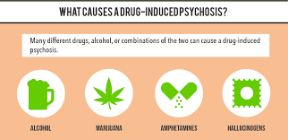
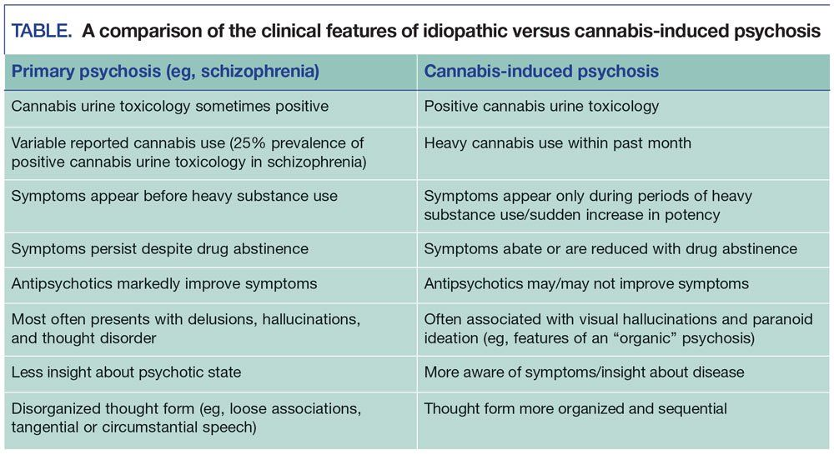
SUBSTANCE-INDUCED PSYCHOSIS
Cannibis use psychosis is most commonly seen but quite a few drugs used – mentioned previously – may also cause psychosis.

Slide 18
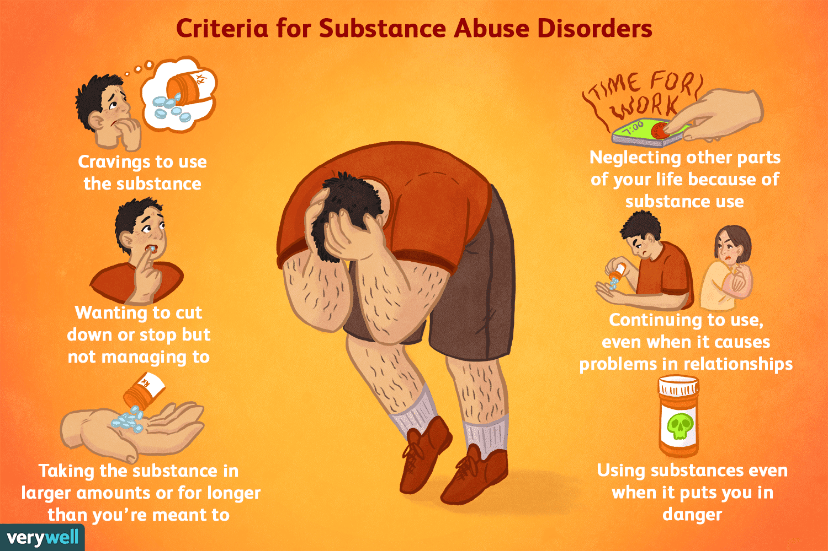
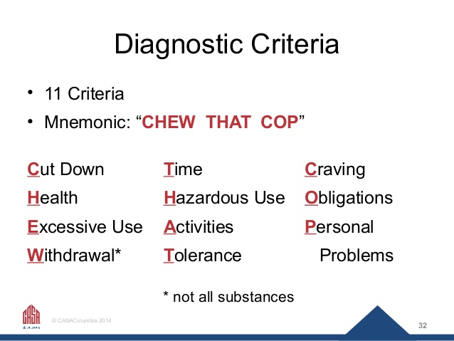
NB: to pick up especially at a primary health care level!

Slide 19
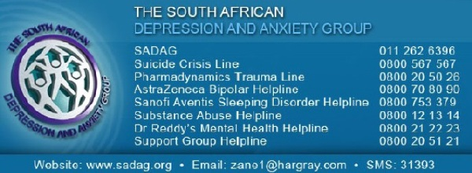
MOOD DISORDERS BRIEF OVERVIEW
When general emotional state or mood is distorted and this interferes with their day to day ability to function.
According to the Diagnostic and Statistical Manual of Mental Disorders, Fifth Edition (DSM-5), mood disorders have been broadly categorized as bipolar disorders and depressive disorders.
Bipolar disorders are further categorized as bipolar I, bipolar II, cyclothymic disorder, bipolar and related disorder to another medical condition, substance/medication-induced bipolar and related disorder, other specified bipolar and related disorder, and unspecified bipolar and related disorder.
Depressive disorders are also further categorized as major depressive disorder, disruptive mood dysregulation disorder, Persistent depressive disorder (PDD), Premenstrual dysphoric disorder.

Slide 20
MAJOR DEPRESSIVE EPISODE/DISORDER
Biological: antidepressants primarily:
First line Selective serotonin reuptake inhibitors, e.g.: Fluoxetine, oral. o Initial dose: 20 mg o If there is no or partial response after 4–8 weeks, increase to 40 mg, if well tolerated. OR Citalopram, oral. o Initial dose: 20 mg o If there is no or partial response after 4–8 weeks, increase to 40 mg, if well tolerated. OR Tricyclic antidepressants, e.g. Amitriptyline, oral, at bedtime. o Dose range: 75 – 150 mg. Start with: 25 mg, increase by 25 mg/day at 3–4 day interval
Psychological: individual therapy (psychodynamic, interpersonal, CBT), family therapy, group therapy
Social: vocational rehabilitation, social skills training
REFERRAL: Inadequate response to treatment. High suicide risk. Psychotic features.
Major depression is characterised by a depressed mood (sadness)
accompanied by loss of interest and decreased experience of pleasure, and social withdrawal.
Irritability may also occur, especially amongst adolescents.
Reduction in sleep, appetite, energy, motivation, concentration and memory may occur.
The patient may report feelings of worthlessness and hopelessness, and express thoughts of suicide.
Symptoms are usually present for at least two weeks and impact on the person’s ability to function normally.
Exclude underlying medical conditions that may present with depression, e.g. thyroid disease.

Slide 21
Suicide Risk assessment
REFERRAL
All patients who have attempted a medically serious act of self-harm/suicide.
All patients where there is an imminent risk of self-harm/suicide.
All patients with a high index of suspicion.
All patients who are medically unstable
If not requiring referral:
Manage underlying factors: medical conditions, substances, psychiatric conditions
Psychosocial management most important
Notes:
There are 5 important components when assessing suicide: ideation (thoughts), intent, plan, access to lethal means, and history of past suicide attempts. Key risk factors for suicide include previous suicide attempt, current suicidal plan or ideation, and history of mental illness (most commonly major depressive disorder and substance abuse), access to lethal means, history of childhood sexual/physical abuse, family history of suicide and suicidality in males, adolescents, elderly patients and lesbian, gay, bisexual, and transgender (LGBT) patients

Slide 22
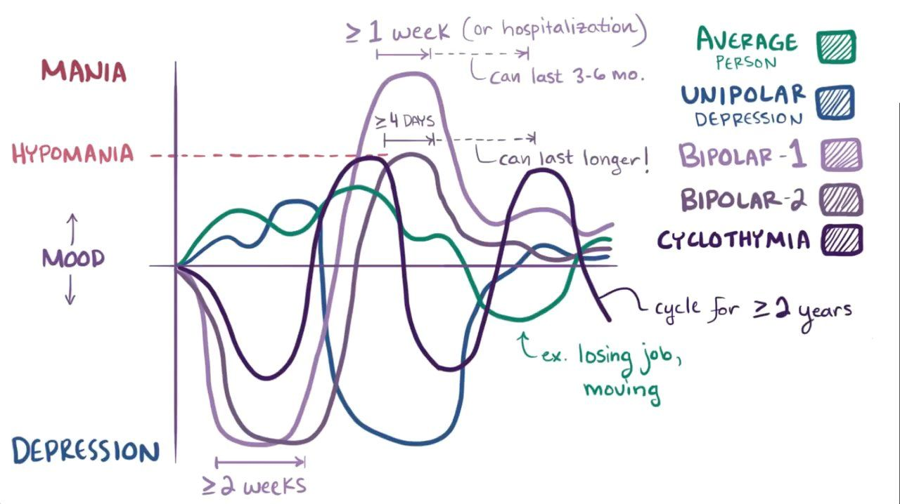
BIPOLAR DISORDER
Bipolar disorder may have an episodic, variable course. The patient may present with manic, hypomanic, or depressive. By definition, a diagnosis of bipolar disorder requires either a current or previous episode of mania or hypomania, and a past or current major depressive episode.
An episode of mania is typically characterised by an elevated mood (e.g.
extreme happiness or irritability). This mood disturbance may be associated
with increased energy/goal-directed activity, talkativeness and flight of ideas,
a reduction in the need for sleep, and grandiosity and/or religious delusions.
Even during periods of relative euthymia, i.e. without either clearly manic or
depressive features, patients may still experience impairments in
psychosocial functioning.

Slide 23
BIPOLAR DISORDER BRIEF OVERVIEW OF MANAGEMENT
Biological: Lithium is the drug if choice (an oral dose of 250 mg 12 hourly. Usual dose range: 200–500 mg/dose 12 hourly). May be given as a single total daily dose at night to enhance adherence. The therapeutic range is 0.4–0.8 mmol/L for maintenance therapy. Monitoring of renal function is also NB. AND/OR Valproate (oral, 300 mg 12 hourly). Dose can be increased to a maximum dose of 20 mg/kg/day 12 hourly. [Treatment of bipolar depression must be done extremely cautiously, as a switch from depression to mania can result; monotherapy with antidepressants should be avoided]
Drugs as Quetiapine, Risperdal, Lamotrigine and Olanzipine are also used in our setting for acute manic episodes as well as for maintenance.
Psychological: supportive or psychodynamic psychotherapy, CBT, IPT or interpersonal social rhythm therapy, family focused treatment
Social: vocational rehabilitation, consider leave of absence from school/work, assess capacity to manage finances, drug and EtOH cessation, sleep hygiene, social skills training, education for family members
REFERRAL: Mixed features or rapid cycling bipolar disorder. Depressive episodes in bipolar patients not responding to second line treatment. Manic episodes not responding to treatment or mania with severe psychotic features.

Slide 24
COMMON SIDE EFFECTS
SSRI’S: mostly GIT side effects(eg. nausea, vomiting, dyspepsia, abdominal pain, diarrhoea);headache, restlessness, anxiety, insomnia; sexual dysfunction. Serotonin syndrome: Symptoms occur within minutes to hours, and may include: Agitation or restlessness; Diarrhea; Fast heart beat and high blood pressure; Hallucinations; Increased body temperature; Loss of coordination; Nausea; Overactive reflexes; Rapid changes in blood pressure; Vomiting.
TCA’s- side effects limit their use, especially in elderly and suicidal pts.Anticholinergic and antihistaminergic problems- weight gain, sedation, cardiac arrhythmias, seizures, toxicity and death in overdose.
Lithium: Most side effects are dose-related; Thirst/polydipsia; polyuria; fine tremor (can Rx with propranolol); weight gain; nausea, vomiting, diarrhea; nephrogenic diabetes insipidus; hypothyroidism; mild oedema; cardiac arrhythmias; sexual side effects; cognitive “greying”; acne; psoriasis; hair loss; leucocytosis; renal failure. Teratogenicity- cardiac/ Ebstein’s anomaly;Neonatal goitre.

Slide 25

IN SUMMARY:
Continued education of ourselves and patients is important is ensuring continuity of care and good help seeking behaviour
Understanding the processes of referral and treatment relevant at each level of care is important to ensure that our communities receive the best care
Destigmatizing mental health – with the awareness of our cultural context – is important to ensure that adherence, help seeking and good mental health is maintained

