Slide 1

Motivational interviewing
Dr. Carlota Sekhokoane
Dr. Nakisa Quma
Dr. Rachelle Toi
Notes:
Good afternoon everyone.
Today we will be presenting the topic: Motivational interviewing. I’m Carlota Sekhokoane and our other two presenters are Nakisa Quma and Rachelle Toi. (next slide)

Slide 2


What is it and what is it’s purpose?
Definition: “A directive, client-centered counselling style for eliciting behaviour change by helping clients to explore and resolve ambivalence.”
Purpose: Help individuals- explore, identify and resolve areas in their lives that could benefit from change + assisting them to overcome barriers that prevent the individual from achieving this desired outcome + acknowledging conflicting beliefs/feelings.
Notes:
So, what is motivational interviewing and what is its purpose?
The practice was originally described over 20 years ago and was later tailored and modified to what we know it to be now.
It is formally defined as: A directive, client-centered counselling style for eliciting behaviour change by helping clients to explore and resolve ambivalence.
In much simpler terms it’s a way of guiding someone to try bring out/ draw out behavioural change by helping them look into and settle clashing feeling or thoughts about things.
The purpose of this is to help individuals explore, identify and resolve areas in their lives that could potentially benefit from change and assisting them to overcome barriers that prevent the individual from achieving this desired outcome while also acknowledging conflicting beliefs or feelings they may have. (next slide)

Slide 3


Where does it come from?
Origin: 1983 by clinical psychologist, William Richard Miller from the USA.
Counselled patients struggling with substance abuse and realized:
Most effective treatment: active and empathetic (brief interviewing, motivational enhancement)
Least effective: passive (films, lectures, confrontation)
Teamed up with a South African psychologist, Stephen Rollnick, in the early 1990s - co-write a book on the techniques practiced in motivational interviewing.
Originally used in the treatment of alcoholism but was later developed and seen as useful in the prevention and treatment of lifestyle conditions eg. diabetes, eating disorders, etc.
Dr. William R Miller
Dr. Stephen Rollnick
Notes:
Where does it come from you may ask?
Motivational interviewing originated in 1983 by an American clinical psychologist, William Richard Miller, who later became a professor of psychology and psychiatry in Albuquerque.
He realized quite early in his career that when counselling patient’s struggling with substance abuse, specifically alcoholism, the most effective treatment was often more active and empathetic like brief interviewing and motivational enhancements while the least effective were passive like films, lectures or confrontation. So he pioneered this therapeutic approach we now know.
He later teamed up with a South African psychologist, Stephen Rollnick, in the early 1990s to co-write a book on the techniques practiced in motivational interviewing
This intervention strategy was originally used in the treatment of alcoholism but was later developed and seen as useful in the prevention and treatment of lifestyle conditions eg. diabetes, eating disorders, etc. (next slide)

Slide 4

The Principles
Five central principles of motivational interviewing:
Express empathy.
Develop discrepancy.
Avoid Argument.
Rolling with resistance.
Support self efficacy.
Notes:
Principles
There are 5 central principles of Motivational Interviewing we need to look at:
Express empathy: This principle is key to MI. It requires one to use reflective listening while communicating respect and support for your patient. Establish a safe and open environment to help the patient believe that ambivalence is completely normal. Acceptance facilitates change.
Develop discrepancy In this principle, it is the health professionals’ job to magnify the difference between the patient's current behaviour and their goals in order to allow the patient to present an argument for change by raising their awareness of the negative consequences surrounding problem behaviour.
Avoid Argument
Trying to convince your patient that a problem exists or that they need to change could result in more resistance. This can rapidly result in a power struggle and does not enhance motivation. The goal is to “walk” with the individual, not “drag” them.
Rolling with resistance Resistance is almost inevitable however should not be opposed but rather be acknowledged and explored. Resistance is an indication that there is a need to change strategies OR listen more carefully.
Support self-efficacy This principle focuses on building confidence in patients to believe that they will find solutions to the problems they identify and will be responsible for the method of bringing about change. This is a critical component of behavioural change so its crucial that you as a health practitioner also believe in your patient’s capacity to reach their goals.
(Nakisa will be taking over from here)

Slide 5


Techniques:
F: Feedback
R: Responsibility for change
A: Advice giving
M: Menu for change
E: Empathic style
S: Self-efficacy
Notes:
There are multiple trainable MI techniques that are described by Rollnick and Miller. The use of the FRAMES acronym is an application of MI techniques in it use for effective brief interventions. This acronym therefore provides a useful way to remember techniques in a consultation. The FRAMES technique will therefore forms the focus of our discussion of the MI techniques.
Feedback: The act of constructive, non-judgmental feedback of the patient behaviour based on information from structured and objective assessments. Give feedback on the risks and negative consequences of behaviour and then Seek the patients reaction and listen. Delivery should be respectful, straight forward, easy-to-understand and culturally appropriate. One should practice Reflective listening and an empathic style
Responsibility: Emphasize that the individual is responsible for making his or her own decision about the discussed behaviour. Their role is active rather than passive in both choosing the treatment and carrying it out
Advice: Prior to giving advice, the patient should be asked for permission to talk about behaviour and to give advice. Advice should be: simple, not overwhelming, and matched to the client's level of understanding and readiness, the urgency of the situation, and her culture. Should not to tell people what to do—but rather suggesting the approach may be either directive (making a suggestion) or educational (explaining information).
Menu of options: Give menus of options to choose from, fostering the patients involvement in decision-making. This may be in the form of choices regarding treatment goals and types of services needed.
Empathy: Be empathic, respectful, and non-judgmental. In order to display empathy, this usually entails reflective listening (the act of listening and comprehending back to the patient what has been heard in order to ensure that what was heard was correct and to demonstrate to the patient that they have been heard
Self-efficacy: Self-efficacy is one's ability to produce a desired result or effect. In this technique, the role of the HCP is to encourage the patient to believe they will be able to make the change possible Express optimism that the individual can modify his or her behavior

Slide 6



Scenario:
Notes:
We will now be moving to a podcast of Dr Toi’s Anatomy where we will be in Dr Toi's Consultation room at the local CHC where a 20 year old female has presented for a consultation. Here we will demonstrate some the techniques discussed, focusing mainly on those that are part of FRAMES
From this podcast we see several of the MI principles being demonstrated by Dr Toi -Through reflective listening, we see the use of feedback in a sophisticated way. Dr Toi is comprehending the patients history and feeds back in a constructive manner. -Through out this podcast the principle of empathy is demonstrated through the doctors reflective style -The doctor ends with encouragement and an optimistic statement. This is a demonstration of the principle self efficacy The techniques can be used at various points and repeated during the consultation. Also note that not all techniques need to be used in every consultation.

Slide 7
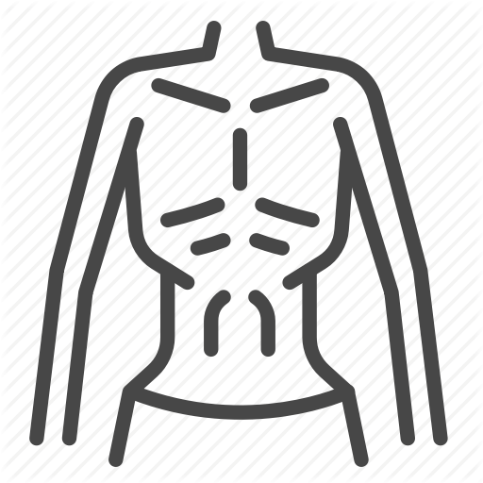
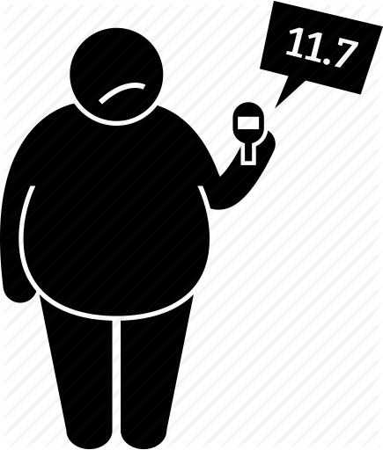
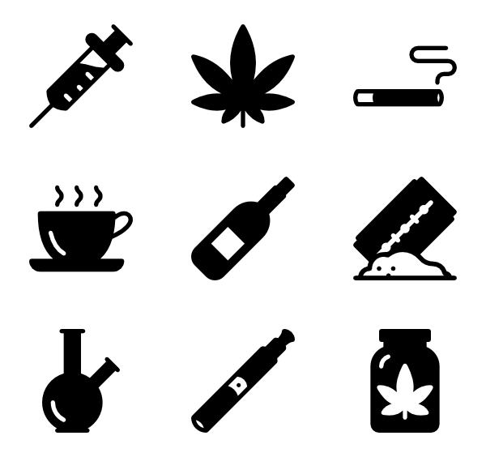

Motivational interviewing is effective in...
Smoking cessation
Medication compliance
Diabetes management
AIDS risk reduction
Eating disorders
Dietary changes
Substance abuse
etc…..
Notes:
Smoking cessation
Medication compliance
Diabetes management
AIDS risk reduction
Eating disorders
Dietary changes
Substance abuse
etc….. (List as per Motivational interviewing in health care)

Slide 8
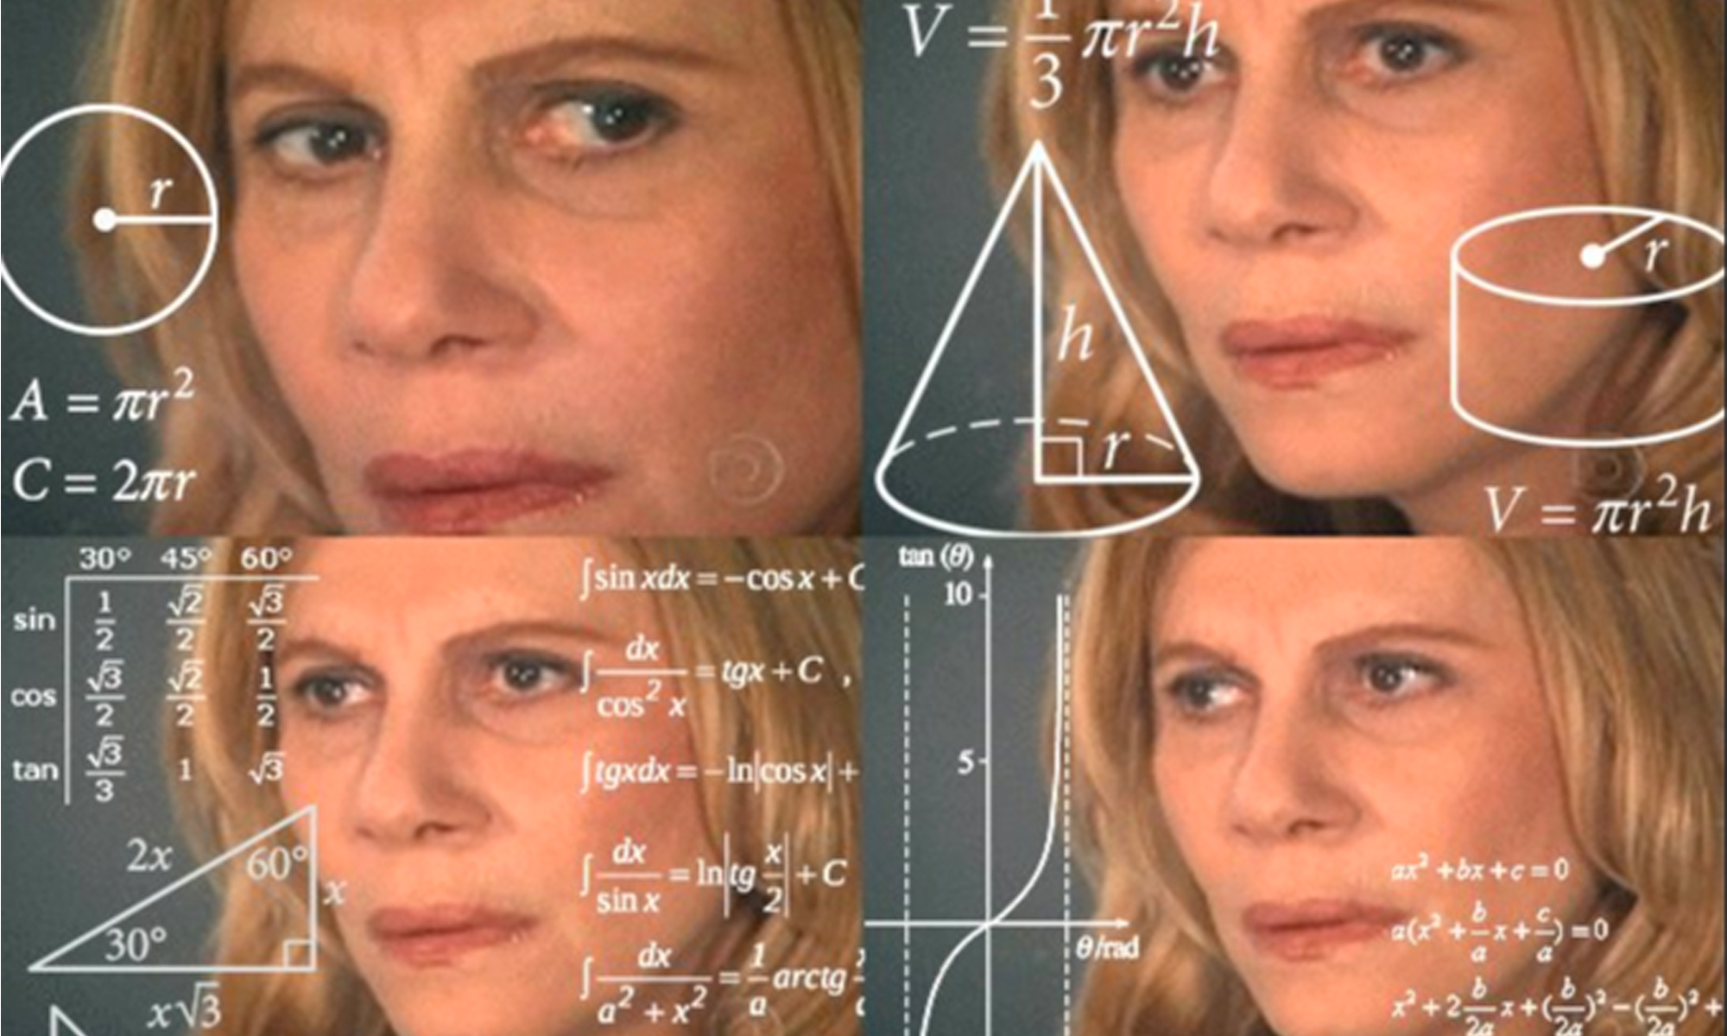

But, does it work?
Yes. According to Rubak, Sandboek, Lauritzen and Christensen, 80% of studies reviewed in a systematic review and meta-analysis study showed that motivational interviewing is effective in changing patient’s behaviour. It also shows that it outperforms traditional advice.

Slide 9

MI misconceptions
MI is not a way of tricking people into doing what they don’t want to do
MI is not a form of cognitive-behavior therapy
MI is not just client-centered counseling
MI is not a panacea (solution/remedy to all difficulties/diseases)
Notes:
In order to ensure that this approach is carried out in the highest quaility, not only do we need to know what it is but we need to be clear about what it is not.
1.MI is not a way of tricking people into doing what they don’t want to do.
MI is not a way to strip one's autonomy from them in order to do what we want them to do. If there is no inherent motivation to change, MI will not manufacture it.
2. MI is not a form of cognitive-behaviour therapy
CBT generally presumes that the patient lacks something, whether is be new coping skills, learning new behaviours etc. However MI is a brief conversation in which we elicit that what is already there, not teaching new skills, new conditioning or re-educating
3. MI is not just client-centered counseling
Although there are similarities to the traditional client-centered approach, MI is about being consciously goal-orientated, about having intentional direction to change.
4. Mi is not a panacea
MI is not used to address any and all issues that presents itself to a health professional. Those who already have the motivation to change do not need MI. Studies have shown that using MI in areas where a health professional has no business tipping the balance one way or the other has actually caused more harm than good. Hence why it is used in certain areas.

Slide 10
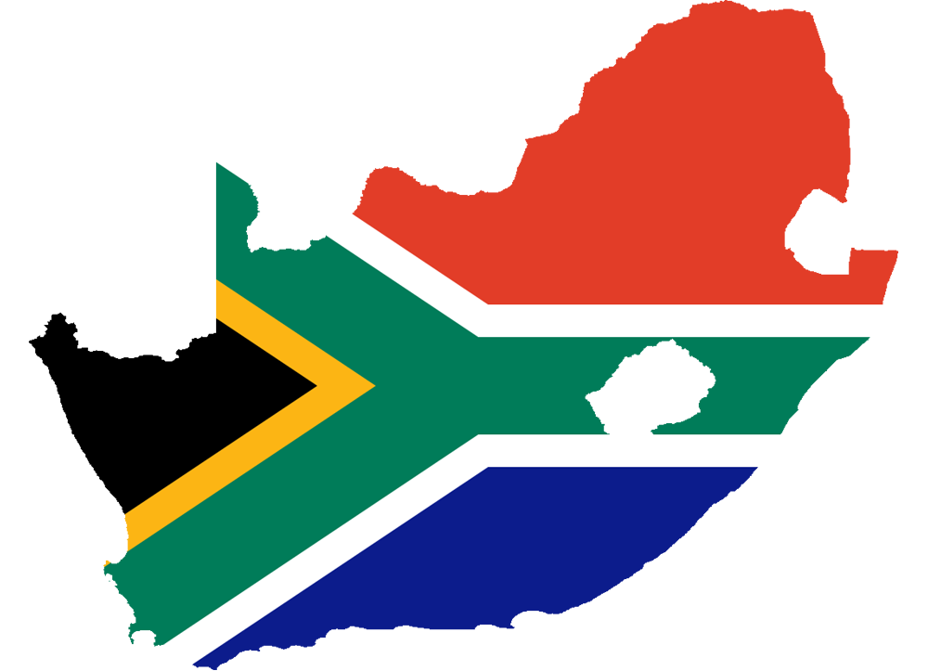
South African context and Limitations
Time constraints: 5-10 consultations, too many patients, not enough people.
Language barriers.
Cultures: roles in families, traditional practices, community and gangs, pop culture.
Privacy.
Lack of training.
Follow up: 1) setting eg. ed where there is no follow up 2) loss to follow up eg. clinics
Finances: public vs private
Notes:
Time constraints: due to the high patient load and being understaffed, consultations are limited
Language barriers: MI is best done when the patient understands in their home language
Cultures: one has to be cognisant of all the different cultures we have in our country that could potentially lead to certain limitations. I am going to highlight some of the cultural limitations we must be aware of. We must be aware of the different roles in families, how traditional practices influence our patient’s behaviours. We must be aware that not everyone is fortunate enough to have an extensive background in health literacy. For many people, they were brought up in the type of culture where self reflection does not come easily. Expressing ones fears and desires may be particularly challenging to them. I think an important one to mention is also the gang community and pop culture that also plays a big role in our society. For many people, drugs and alcohol is a right of passage in their life. In terms of pop culture, we have all seen the impacts of it on society, specifically young teenage females with regard to eating disorders.
Privacy: there aren’t private rooms in the places we work, e.g ED
Lack of training: MI is a relatively new phenomenon, although it is incorporated into most university training programs, its still a work in progress and the training varies
Follow up: this limits us on 2 levels. 1 - when we are seeing patients in areas where follow up isn’t necessarily included in the plan even though they may require MI. 2 - some patients have loss to follow up in the system, whether at a clinic or hospital.
Finances: generally if you are seeing a doctor in private, you’re more likely to get MI at the time of consultations purely on the basis that the above limitations are not usually a problem. I.e youre more likely to see a doctor who speaks your language, consultation times are longer, there is privacy etc.

Slide 11

Take home messages
Mi is useful in areas where there is resistance to change
MI works if done in the right setting
South Africa has limitations to MI
We must be cognitive about how to solve these limitations

Slide 12

References
Miller, W. and Rollnick, S., 2009. Ten Things that Motivational Interviewing Is Not. Behavioural and Cognitive Psychotherapy, 37(2), pp.129-140.
Treasure J. Motivational interviewing. Advances in Psychiatric Treatment. 2004;10(5):331-337.
Soderlund L, Madson M, Rubak S, Nilsen P. A systematic review of motivational interviewing training for general health care practitioners. Patient Education and Counseling. 2011;84(1):16-26.
Miller,W and Rollnick, S. Motivational Interviewing as a Counseling Style. Center for Substance Abuse Treatment. SAMHSA/CSAT Treatment Improvement Protocols. Rockville (MD): Substance Abuse and Mental Health Services Administration (US); Chapter 3. 1993: pp 1-7.
Miller, W., 2009. Enhancing motivation for change in substance abuse treatment. 35th ed. Rockville, MD: U.S. Dept. of Health and Human Services, Public Health Service, Substance Abuse and Mental Health Services Administration, Center for Substance Abuse Treatment.
Emmons, K. and Rollnick, S., 2001. Motivational interviewing in health care settings Opportunities and limitations. American Journal of Preventive Medicine, 20(1), pp.68-74.

Slide 13

Case:
You are a 2nd year intern working in casualty. An 18 year old male, Jacobus, is being brought in bleeding out from multiple stab wounds after a heavy night of drinking. His friends state that this is a regular occurrence for the crew as they too get black out drunk and fight often. You stabilize Jacobus and just finish inserting an ICD for his right sided haemophneumothorax whie radiology impatiently waits at the door to take him for a CT scan. You want to counsel and consult this patient but you’re post call and leaving soon.
In an ideal setting, when would be an appropriate time to consult this patient?
How will you make use of the FRAMES technique to consult Jacobus?
This man is not interested in changing, what are some of the reasons he might be resistant to change? How will you approach these concerns?

Slide 14

Thank you!

Slide 15
QUESTONS?

