Slide 1
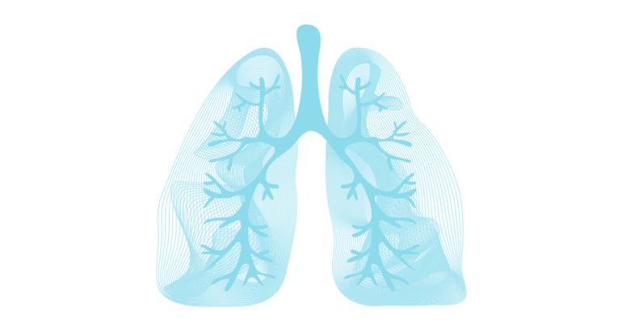
COPD (Chronic Obstructive Pulmonary Disease)
Aamirah Walljee
Claudia Summers
Waseem Talia

Slide 2
Definition
Chronic Obstructive Pulmonary Disease is a disease characterized by chronic respiratory symptoms and airway obstruction that is due to small airway and parenchymal abnormalities usually caused by significant exposure to noxious particles.
Two subtypes:
Chronic bronchitis
Emphysema

Slide 3
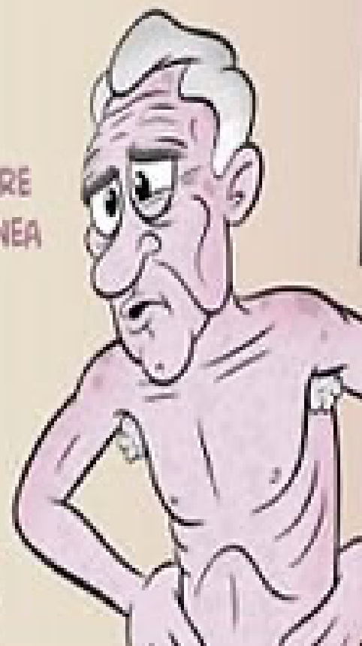

Pathogenesis
Chronic Bronchitis
Emphysema
Increased no. of goblet cells
Mucus hypersecretion
Enlarged submucosal glands
Impaired mucociliary clearance
↓
Excessive mucus production
↓
V/Q mismatch:
Poorly ventilation
Good circulation
↓
Blue Bloaters
Increased no. of goblet cells
Mucus gland hyperplasia
Increased no. of neutrophils
↓
Loss of elastic alveolar recoil
Destruction of alveolar walls/capillary beds
↓
V/Q mismatch:
Poor ventilation
Poor circulation
↓
Pink Puffers

Slide 4
Clinical Features: History
Symptoms
Dyspnoea
Cough with/without sputum
Tight chest
Wheeze
Inhalation exposure history
SMOKING
Exposure to occupational fumes
Air pollution

Slide 5
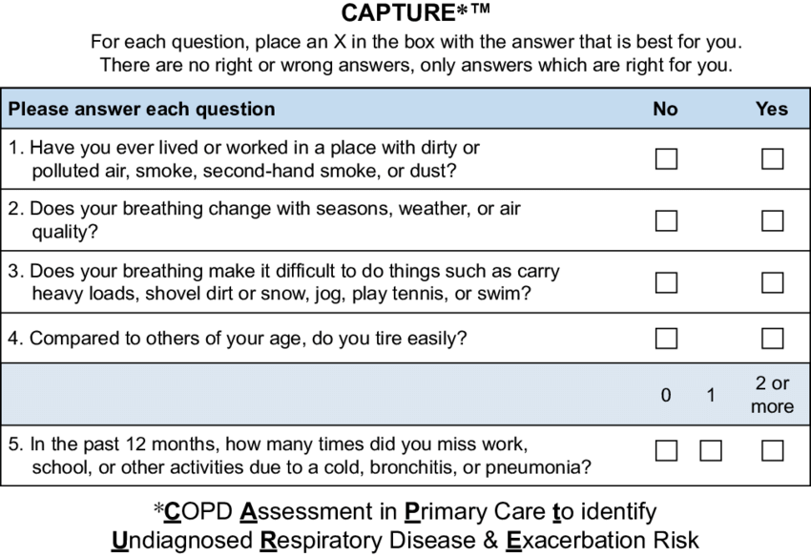

Slide 6
Clinical Features: Examination
Low saturation
Cyanosis (chronic bronchitis)
Pursed-lip breathing (emphysema)
Nicotine staining of fingers
Signs of respiratory distress
Signs of hyperinflation
Low-pitched wheezes
Early- inspiratory crackles
Signs of right heart failure

Slide 7
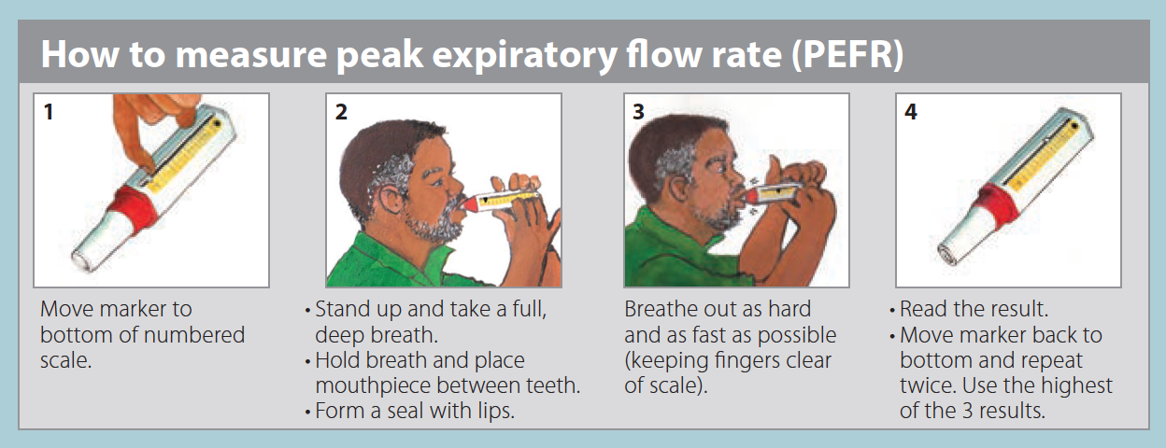
Investigations
Chest X-ray
Peak expiratory flow rate
Spirometry

Slide 8
Diagnosis
Diagnosis is usually made in light of the symptoms and a history of exposure to triggers of COPD (e.g. smoking and occupational dust or biomass exposure)
It is also important to consider the cause, and review whether underlying asthma, workplace exposures, indoor use of biomass fuel, a prior history of tuberculosis, or familial predisposition is contributory,
It is appropriate to screen all patients with COPD for alpha-1 antitrypsin (AAT)
It can also be confirmed by the following:
Spirometry: airflow limitation [FEV1/FVC] ratio less than 0.7 that is incompletely reversible after the administration of an inhaled bronchodilator

Slide 9
Differential
Chronic obstructive asthma (important to note that asthma and COPD can co-exist)
Chronic bronchitis (smokers can present with a chronic productive cough, however with normal spirometry)
Central airflow obstruction
Bronchiectasis (cough and sputum production and the presence of bronchial wall thickening and luminal dilatation CT scans)
Heart failure (differentiated by basal crackles, radiographic changes, and increased pro-BNP)
Tuberculosis
Constrictive bronchiolitis
Diffuse panbronchiolitis

Slide 10
Staging
The Global Initiative for Chronic Obstructive Lung Disease (GOLD) guidelines uses FEV1; expressed as a percentage to stage disease severity. Symptoms can be assessed by the Modified Medical Research Council (mMRC) breathlessness scale and the COPD Assessment Test (CAT), and the history of exacerbations should also be noted.
The above mentioned factors, combine to form the modified GOLD “ABCD” evaluation, and assists in the management of COPD.

Slide 11

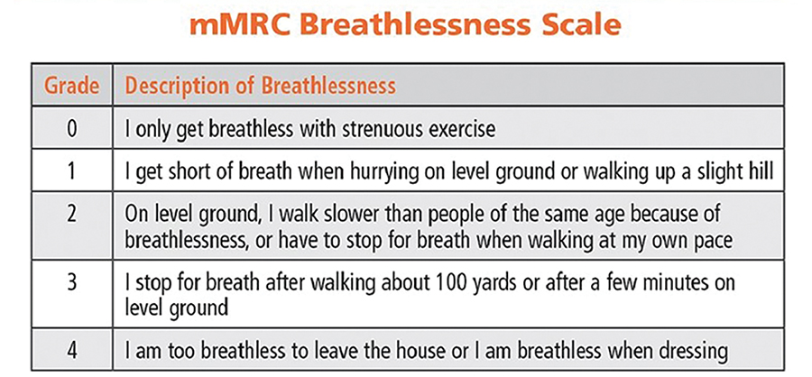
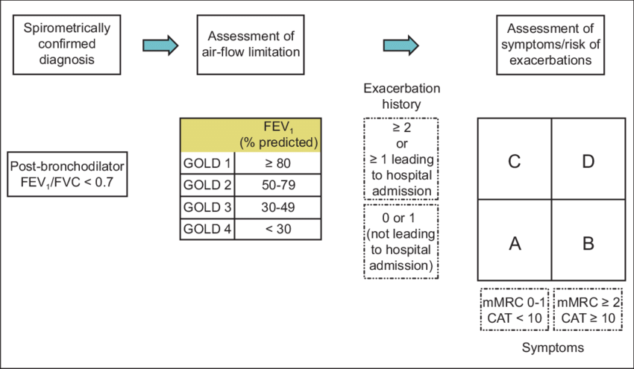

Slide 12
Disease Pattern and Severity
Individuals are then classified into one of the four groups (A, B, C, or D) based on their symptoms, risk of exacerbations and hospitalization for exacerbations.
Group | Features
A | Minimally symptomatic low risk of future exacerbations: mMRC grade 0 to 1 or CAT score <10 0 to 1 exacerbation per year and no prior hospitalization for exacerbation
B | More symptomatic low risk of future exacerbations: mMRC grade ≥2 or CAT score ≥10 0 to 1 exacerbation per year and no prior hospitalization for exacerbation
C | Minimally symptomatic high risk of future exacerbations: mMRC grade 0 to 1 or CAT score <10 ≥2 exacerbations per year or ≥1 hospitalization for exacerbation
D | More symptomatic high risk of future exacerbations: mMRC grade ≥2 or CAT score ≥10; ≥2 exacerbations per year or ≥1 hospitalization for exacerbation

Slide 13
Management
Stable
Exacerbation

Slide 14
Side Note
Co-morbidities are likely
Obesity
OSA
Heart Failure
Opioid use

Slide 15
All patients
Risk factor modification - smoking cessation (cigarettes and other)
Pneumococcal and influenza vaccination
Physiotherapy
Exercise
Correct inhaler technique + review at each visit
COVID-19 - avoid exposure: associated with greater likelihood of ICU admission, invasive ventilation, and death

Slide 16
Stable COPD
Aim of therapy
Improve symptoms
Decrease exacerbations
Improve patient function and quality of life

Slide 17
GOLD A – Minimally Symptomatic, Low Risk of Exacerbation
Short Acting Bronchodilators
SABA – ipratropium bromide
SAMA - salbutamol
Rapid onset of action, short duration of action (4 – 6 hours)
Relief of intermittent increase in dyspnoea
Either alone or in combination

Slide 18
GOLD B - More Symptomatic, Low Risk of Exacerbation
Long Acting Bronchodilators
LAMA - triotopium, glycopyrrorium – non EML
LABA - salmetarol, indacaterol / Ombrez (prescribed with consultant permission)
Regimen: long acting bronchodilator + short acting bronchodilator for symptom relief
Recommended LAMA + SABA or LABA + SAMA/SABA
Choice based on preference and SE profile
LABA SE: Resting tachycardia or tremor
LAMA SE: urinary retention
LAMA reduces exacerbations > LABA
No difference between QOL or SOB between the two

Slide 19
GOLD C - Minimally Symptomatic, High Risk of Exacerbation
LAMA suggested

Slide 20
GOLD D - More Symptomatic, High Risk of Exacerbation
LABA/LAMA combination preferred over LABA/ICS
LABA/ICS combination associated with reduced mortality and exacerbations compared with single bronchodilator therapy

Slide 21
Non – pharmacological therapy
Supplemental oxygen - chronic hypoxaemia
Nocturnal hypoxaemia - various options based on co-morbidities and sleep studies; CPAP as an example
Surgical - lung volume reduction or transplant

Slide 22
Monitoring
Three-to-six monthly visits: assess symptoms (mMRC) and oximetry, smoking status, adherence to medication
Annual spirometry - assess degree of airflow limitation
Screening for lung cancer and co-morbidities like heart failure, ILD, cardiac arrhythmias and, bronchiectasis

Slide 23
COPD Exacerbation
The WHO defines an exacerbation of COPD as "an acute event characterized by a worsening of the patient's respiratory symptoms that is beyond normal day-to-day variations and leads to a change in medication.”
This includes an acute change in one or more of the following symptoms:
Cough increases in frequency and severity
Sputum production increases in volume and/or changes character
Dyspnoea increases

Slide 24
Symptoms
Wheeze
Chest tightness
Respiratory distress
SOB
Cough

Slide 25
Home vs Hospital
Clinical severity
Respiratory failure

Slide 26
Clinical Severity
Moderate vs Severe
Head to toe
 | Moderate | Severe
Alertness | Agitated | Drowsy or confused
Talks | Phrases | Words
PR | 100 – 120 | >120
RR | 20 – 30 | >30
Wheeze | Loud | Loud/Absent

Slide 27
Respiratory Status
Mental | No failure | Non life threatening failure | Life threatening failure
RR (breaths/min) | 20-30 | >30 | >30
Saturation (% O2) | 88-92 with 40%mask | 88-92 with 40% mask | 88-92 with >40% mask
Mental Status | Unchanged | Unchanged | Acute change
Hypercapnia | Normal | 50 - 60 or over baseline | >60 or acidosis

Slide 28
Home Management
Intensify bronchodilator therapy
Oral glucocorticoids
± Antibiotic
Decision for antibiotic – 2/3 of:
Increased SOB
Increased sputum volume
Increased sputum purulence

Slide 29
Acute Management
While in casualty
Salbutamol MDI 4-8 puffs with spacer allowing 4 breaths between
Repeated every 20-30 min for the first hour
Thereafter every 2-4 hours as needed
OR
Salbutamol 0,5% nebulised solution
Repeated as above if needed
Adequate response:
PEFR improved >20% from baseline
RR <20
Normal speech

Slide 30
Hospital Referral
According to the GOLD guideline:
Inadequate response to outpatient or emergency department management
Onset of new signs (cyanosis, altered mental status, peripheral oedema)
Marked increase in intensity of symptoms over baseline (new onset resting dyspnoea) accompanied by increased oxygen requirement or signs of respiratory distress
History of frequent exacerbations or prior hospitalisation for exacerbations
Serious comorbidities including pneumonia, cardiac arrhythmia, heart failure, diabetes mellitus, renal failure or liver failure
Frailty
Insufficient home support

Slide 31
Hospital Referral
According to national guideline:
All patients with a severe attack (according to clinical severity)
Poor response to casualty management
PEFR <75% predicted
Presented in the afternoon/late evening
Recent onset nocturnal symptoms
Previous severe attacks, especially if with rapid onset

Slide 32
While awaiting referral
Same as acute management in casualty (salbutamol etc.)
In addition:
Oxygen – enough to maintain O2 saturation of 88 – 92%
Prevents worsening hypercapnia – maintaining these saturations are associated with a lower mortality rate
Steroid therapy – oral or hydrocortisone 100mg IVI (slow infusion)
Ipratropium bromide nebulised if poor response to salbutamol

Slide 33
References
https://goldcopd.org/wp-content/uploads/2016/12/wms-GOLD-2017-Pocket-Guide-1.pdf
https://www.researchgate.net/publication/325345675_An_Update_on_the_Global_Initiative_for_Chronic_Obstructive_Lung_Disease_2017_Guidelines_With_a_Focus_on_Classification_and_Management_of_Stable_COPD

